Slide 1
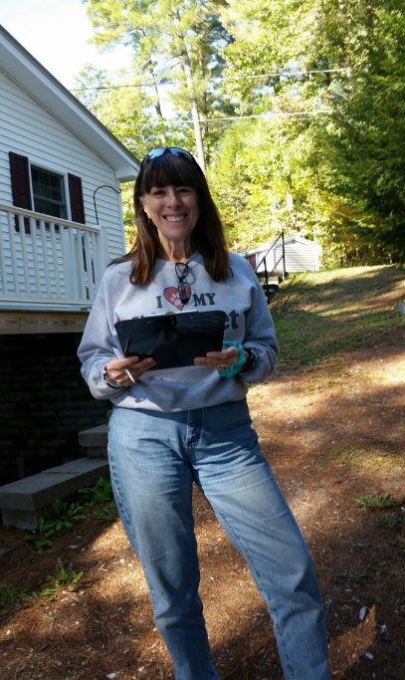

LakeSmart
Lake Stewardship in Action

Slide 2

Maine’s Lakes Are our Heritage

Slide 3

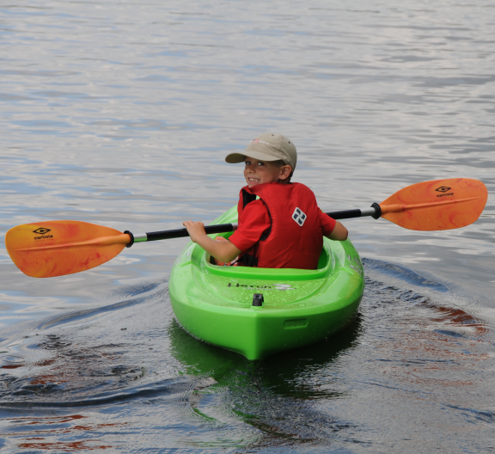
And the Legacy We Leave Behind

Slide 4
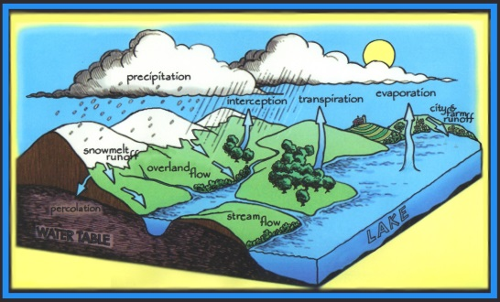
Lakes are Dynamic Systems that Respond to their Environment
Water always runs downhill
Lakes fill the low places
Lakes are still waters, not constantly renewed like rivers, streams
Lakes keep 90% of what’s washed into them

Slide 5
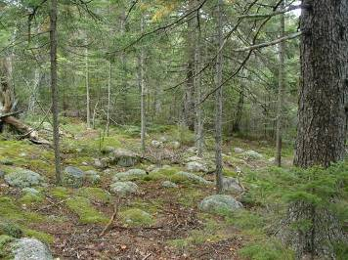
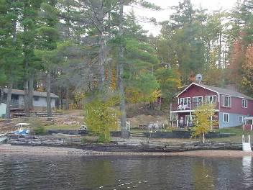
Forested Watershed
Developed Watershed
5 to 10 times the amount of phosphorus
in the runoff from developed land

Slide 6
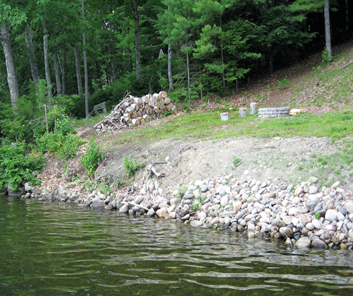

Slide 7
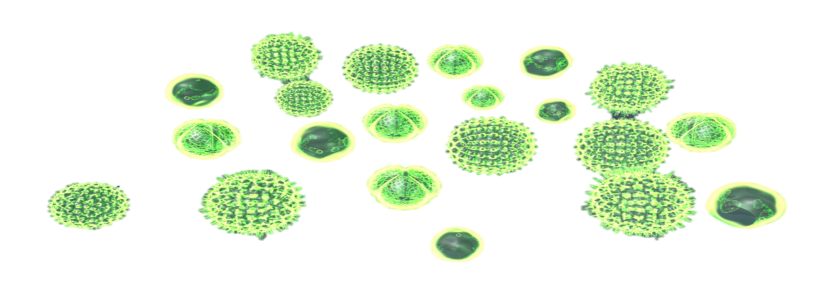
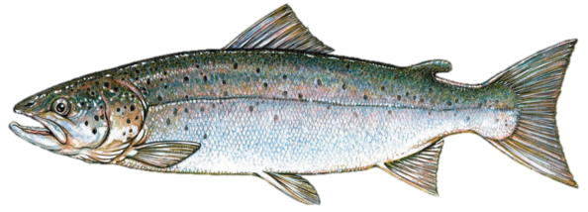
High Nutrient Lake 100 Years or Less
EPILIMNION
oxygen
Outflow
Inflow
Warm, Increasing Nutrients, High Algae Growth
HYPOLIMNION
Cold, High Nutrients, No Oxygen at Depth
Fish Die, Sediments Release Nutrients
D. Whitney King, Colby College

Slide 8
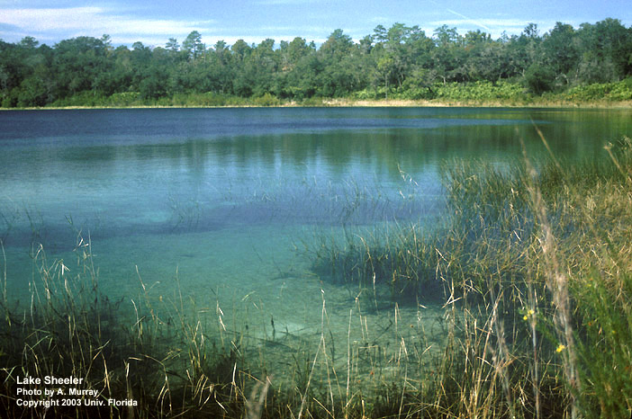
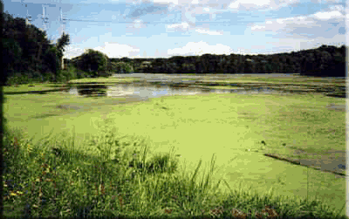
Death by a Thousand Cuts
Unintended consequence of uninformed practice

Slide 9
How We Counter the Threat
Capture and manage stormwater on land
Keep all stormwater from flowing into the lake
Stabilize the land
Cover bare soil
Infiltrate stormwater runoff
Divert flows to natural or manmade “sinks”
Shoreline buffers are necessary
The Shoreland Zone has a disproportionately large effect on lake water quality in comparison to its size.

Slide 10

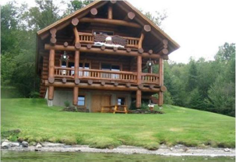
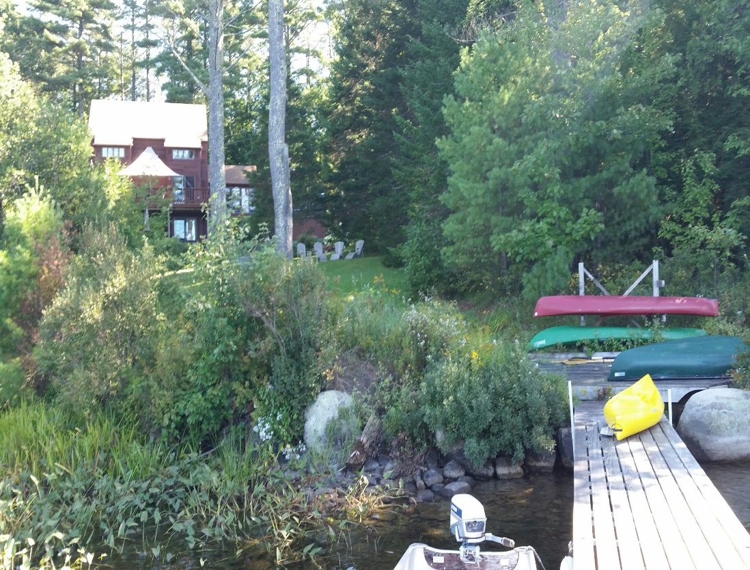
LakeSmart Is an Incentivized Education Program for Homeowners
GOAL: Establish a Community-wide Norm

Slide 11
LakeSmart is a Carrot, not a Stick
Learning and Reward Program
Illustrates Lake-friendly Landscaping
Protects Home Value
Preserves Habitat
LakeSmart Is Positive
It Tells You What You CAN Do

Slide 12
The LakeSmart Brand
Award Signs identify homes of good lake stewards
Award properties demonstrate lake-friendly behavior
Award signs arouse curiosity. People ask, “What is that? How can I get one of those?”

Slide 13
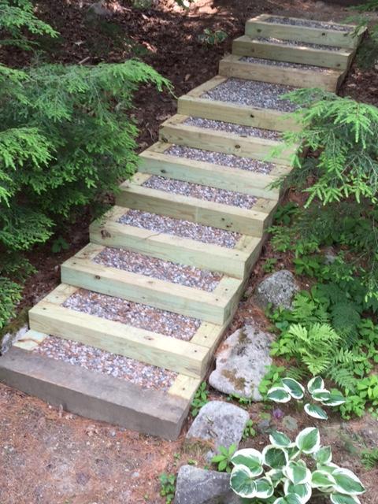
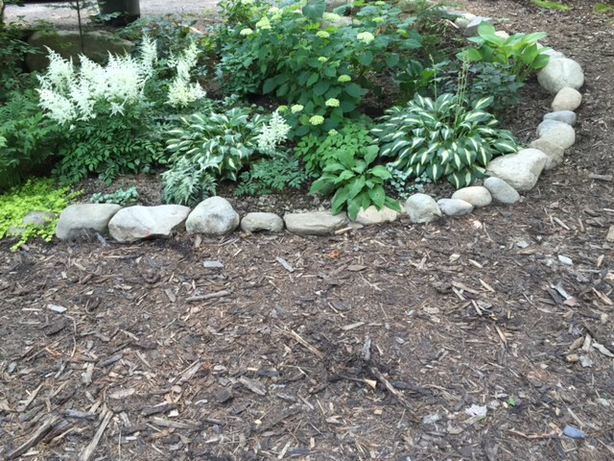
LakeSmart Recommends Practices
That Capture Stormwater on Site

Slide 14
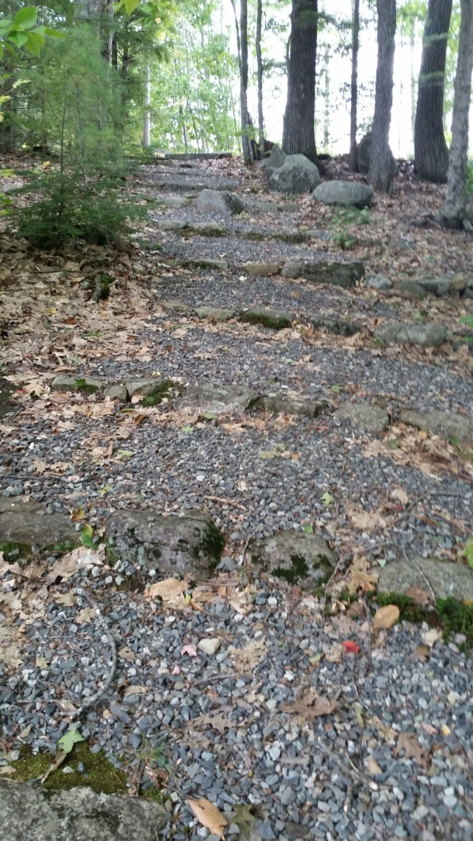
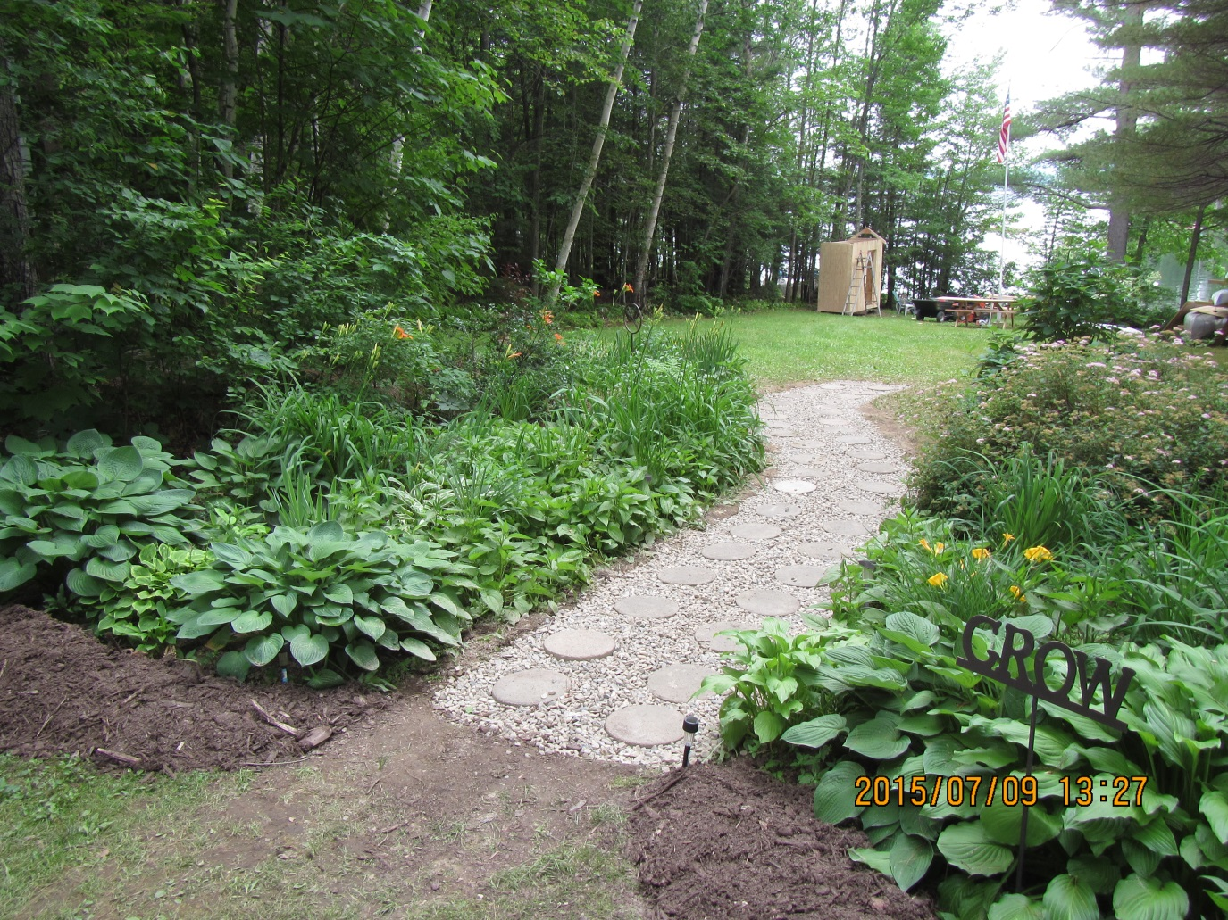
DIY or Contracted Out

Slide 15
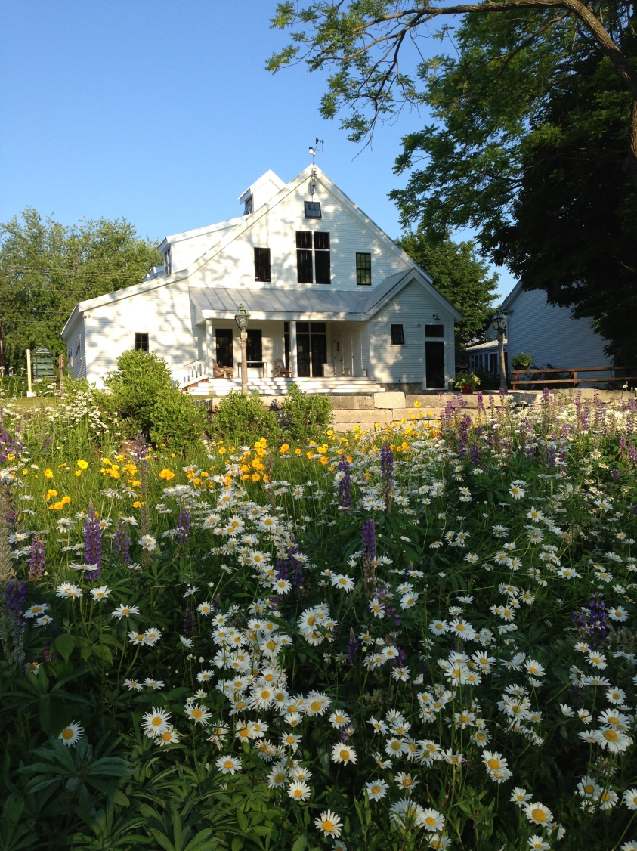
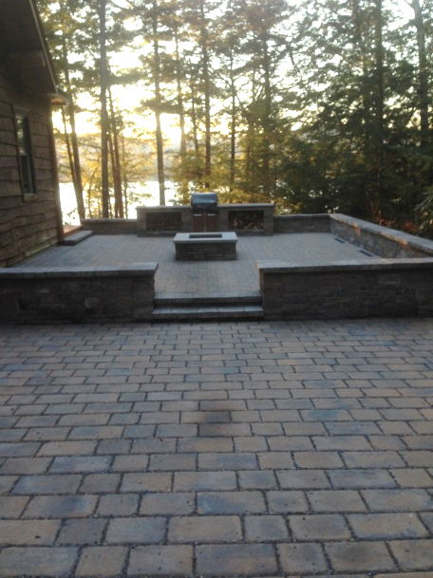
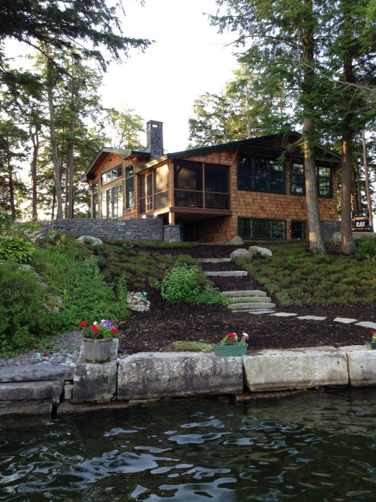
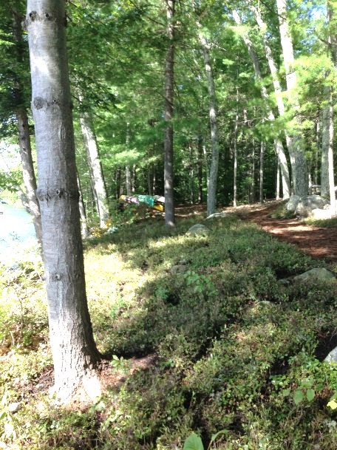
There is a Portfolio of “Fixes”

Slide 16
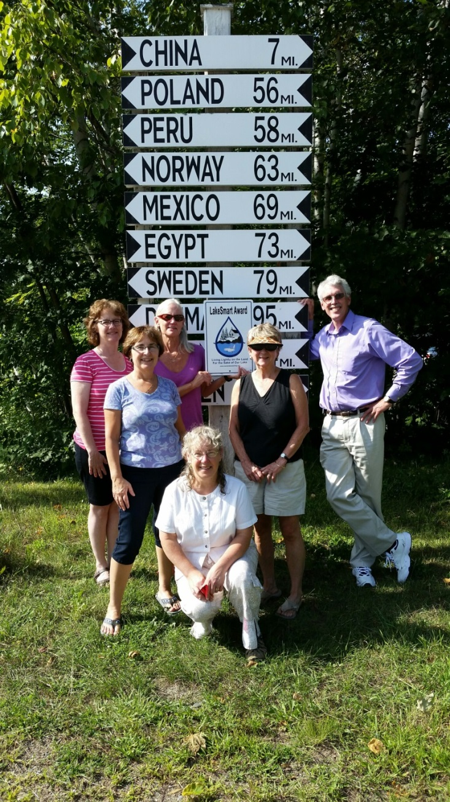
LakeSmart is a Local Team Effort
Lake Associations handle local outreach/publicity
Conduct evaluations, make recommendations
Keep records and report
They fuel action

Slide 17
Lake Associations Make
LakeSmart Possible
Maine Lakes provides the program
  Training, all materials
  On-site coaching
  Support for implementation
Local Partners Provide
  Outreach to neighbors
  Perform property screenings
  Keep records
  Make the Awards

