Slide 1
Bolton Heritage Farm – Master Planning for Site Development Presentation to Board of Selectmen June 7, 2022
Nelson Edwards Company Architects, LLC □ Elmore Design Collaborative LLC □ Public Archaeology Survey Team (PAST)

Slide 2
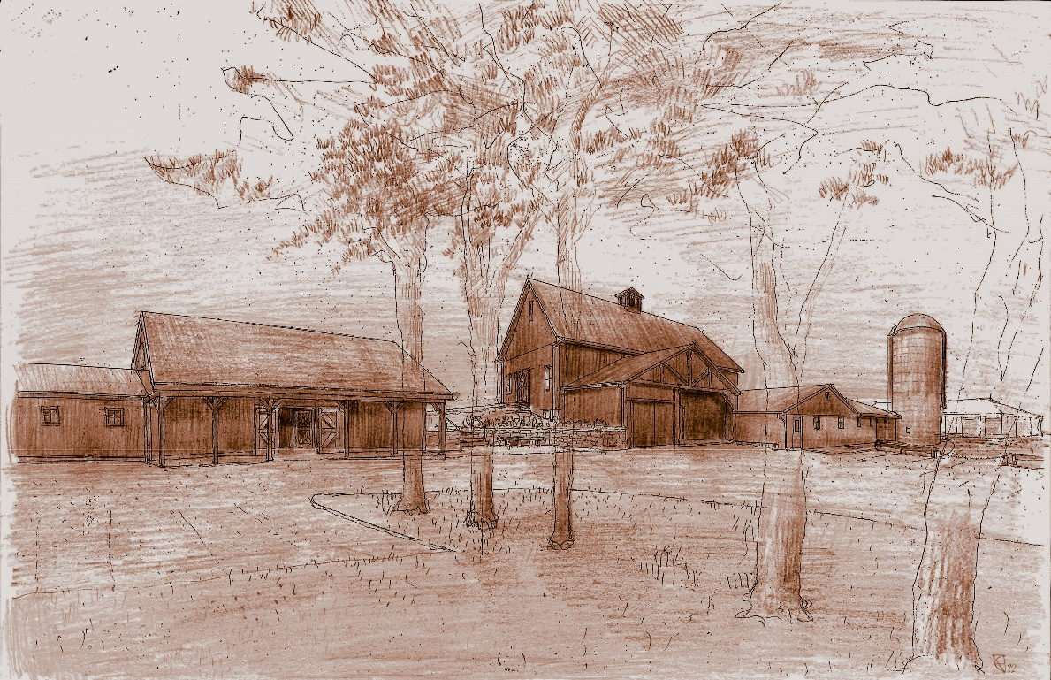
Presentation Overview
Goals & Background
Team Members
Process
Program Identification
Revenue Generation
Master Plan Components
Phasing and Costs
Funding
Discussion
Bolton Heritage Farm – Master Planning for Site Development Presentation to Board of Selectmen June 7, 2022
Nelson Edwards Company Architects, LLC □ Elmore Design Collaborative LLC □ Public Archaeology Survey Team (PAST)

Slide 3
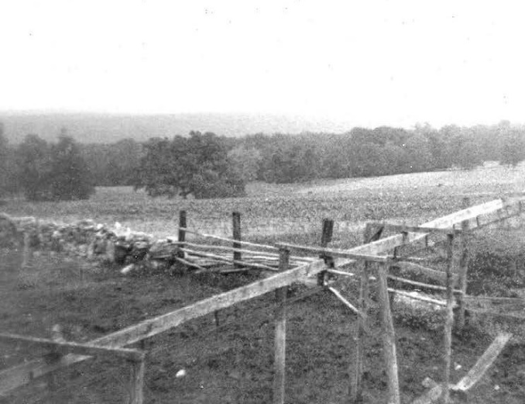
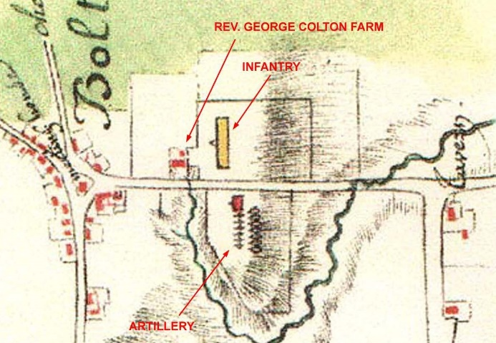
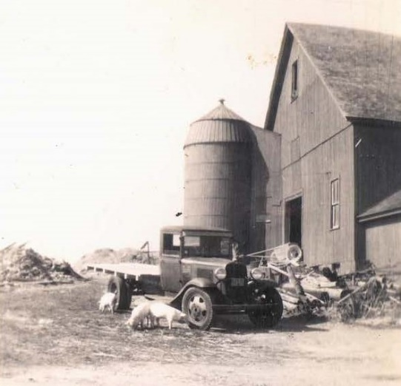
In the context of a historically and municipally important site,
to develop a master plan that synthesizes prior work and with the desire for more intensive public use of the barn and house for the benefit of the Town,
&
In keeping with the unique historic, visual and ecological characteristics of the site.
Culmination of this study
is a ‘roadmap’ for phased implementation of site / building improvement
Related to expanded public use and development of areas for revenue generation
Bolton Heritage Farm – Master Planning for Site Development Presentation to Board of Selectmen June 7, 2022
Nelson Edwards Company Architects, LLC □ Elmore Design Collaborative LLC □ Public Archaeology Survey Team (PAST)

Slide 4
Background Studies
The Rochambeau Project, Historical and Archaeological Documentation of the French Army’s Marches Through Connecticut, 1781 and 1782 (1999)
Condition Assessment Study (2008)
Vibrant Communities Initiative Study
(Land Use Study for Bolton Center) (2014)
BHFC Business Plan (2021)
Various repairs (2009 – present)
Bolton Heritage Farm – Master Planning for Site Development Presentation to Board of Selectmen June 7, 2022
Nelson Edwards Company Architects, LLC □ Elmore Design Collaborative LLC □ Public Archaeology Survey Team (PAST)

Slide 5
Town of Bolton,
Connecticut
Heritage Farm
Commission
Town of Bolton Consulting Staff
(Nathan Jacobson)
Town of Bolton Staff
Historic Architect
Nelson Edwards Company Architects, LLC
Sara O. Nelson, AIA
Archaeology
P.A.S.T
Mary G. Harper
Ross Harper, Ph.D.
Historic Engineer
GNCB Consulting Engineers, PC
Historic Landscape Architect
Elmore Design Collaborative, LLC
Thomas Elmore, ASLA
Bolton Heritage Farm – Master Planning for Site Development Presentation to Board of Selectmen June 7, 2022
Nelson Edwards Company Architects, LLC □ Elmore Design Collaborative LLC □ Public Archaeology Survey Team (PAST)

Slide 6
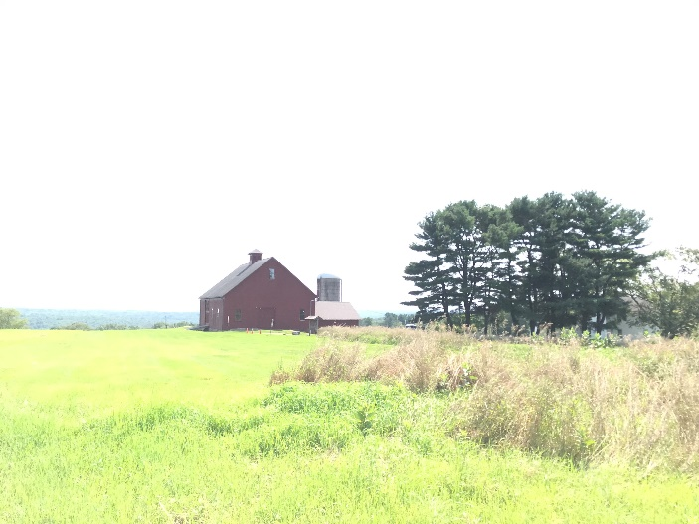
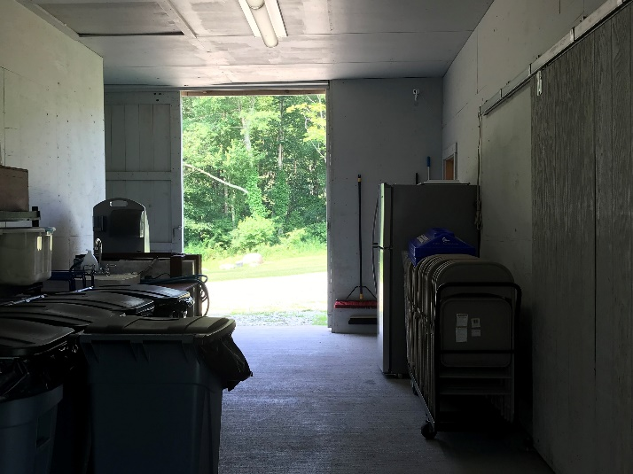
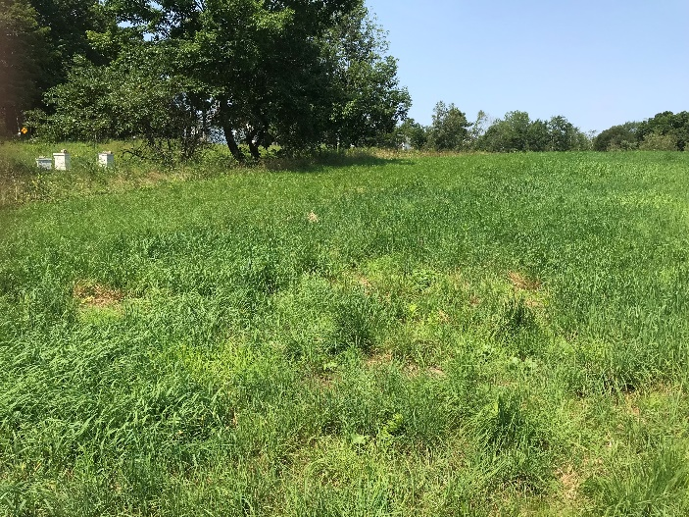
Process - Phase 1
Review of prior studies and site history
Committee Discussions
Site Walks
Research into similar operations (phone, web and in-person visits)
Program Workshop
Archaeological Review of area of question
Bolton Heritage Farm – Master Planning for Site Development Presentation to Board of Selectmen June 7, 2022
Nelson Edwards Company Architects, LLC □ Elmore Design Collaborative LLC □ Public Archaeology Survey Team (PAST)

Slide 7
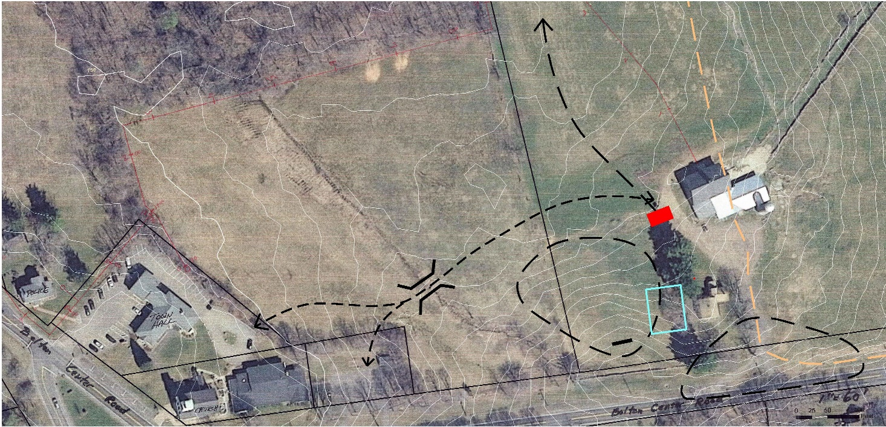
Process - Phase 2
Identification of Issues and Opportunities
Integration of learned experiences by others
Site Walks
Preliminary Design
Commission, Town Staff & Archaeological review of evolving plans
Final Schematic Design
Bolton Heritage Farm – Master Planning for Site Development Presentation to Board of Selectmen June 7, 2022
Nelson Edwards Company Architects, LLC □ Elmore Design Collaborative LLC □ Public Archaeology Survey Team (PAST)

Slide 8
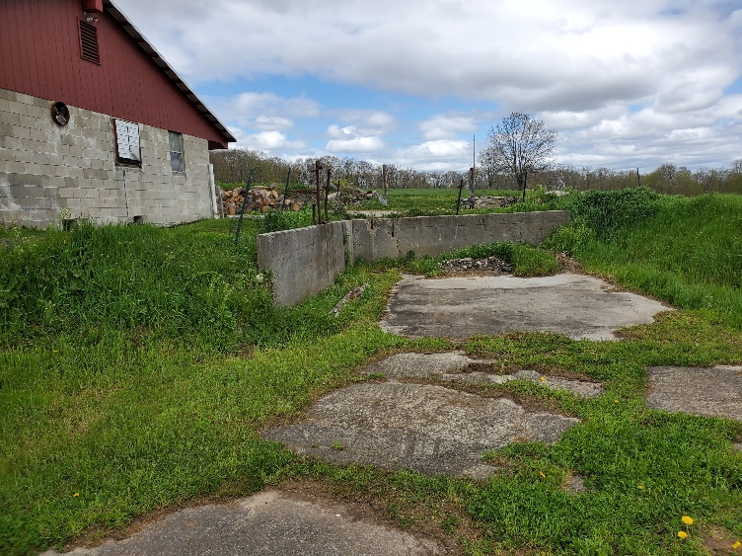
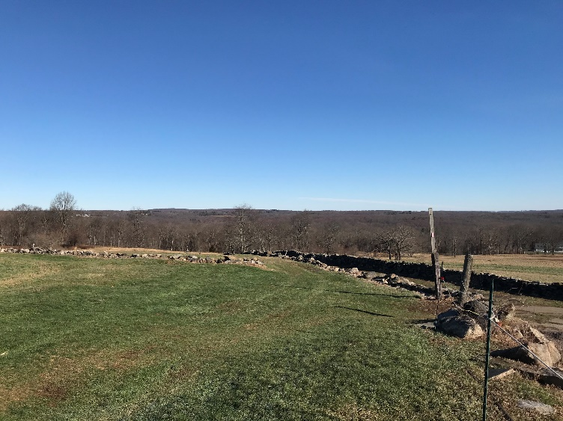
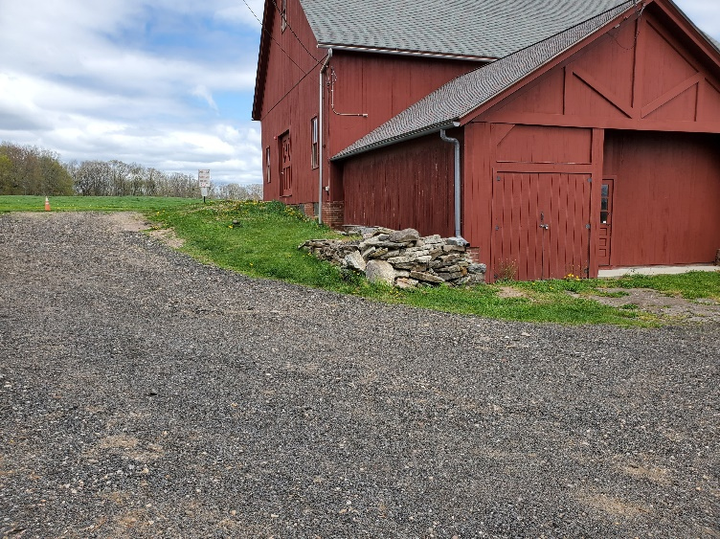
Program Identification
Site
Defining characteristics: Historic, New England Farm; natural beauty intact stone walls, sun and moon rise, dark sky
Existing: Trail walks, Town events, bee keeping, on-site classrooms & educational curriculum, photography, wedding (ceremony only)
Expanded: All of the above, overlooks, outdoor concerts & theater
Needs: Water, power wi-fi; regularized & shared parking, potable water, sanitation
See Topical Work Product – Program Summary
Bolton Heritage Farm – Master Planning for Site Development Presentation to Board of Selectmen June 7, 2022
Nelson Edwards Company Architects, LLC □ Elmore Design Collaborative LLC □ Public Archaeology Survey Team (PAST)

Slide 9
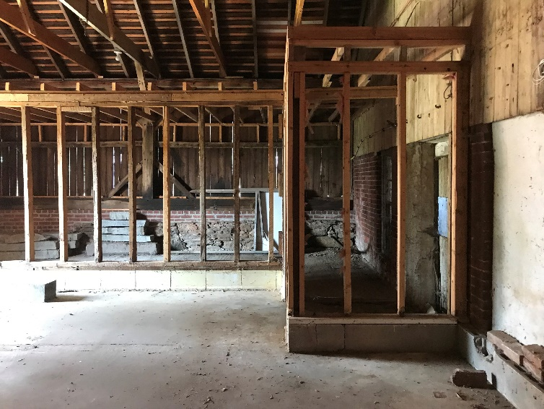
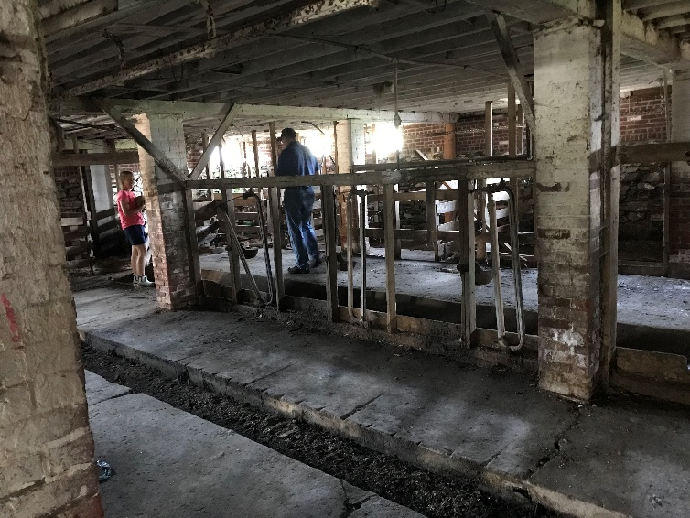
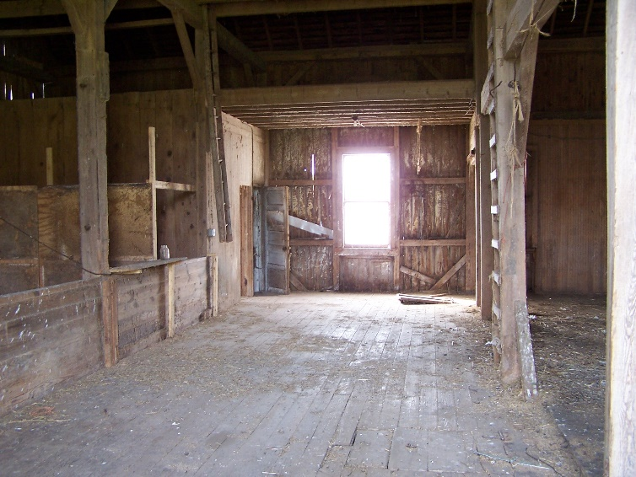
Program Identification
Barn
Defining characteristics: Massing, siting, authentic working barn feel, simplicity
Existing: Utility building under CT State Building Code
Expanded: Formal Change of Use for Assembly occupancy to allow for use as 3-season venue, display in lower area, separated uses of individual areas
Needs: Meet Life Safety code requirements for new use (structural, egress, power, lighting, fire detection); ADA access; separate public restroom facilities
Bolton Heritage Farm – Master Planning for Site Development Presentation to Board of Selectmen June 7, 2022
Nelson Edwards Company Architects, LLC □ Elmore Design Collaborative LLC □ Public Archaeology Survey Team (PAST)

Slide 10
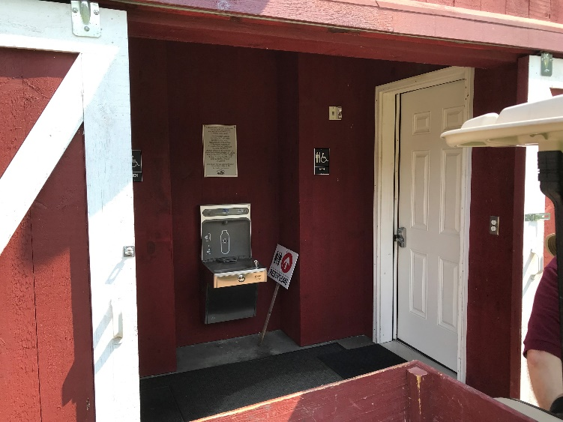
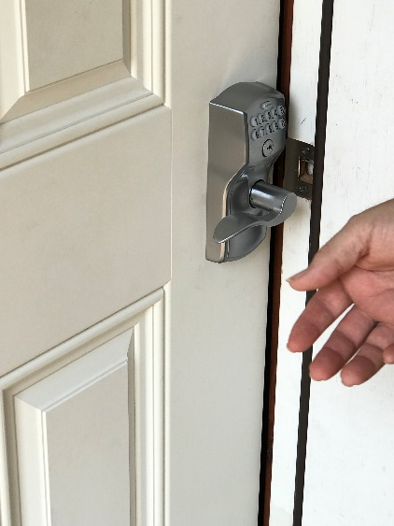
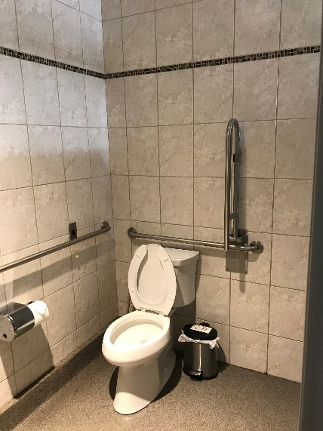
Program Identification
Toilet Facility
Defining characteristics: Does not exist. Any new structure to be compatible with historic site development
Existing: N/A
Expanded: Secure building open for site events and locked at other times; durable
Needs: On site water, power, sewerage (on site or connected to Town Center), durable, able to be easily secured
See Topical Work Product – Program Summary
Bolton Heritage Farm – Master Planning for Site Development Presentation to Board of Selectmen June 7, 2022
Nelson Edwards Company Architects, LLC □ Elmore Design Collaborative LLC □ Public Archaeology Survey Team (PAST)

Slide 11
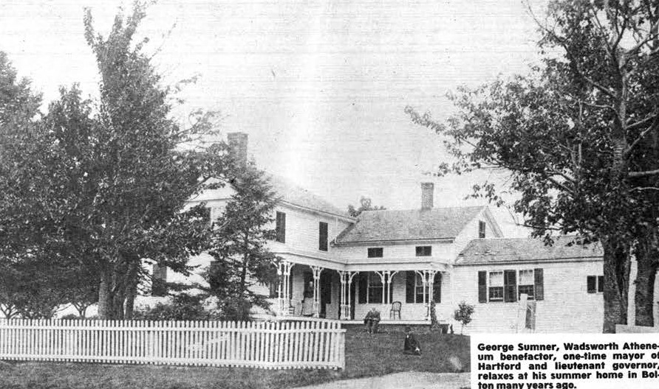
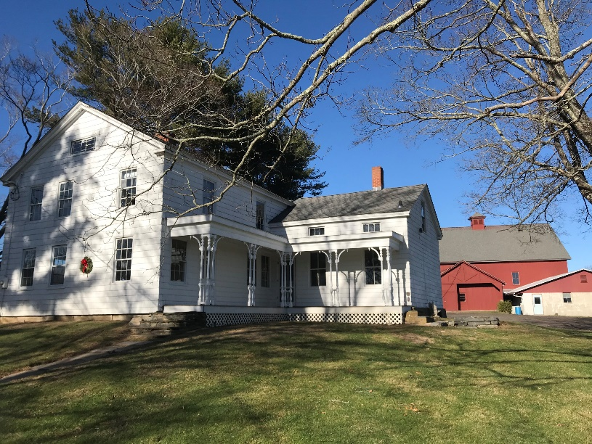
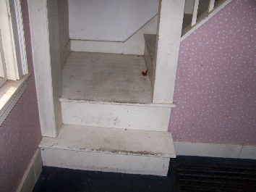
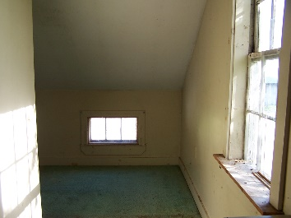
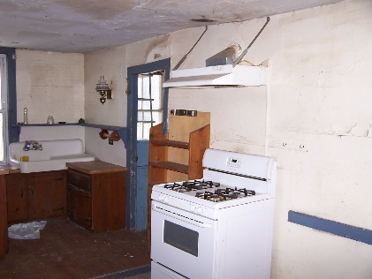
Program Identification
Farmhouse
Defining characteristics: Visible from road, New England Farmhouse, maintains farm/residential character at street, green scape around house, visual buffer, residential sized site characteristics such as stone steps
Existing: 2-story home, small rooms, residential layout
Expanded: Best for use as on-site farm office or care taker house
Needs: Complete overhaul (all systems and finishes.) If converted to office will require formal change of use under the Building Codes and meeting all current code requirements.
See Topical Work Product – Program Summary
Bolton Heritage Farm – Master Planning for Site Development Presentation to Board of Selectmen June 7, 2022
Nelson Edwards Company Architects, LLC □ Elmore Design Collaborative LLC □ Public Archaeology Survey Team (PAST)

Slide 12
Revenue Considerations
Identification of Opportunities
From relevant and similar operations
Bolton Heritage Farm – Master Planning for Site Development Presentation to Board of Selectmen June 7, 2022
Nelson Edwards Company Architects, LLC □ Elmore Design Collaborative LLC □ Public Archaeology Survey Team (PAST)

Slide 13
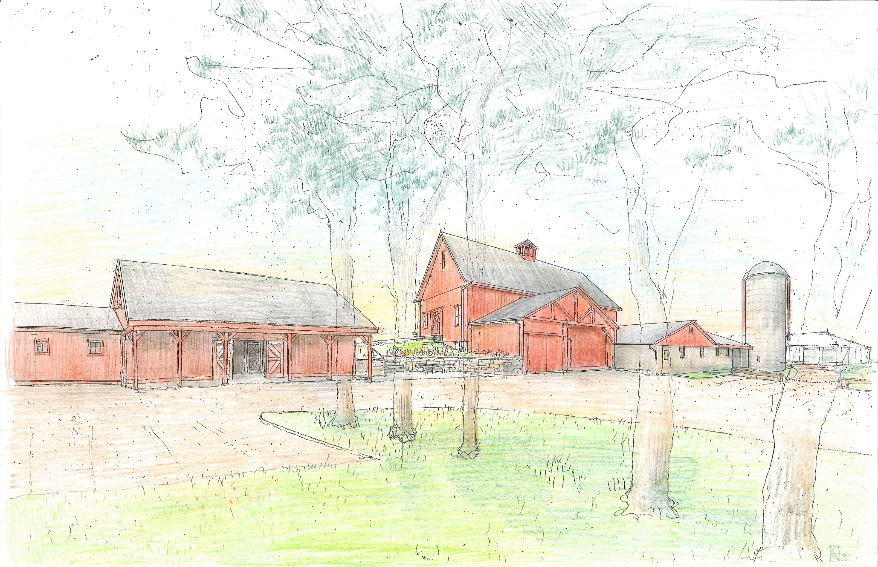
Master Plan
Proposed view
looking North
Bolton Heritage Farm – Master Planning for Site Development Presentation to Board of Selectmen June 7, 2022
Nelson Edwards Company Architects, LLC □ Elmore Design Collaborative LLC □ Public Archaeology Survey Team (PAST)

Slide 14
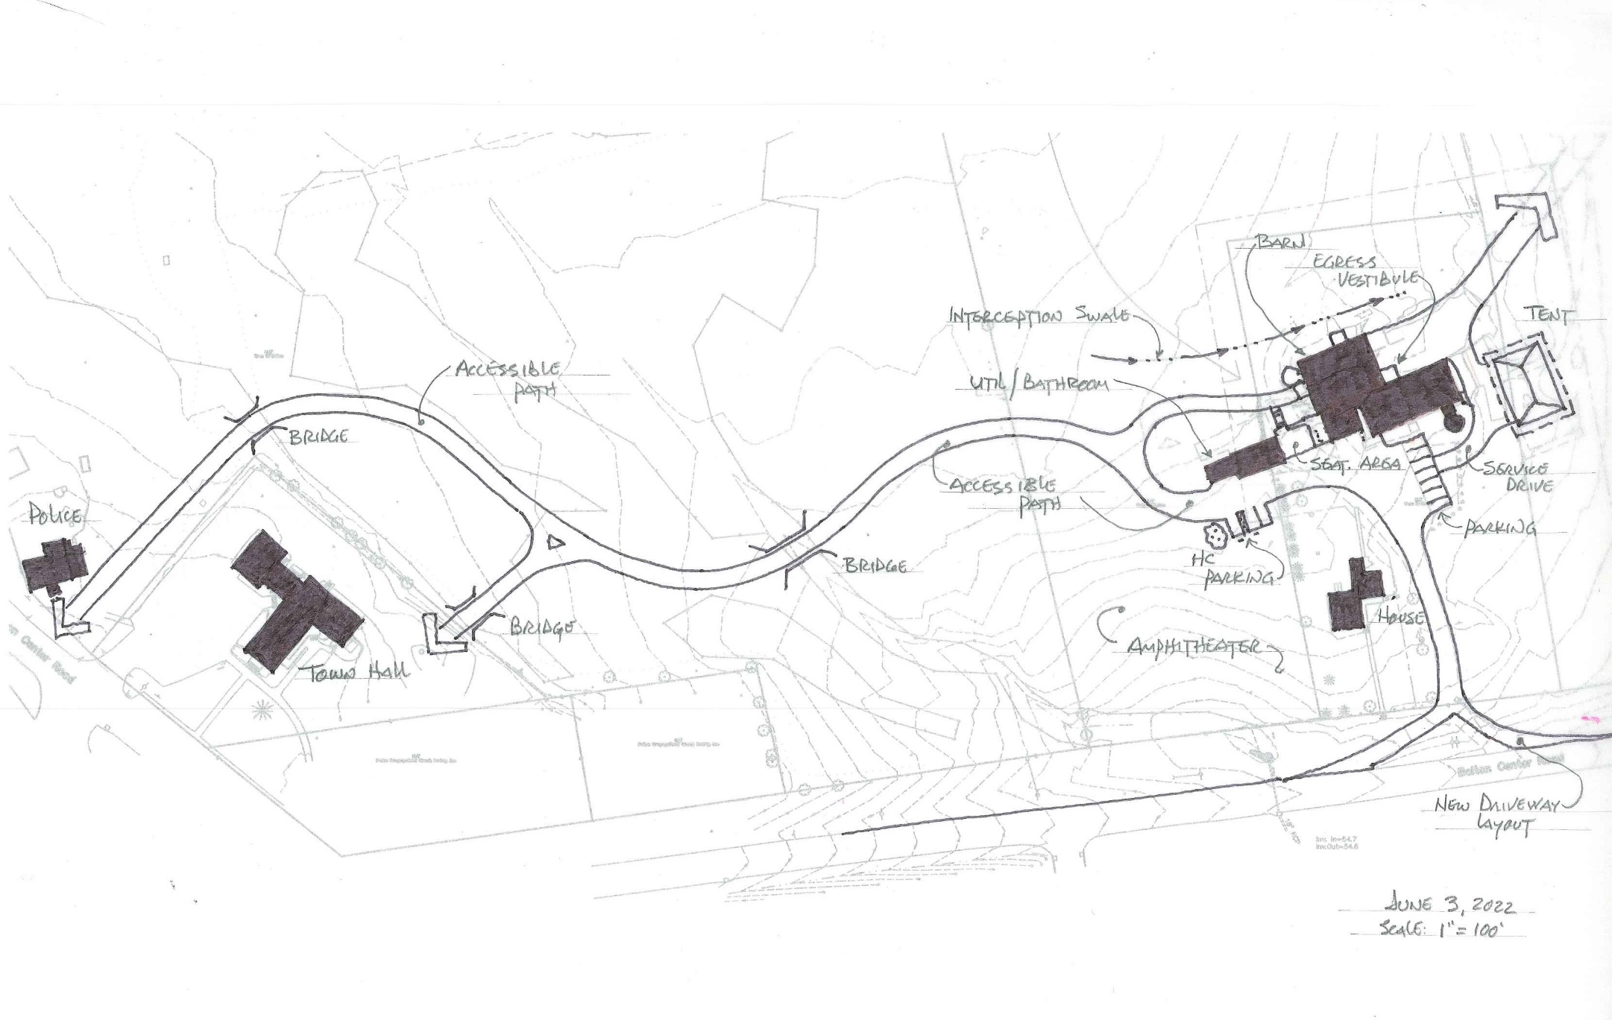
Master Plan
Town Center to
Bolton Heritage Farm
Bolton Heritage Farm – Master Planning for Site Development Presentation to Board of Selectmen June 7, 2022
Nelson Edwards Company Architects, LLC □ Elmore Design Collaborative LLC □ Public Archaeology Survey Team (PAST)

Slide 15
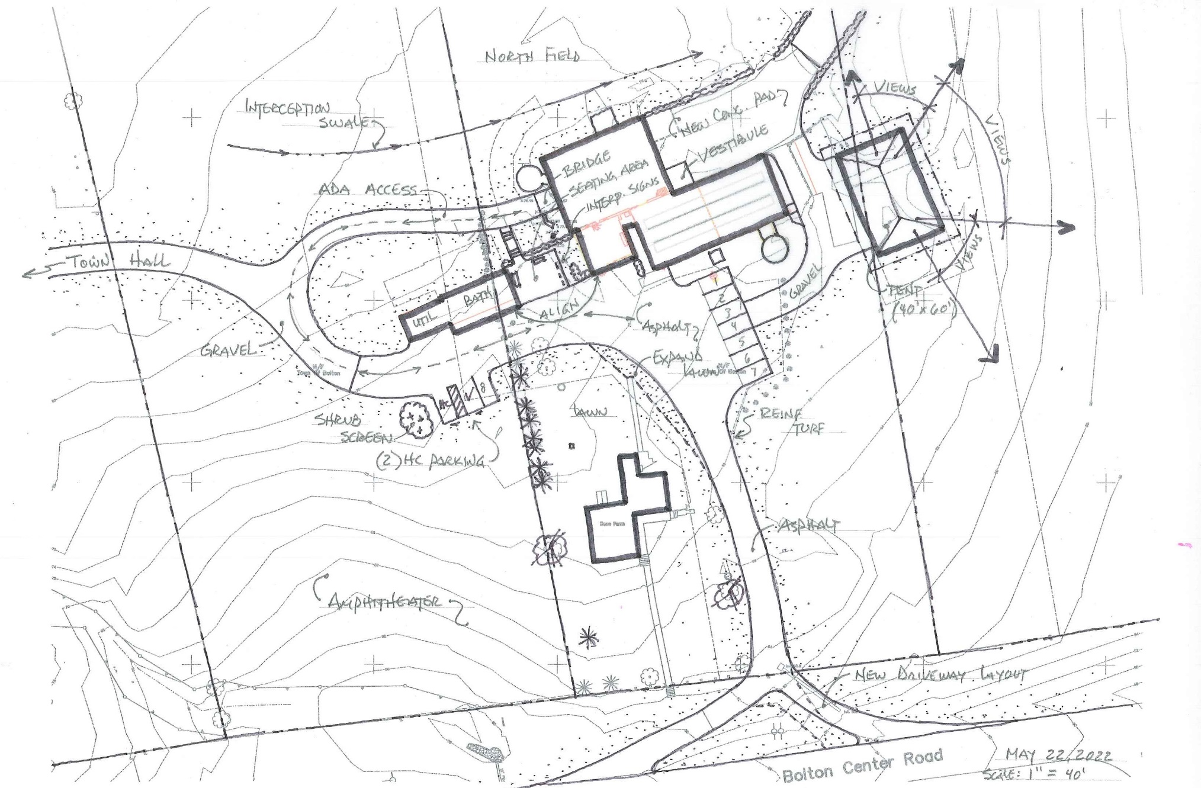
Master Plan
Heritage Farm Circulation and Parking
Bolton Heritage Farm – Master Planning for Site Development Presentation to Board of Selectmen June 7, 2022
Nelson Edwards Company Architects, LLC □ Elmore Design Collaborative LLC □ Public Archaeology Survey Team (PAST)

Slide 16
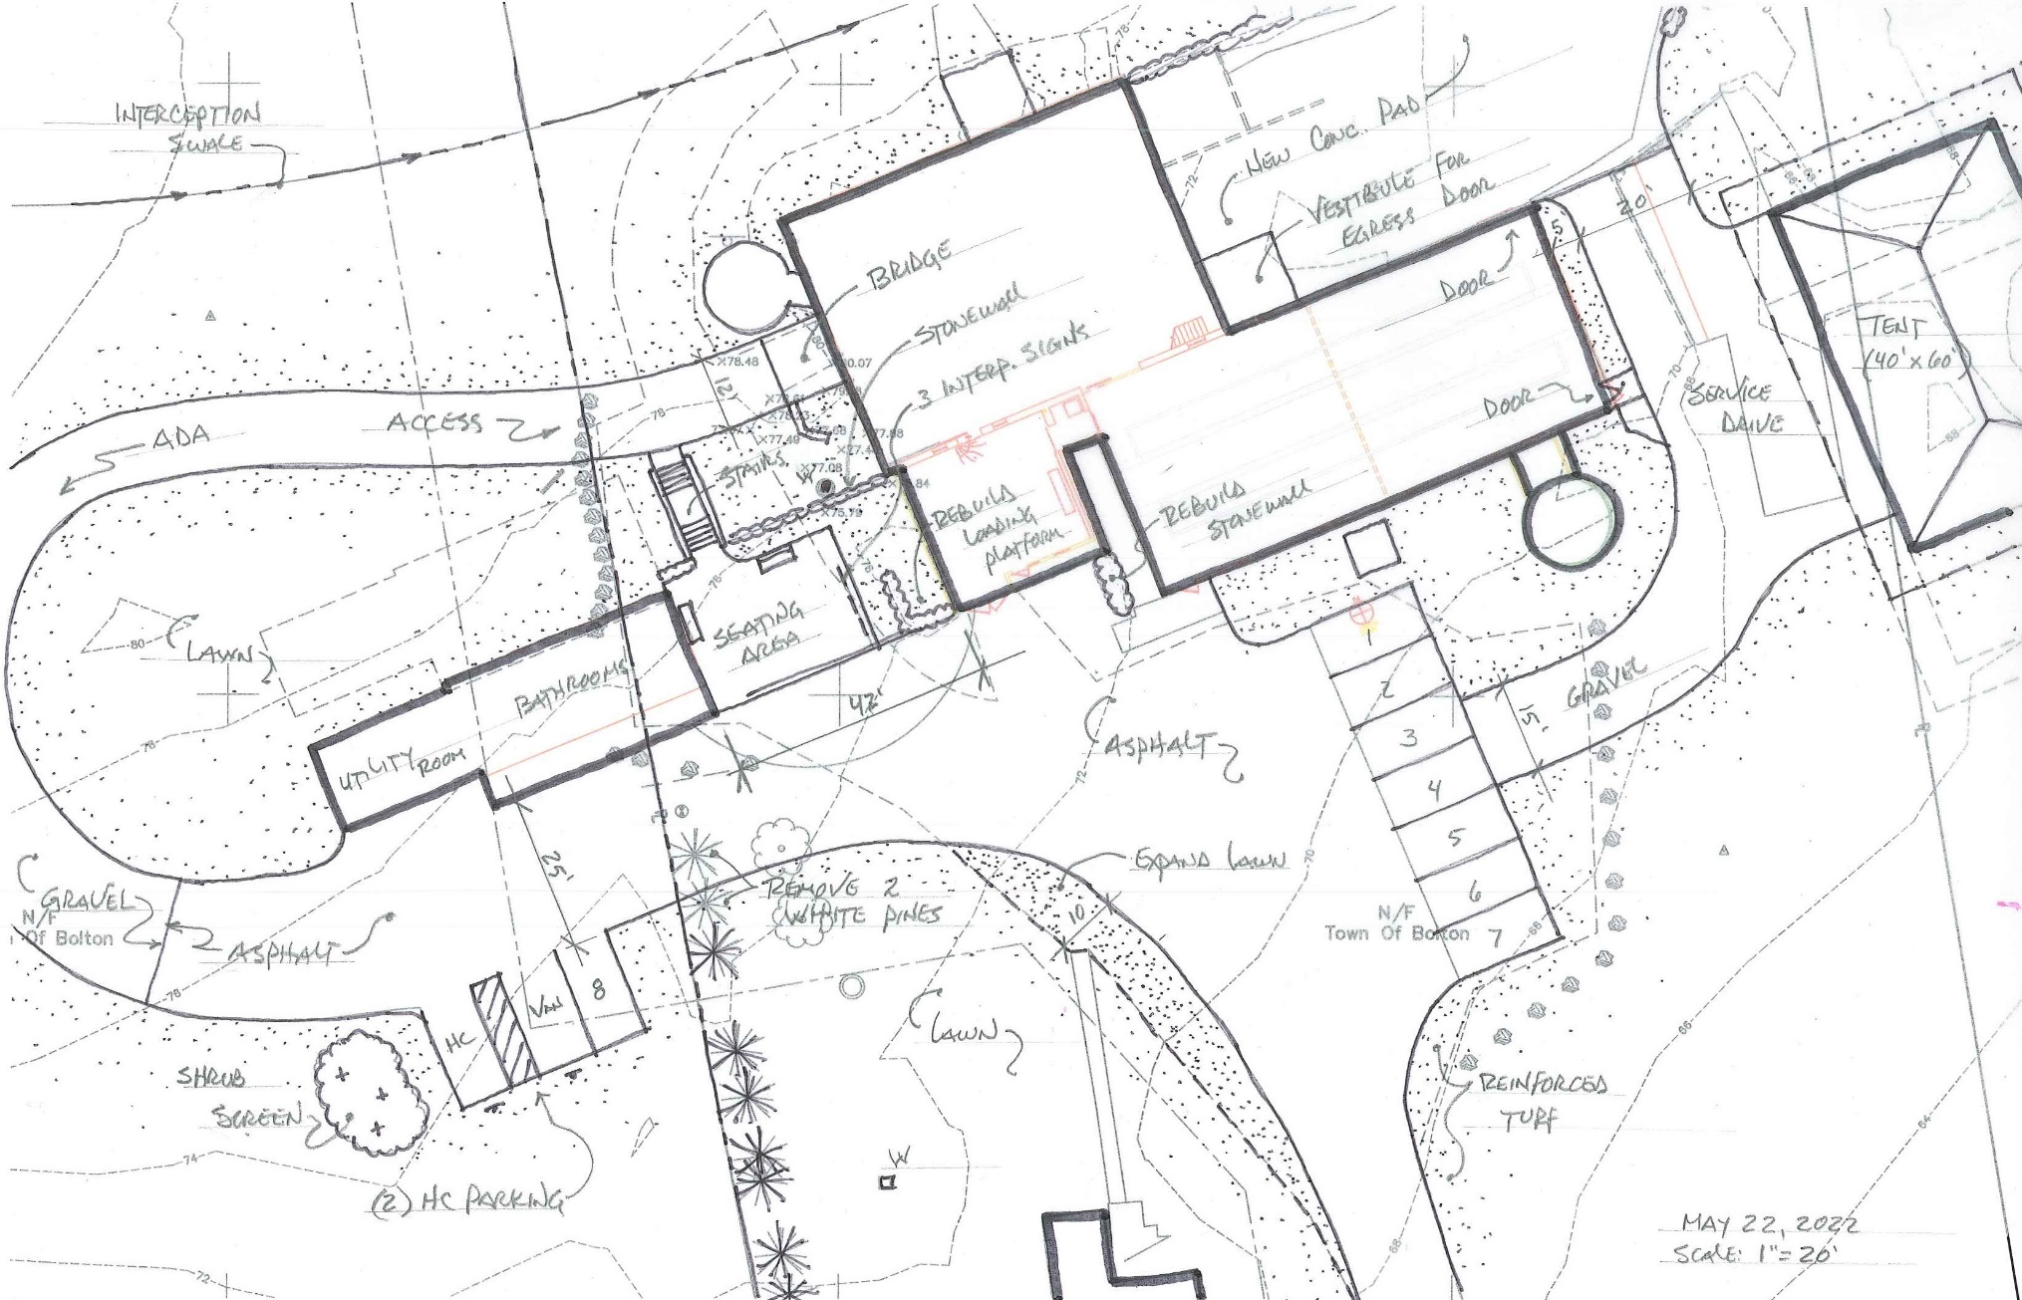
Master Plan
Heritage Farm
Detail Plan
Bolton Heritage Farm – Master Planning for Site Development Presentation to Board of Selectmen June 7, 2022
Nelson Edwards Company Architects, LLC □ Elmore Design Collaborative LLC □ Public Archaeology Survey Team (PAST)

Slide 17
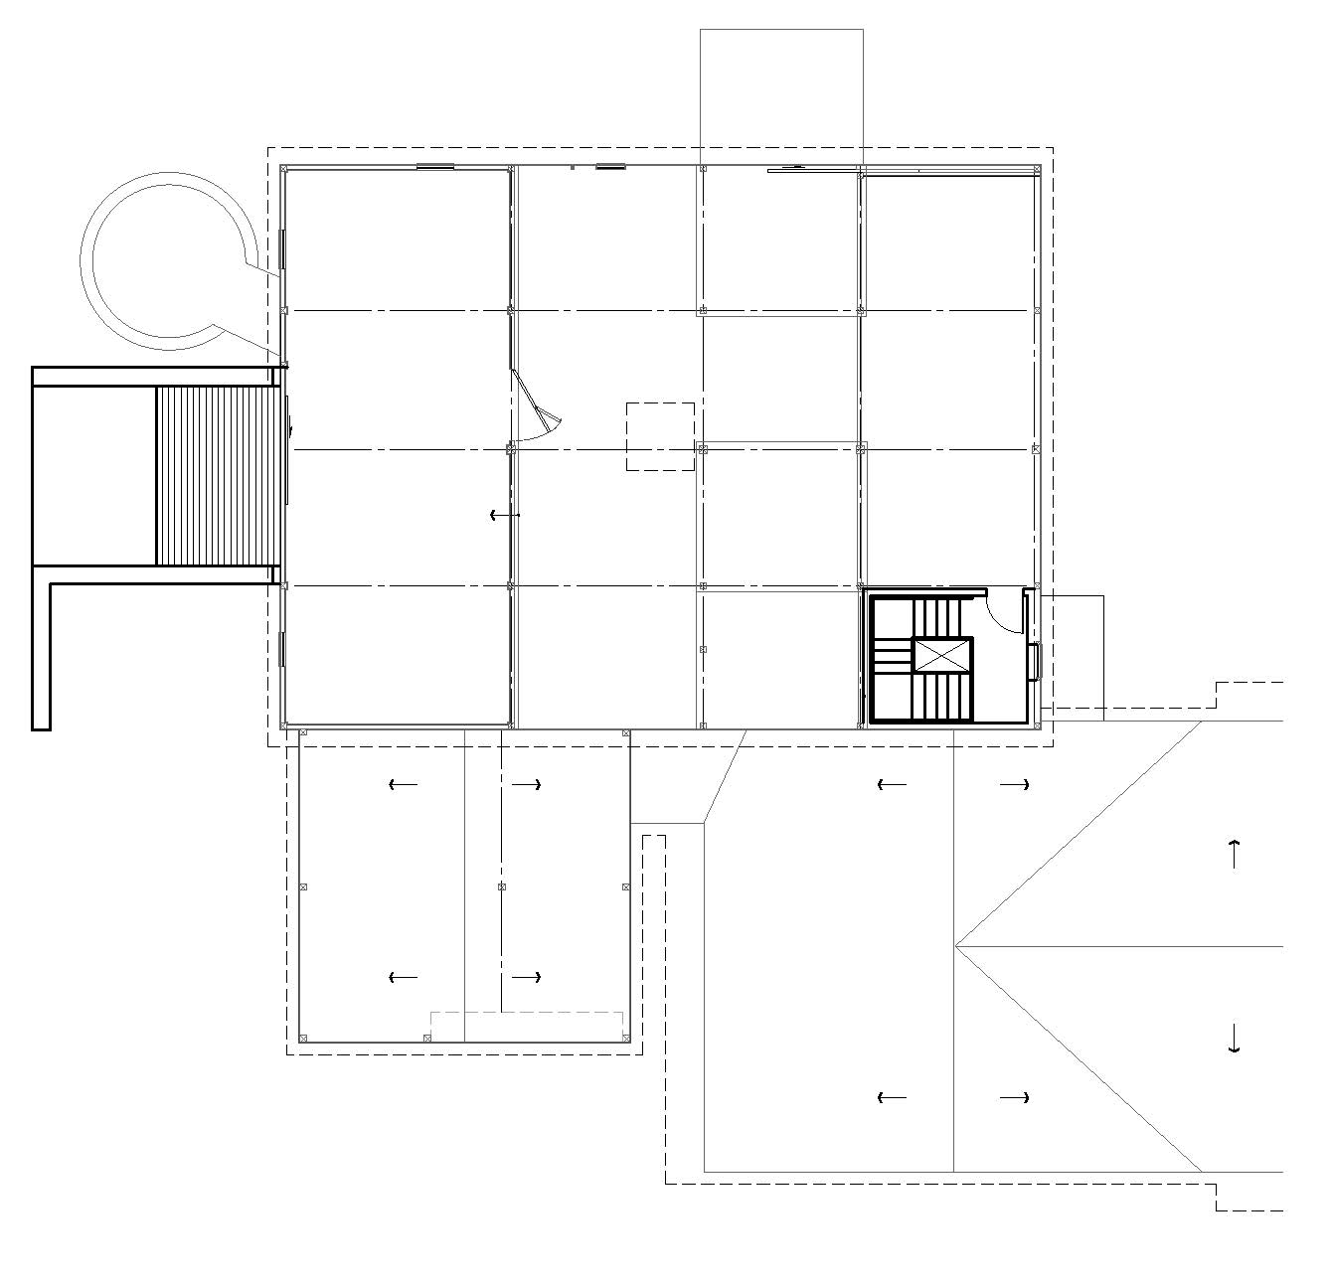
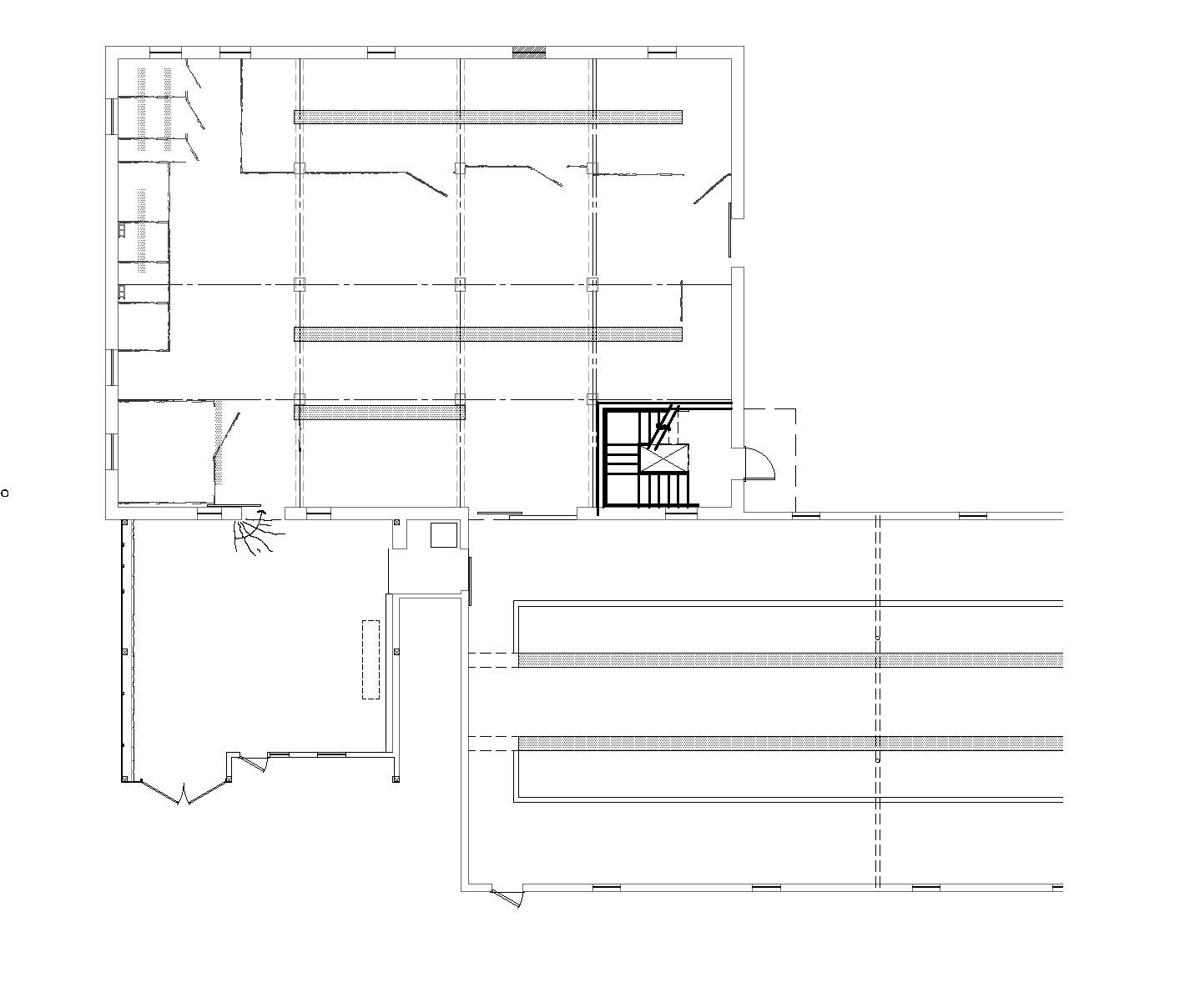
60’
Master Plan - 1908 Barn – Lower Level
Event space
45’
Bridge
New
Egress
New
Egress
Event registration
1980 Milking Parlor
Main Level NSF: 2,564
Master Plan - 1908 Barn – Upper Level
Bolton Heritage Farm – Master Planning for Site Development Presentation to Board of Selectmen June 7, 2022
Nelson Edwards Company Architects, LLC □ Elmore Design Collaborative LLC □ Public Archaeology Survey Team (PAST)

Slide 18
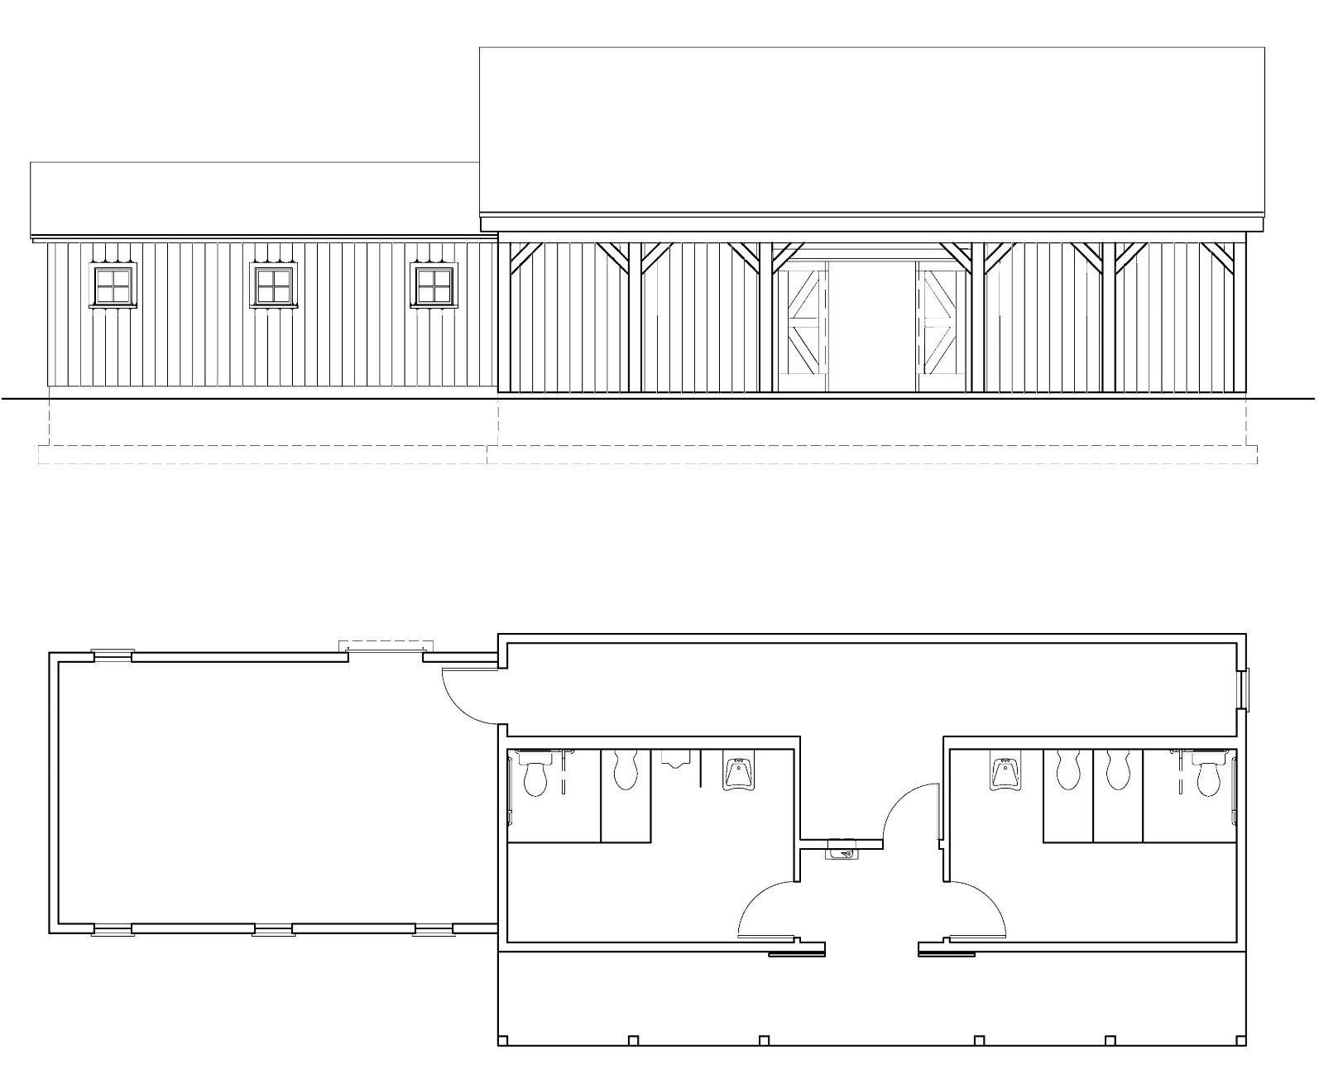
Elevation Looking North
Master Plan
Toilet & Utility
Building
Utility
Men
Women
Covered Porch
Bolton Heritage Farm – Master Planning for Site Development Presentation to Board of Selectmen June 7, 2022
Nelson Edwards Company Architects, LLC □ Elmore Design Collaborative LLC □ Public Archaeology Survey Team (PAST)

Slide 19
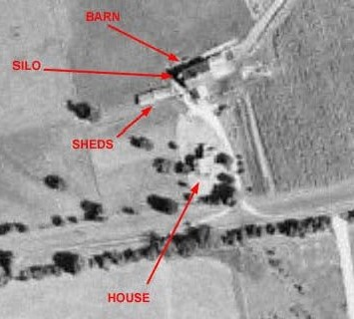
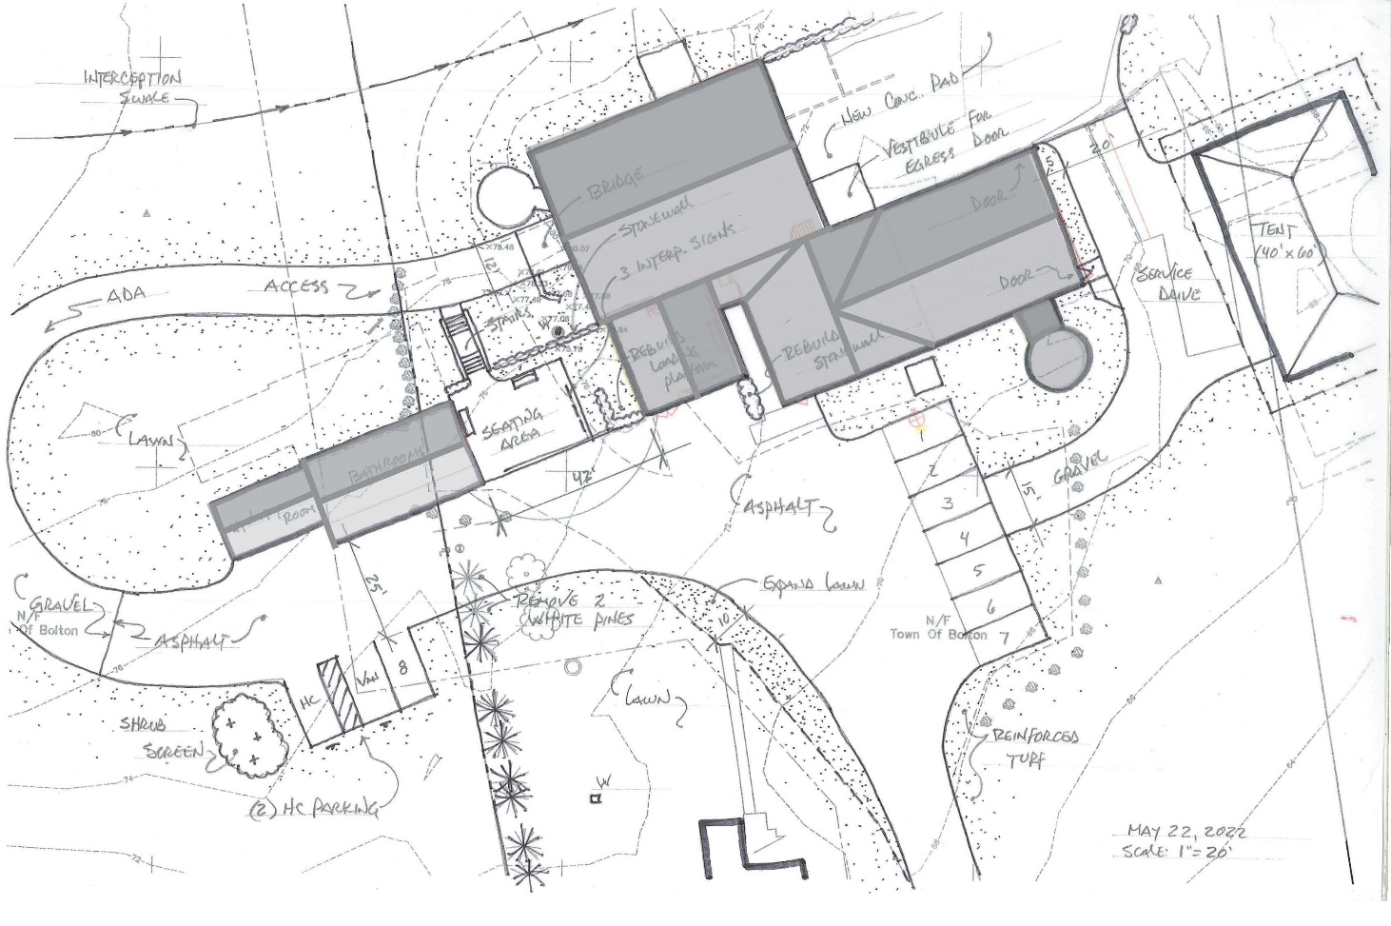
1951 USDA Aerial Photo
2022 Proposed Master Plan
Bolton Heritage Farm – Master Planning for Site Development Presentation to Board of Selectmen June 7, 2022
Nelson Edwards Company Architects, LLC □ Elmore Design Collaborative LLC □ Public Archaeology Survey Team (PAST)

Slide 20
Phase 1
Immediate and expanded use of site;
Preparation for 2023 reenactment tied to the 2026 opening of the W3R route
by the National Park Service
Seating Overlooks (3 heavy Adirondack style chairs with fieldstone paving under)
Flatten the entrance driveway (in-kind donation)
Test site water for potability / If potable, reclassify as ‘Transient, non-community well’
Investigate power needs for expanded site use (current power to site)
Provide wi-fi to site
Mark out location for port-a-potties
Fence off (make safe) manure area
Site lighting tied to hours of operation
Budget: $5,000.00 - $12,000.00
Bolton Heritage Farm – Master Planning for Site Development Presentation to Board of Selectmen June 7, 2022
Nelson Edwards Company Architects, LLC □ Elmore Design Collaborative LLC □ Public Archaeology Survey Team (PAST)

Slide 21
Phase 2
Site Development for municipal connections, parking, ADA access
Construct walkway from Town Hall to BHF including bridge at sliding door for accessibility access
Construct paved parking lot and site drive to Bolton Center Road
Construct overflow parking area on east side of drive
Construct H/C parking area with H/C signage and shrub screen
Connect paved parking lot with accessible (ADA) entrance path to west gable end of barn
Remove 2 White pine trees and 1 ornamental tree for parking area and public restroom building
Construct interception drainage swale
Budget: Items 1-5 included in LOTCIP project work and estimated to be $550,000.00 - $600,000.00
Item 6 ($5,000.00 - $7,000.00)
Item 7 (by Town)
Bolton Heritage Farm – Master Planning for Site Development Presentation to Board of Selectmen June 7, 2022
Nelson Edwards Company Architects, LLC □ Elmore Design Collaborative LLC □ Public Archaeology Survey Team (PAST)

Slide 22
Phase 3
Enabling Project for Expanded Site and Building Usage
Construct stand-alone toilet / site utility facilities with on-site sewerage that can be connected to future Town Center system
Construct landscape improvements adjacent to Utility Building including stairs, retaining wall, paved seating area, signage and new and rebuilt stone walls in accordance with ADA requirements
Remove and regrade manure pad and manure pit/pond area to improve safety and in preparation for expanded site usage
Construct service access and concrete pad for tent / bldg. frame for event rental
Construct catering staging area and service at east end of 1980 barn
Explore the use of the natural amphitheater (part of hay contract)
Budget: $500,000 – $750,000
Bolton Heritage Farm – Master Planning for Site Development Presentation to Board of Selectmen June 7, 2022
Nelson Edwards Company Architects, LLC □ Elmore Design Collaborative LLC □ Public Archaeology Survey Team (PAST)

Slide 23
Phase 4
Barn Renovation for Public Use
Barn renovations:
Under CT State Bldg. Code, Formal Change-of-Use of barn from ‘Storage’ to ‘Assembly’ which, in turn, requires meeting then current Life Safety code requirements for the proposed use.
1. Address Life Safety Code requirements for public (seasonal) use of upper level of barn including:
Emergency egress (includes new stairwell and exit to grade on south side of barn)
Accessibility (ADA) requirements on Main level (ADA)
Fire detection (upgrade existing detection system for Assembly use)
Power and Lighting
Upgrade of floor framing for Assembly occupancy
Budget: $265,000 – 375,000 (1908 Barn ONLY)
Bolton Heritage Farm – Master Planning for Site Development Presentation to Board of Selectmen June 7, 2022
Nelson Edwards Company Architects, LLC □ Elmore Design Collaborative LLC □ Public Archaeology Survey Team (PAST)

Slide 24
Phase 5
Farmhouse Renovation
Farmhouse renovations:
Given size of the building the home is best suited to site office, ancillary to Heritage Farm site operations or as a caretaker’s residence.
Final decisions regarding use will be made evident in the evolution of the Heritage Farm operations.
If office use the building will need to have formal change of use
Budget: $300,000 - $650,000 – Depends on many factors, such as change of use
Bolton Heritage Farm – Master Planning for Site Development Presentation to Board of Selectmen June 7, 2022
Nelson Edwards Company Architects, LLC □ Elmore Design Collaborative LLC □ Public Archaeology Survey Team (PAST)

Slide 25
Funding
State of CT, State Historic Preservation Office
Restoration Fund Grant (Awards up to 200K; matching)
Maintenance and repair funding to non-profit 501c3 and 501c13 and municipally owned buildings listed on the State or National Register of Historic Places.
Federal funds and other non-state funds can be used as a match
National Trust for Historic Preservation
Hart Family Fund for Small Towns (2,500 – 15,000.00)
Public agencies and nonprofit organizations in towns with a population of 10,000 or less are eligible
National Trust for Historic Preservation
Battlefield Preservation (amount not identified)
Typical use: Legal and research fees to mitigate development threats, fund-raising and media plans, feasibility studies for endangered buildings and sites, archeological studies, landscape research and planning, viewshed protection, easement planning, and interpretation and heritage education activities
Bolton Heritage Farm – Master Planning for Site Development Presentation to Board of Selectmen June 7, 2022
Nelson Edwards Company Architects, LLC □ Elmore Design Collaborative LLC □ Public Archaeology Survey Team (PAST)

Slide 26
Funding
State of CT, Office of Policy and Management
STEAP (Small Town Economic Assistance Program)
No more than 500K in one fiscal year
Preserving the historical integrity and beauty of our small towns is vital to our economy and quality of life. The Small Town Economic Assistance Program (CGS Section 4-66g) funds economic development, community conservation and quality-of-life capital projects for localities that are ineligible to receive Urban Action (CGS Section 4-66c) bonds.
Other Avenues (requiring 501c3 status)
1772 Foundation / Preservation CT
Preservation Grants (offered to 501c3)
Exterior painting, finishes and surface restoration, fire detection/lightning protection/security systems, repairs to/restoration of porches, roofs and windows, repairs to foundations and sills, and chimney and masonry repointing
Bolton Heritage Farm – Master Planning for Site Development Presentation to Board of Selectmen June 7, 2022
Nelson Edwards Company Architects, LLC □ Elmore Design Collaborative LLC □ Public Archaeology Survey Team (PAST)

Slide 27
Topical Work Products that inform this master plan
Bolton Heritage Farm Commission
Business Plan, 2021
Site Research Questionnaire
Compendium of Farm Site Venue Research
Bolton Heritage Farm Program Document (with design team)
Consultant Team
Archaeologist’s Memo of Findings & Recommendations (PAST)
Schematic Design Layout of Connection from Town Center to Heritage Farm
Schematic Design Layout of Heritage Farm Complex
Schematic Design Layout of Barn
Schematic Design Layout of Toilet / Utility Building
Master Plan Phasing and Budgets
List of available Funding
Bolton Heritage Farm – Master Planning for Site Development Presentation to Board of Selectmen June 7, 2022
Nelson Edwards Company Architects, LLC □ Elmore Design Collaborative LLC □ Public Archaeology Survey Team (PAST)

Slide 28
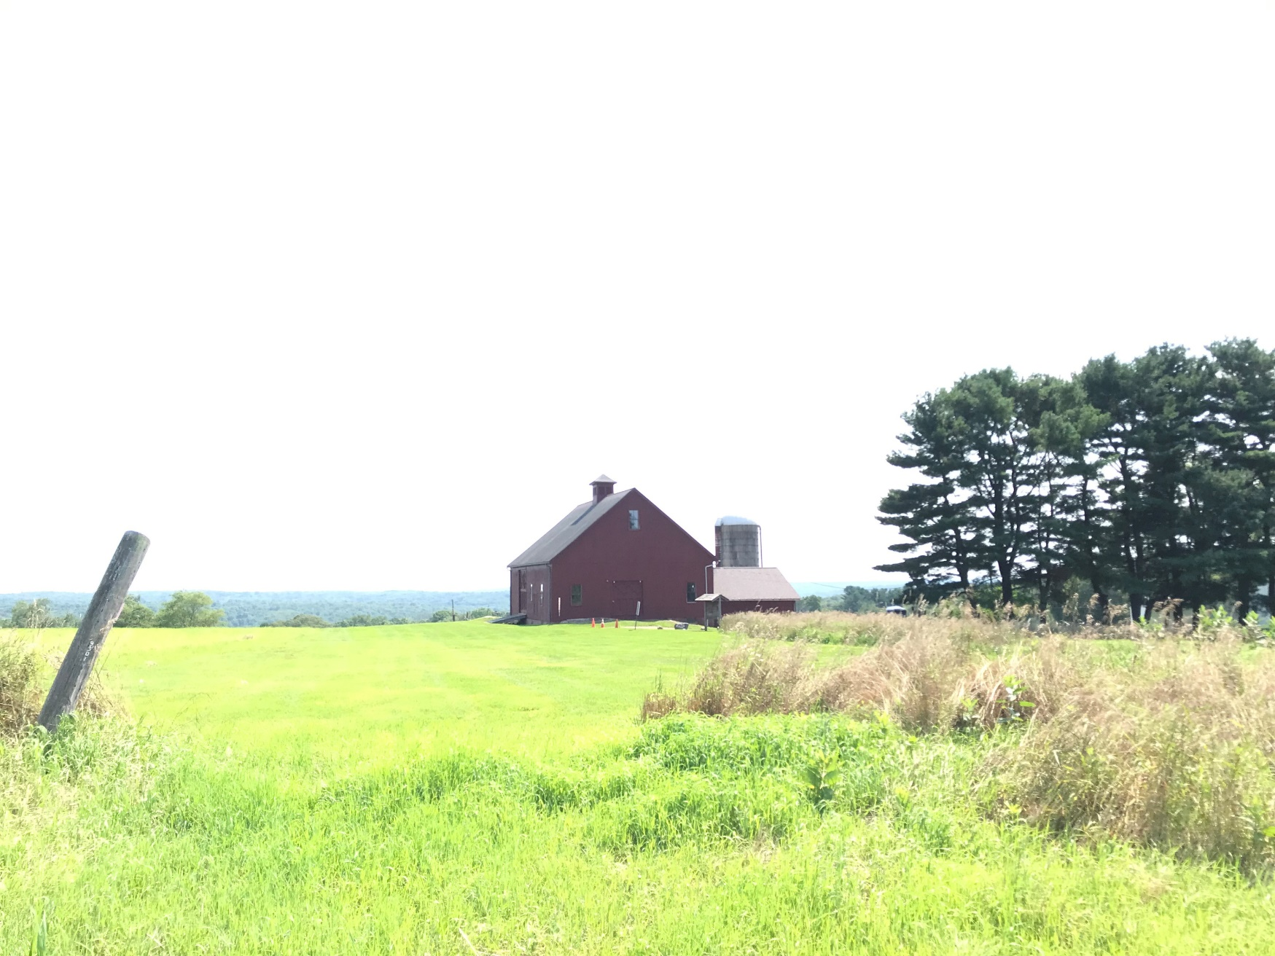
Discussion
Bolton Heritage Farm – Master Planning for Site Development Presentation to Board of Selectmen June 7, 2022
Nelson Edwards Company Architects, LLC □ Elmore Design Collaborative LLC □ Public Archaeology Survey Team (PAST)

Slide 29
Background Material
If needed for discussion
Bolton Heritage Farm – Master Planning for Site Development Presentation to Board of Selectmen June 7, 2022
Nelson Edwards Company Architects, LLC □ Elmore Design Collaborative LLC □ Public Archaeology Survey Team (PAST)

Slide 30
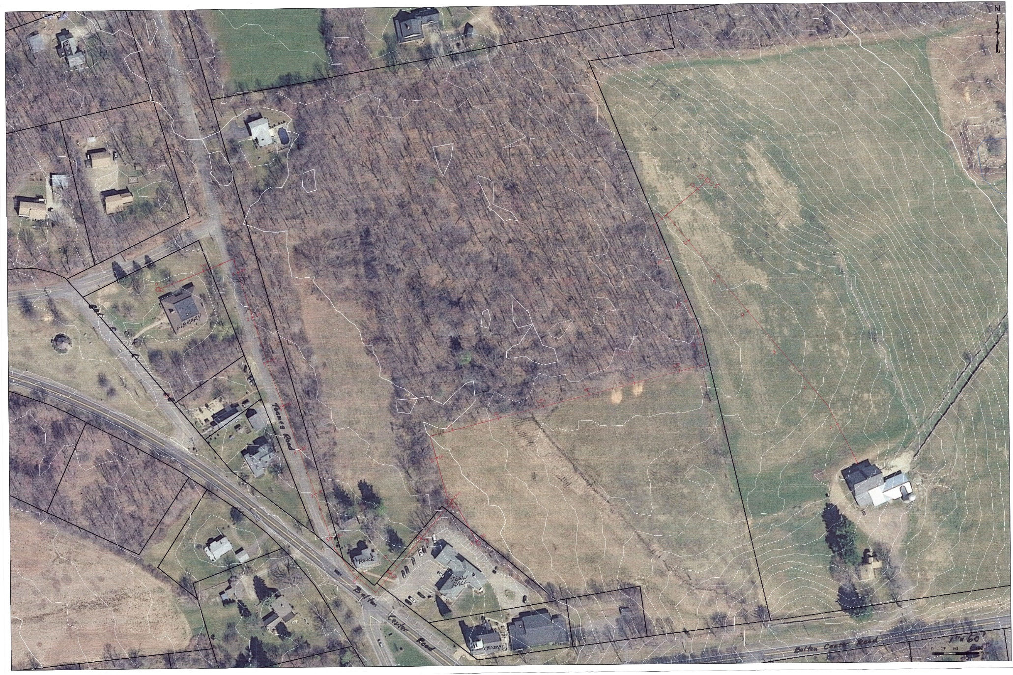
Aerial Photo,
Bolton Center
Bolton Heritage Farm – Master Planning for Site Development Presentation to Board of Selectmen June 7, 2022
Nelson Edwards Company Architects, LLC □ Elmore Design Collaborative LLC □ Public Archaeology Survey Team (PAST)

Slide 31
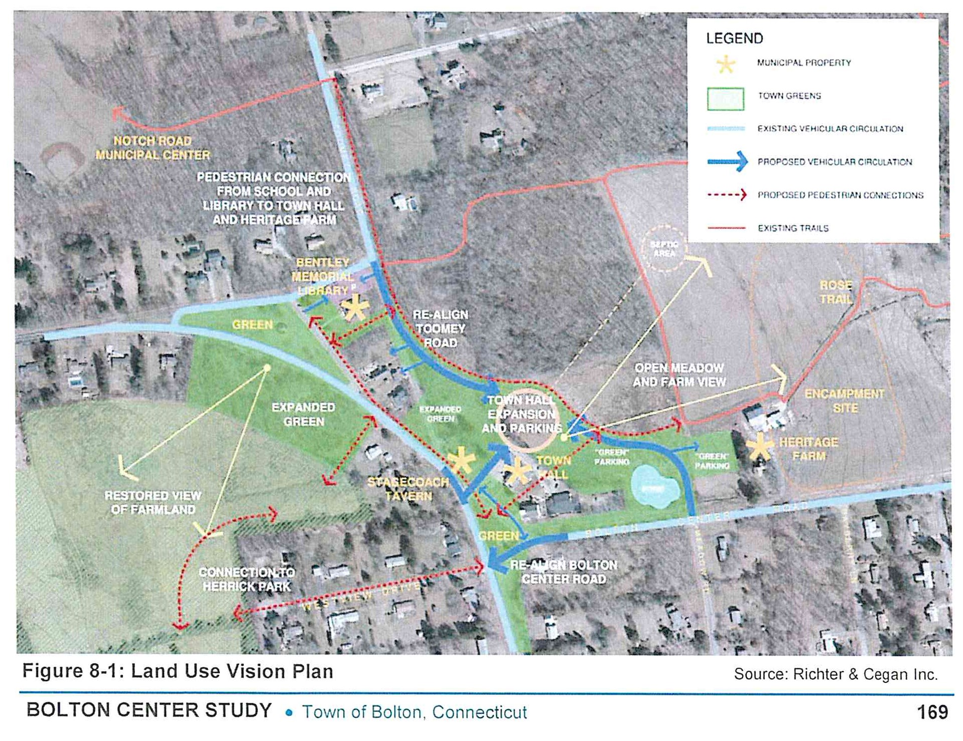
VCI Study
Bolton Heritage Farm – Master Planning for Site Development Presentation to Board of Selectmen June 7, 2022
Nelson Edwards Company Architects, LLC □ Elmore Design Collaborative LLC □ Public Archaeology Survey Team (PAST)

Slide 32
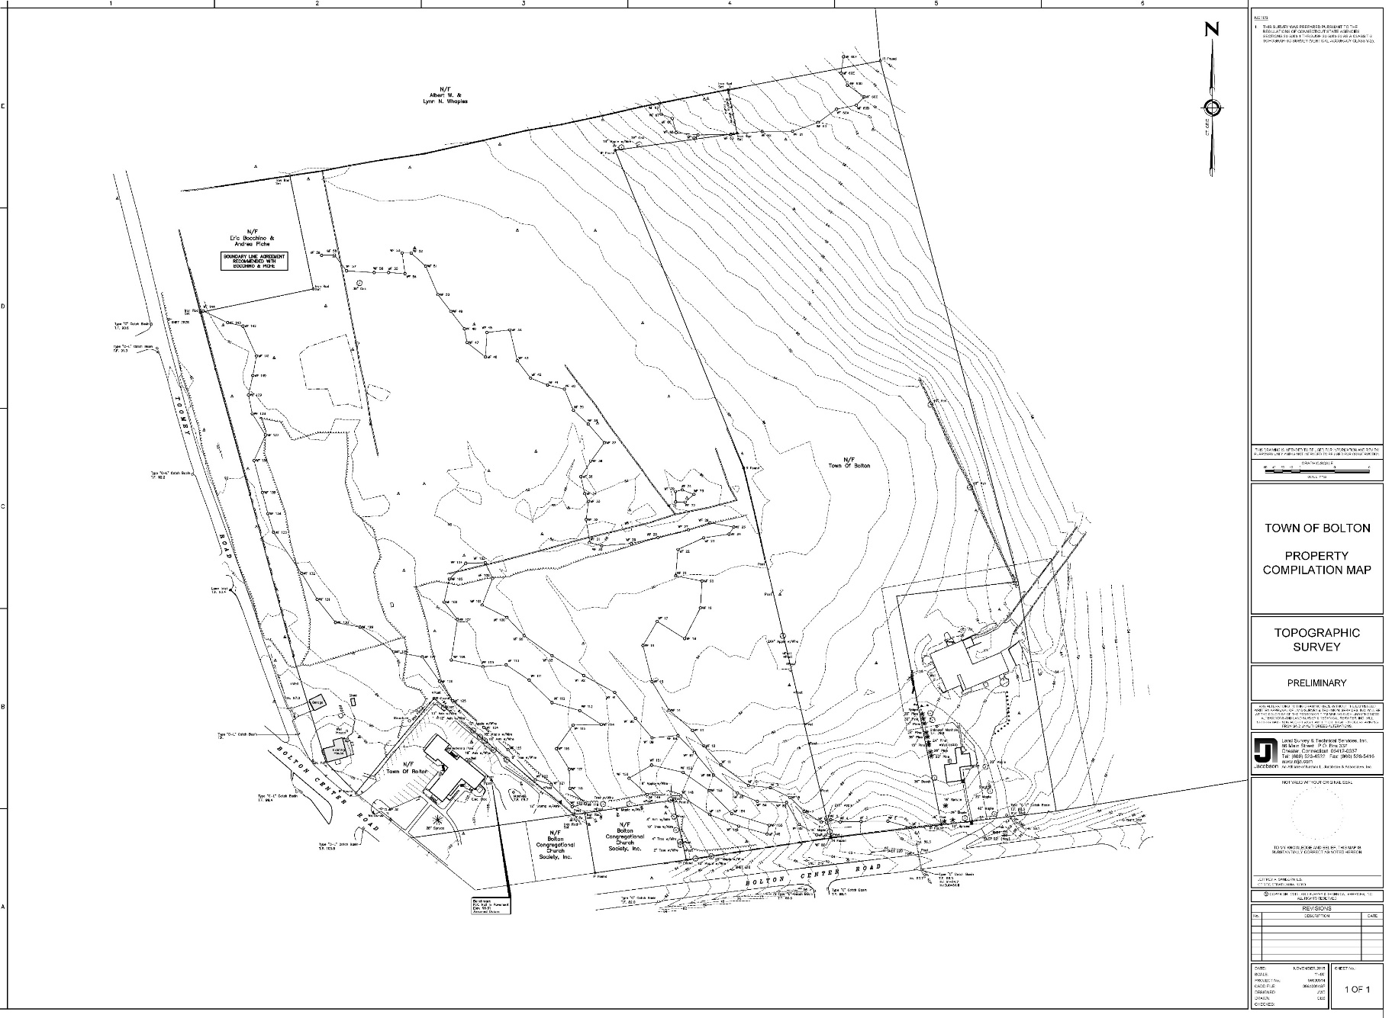
Archaeological Preserve
Town Center Survey
With
Historic Overlay
Additional Historic Area
Area of investigation
Bolton Heritage Farm – Master Planning for Site Development Presentation to Board of Selectmen June 7, 2022
Nelson Edwards Company Architects, LLC □ Elmore Design Collaborative LLC □ Public Archaeology Survey Team (PAST)

Slide 33
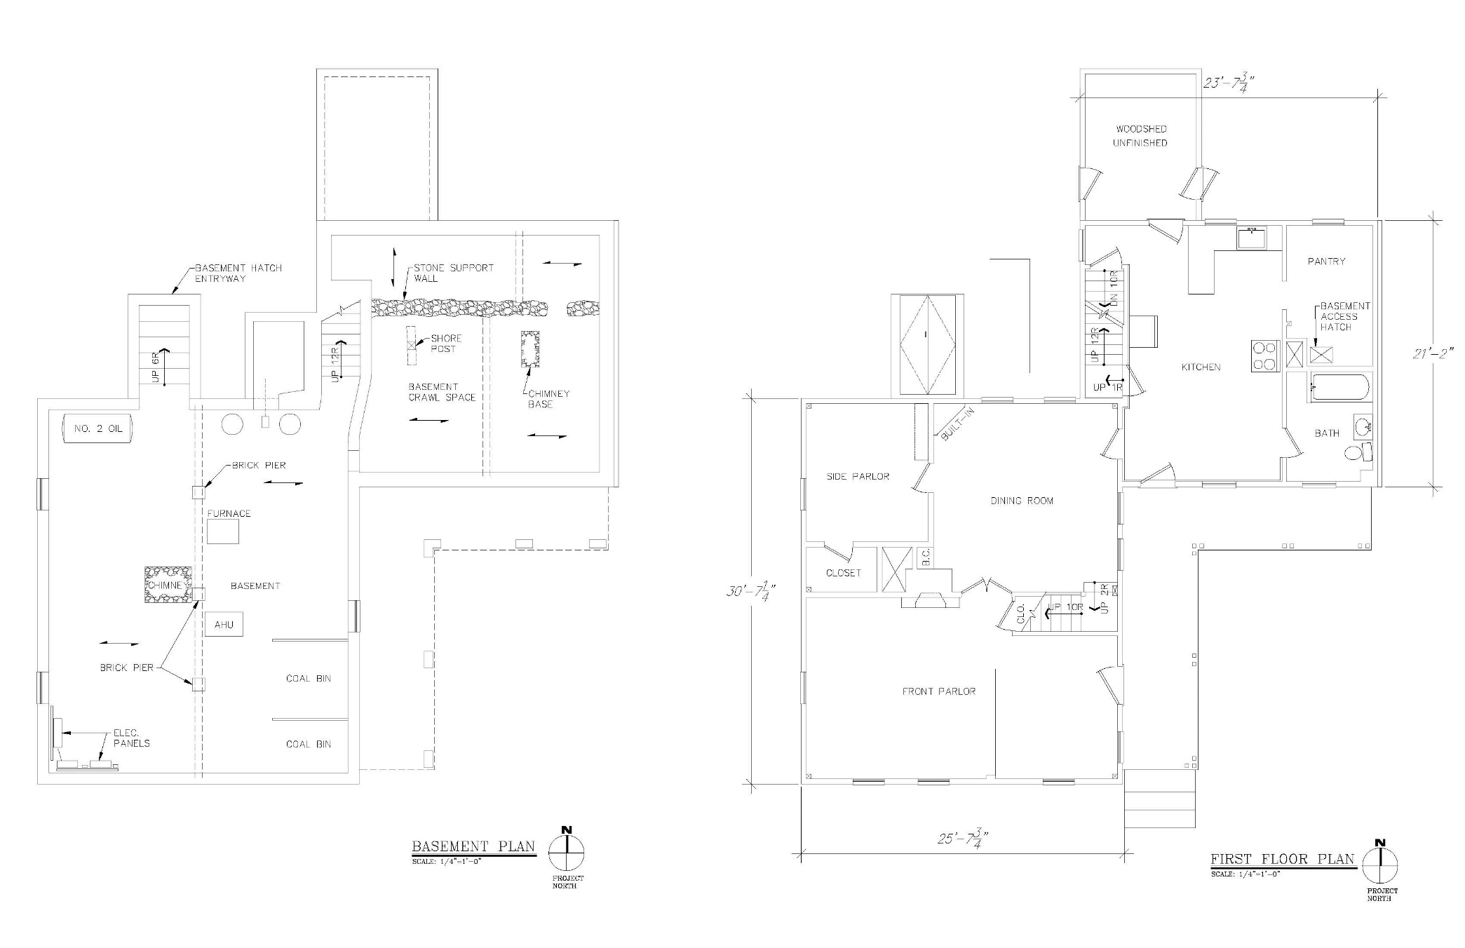
23’-7’
21’-2”
30’-7
25’-7”
Bolton Heritage Farm – Master Planning for Site Development Presentation to Board of Selectmen June 7, 2022
Nelson Edwards Company Architects, LLC □ Elmore Design Collaborative LLC □ Public Archaeology Survey Team (PAST)

Slide 34
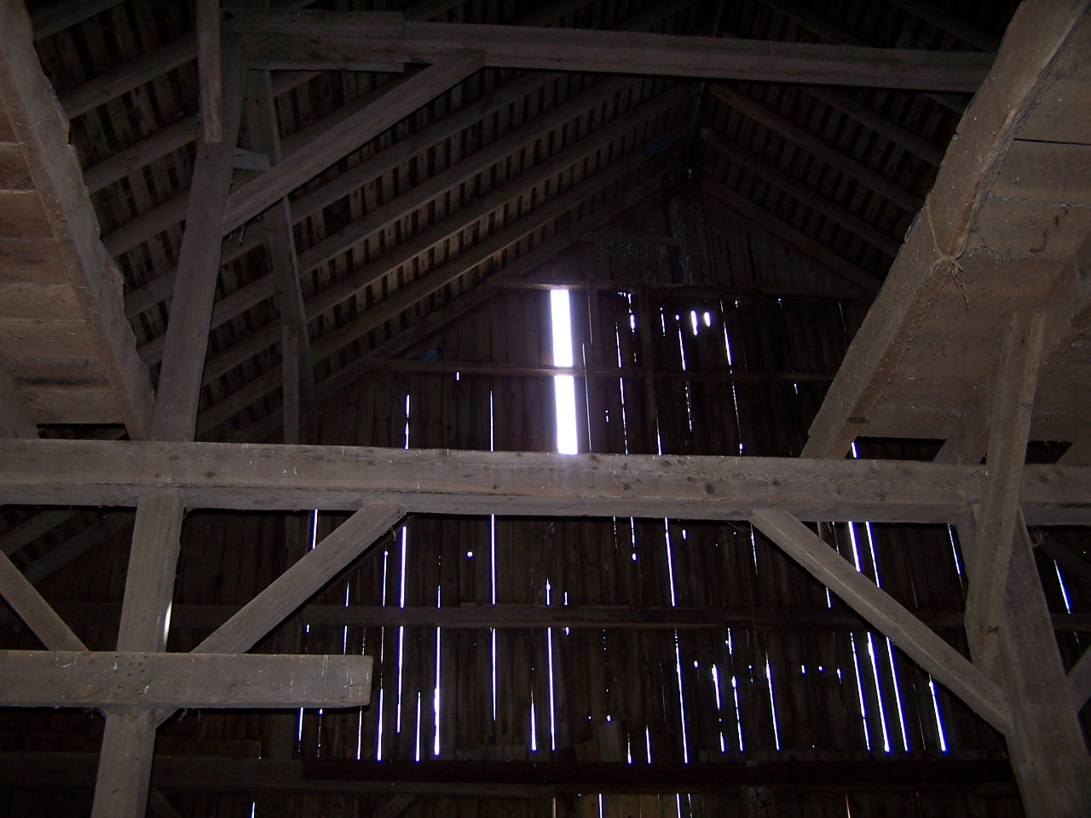
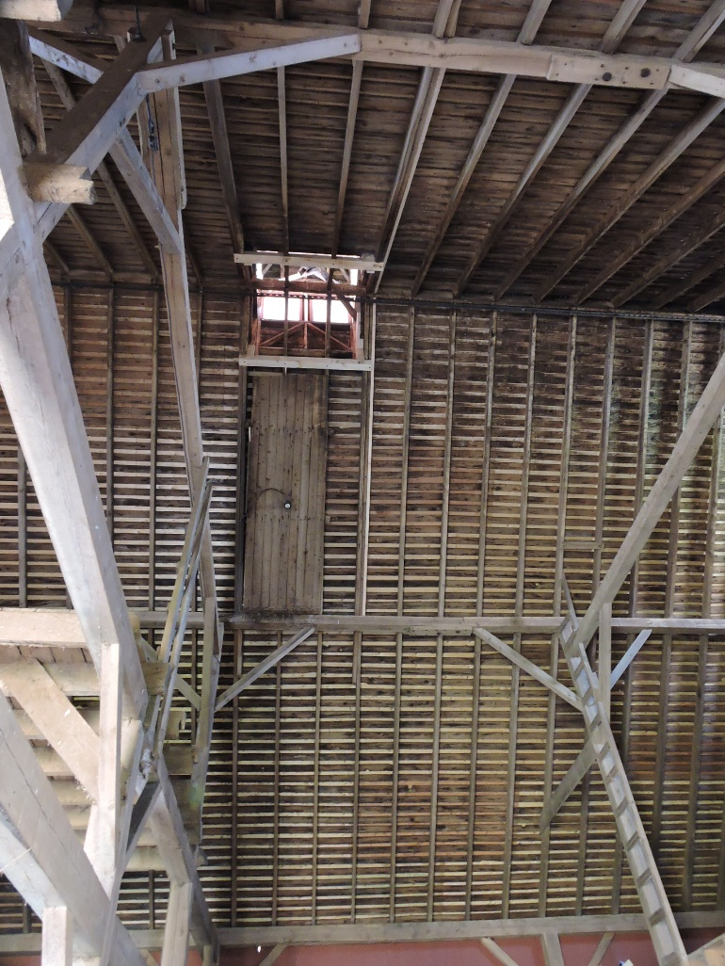
1908 Barn
Bolton Heritage Farm – Master Planning for Site Development Presentation to Board of Selectmen June 7, 2022
Nelson Edwards Company Architects, LLC □ Elmore Design Collaborative LLC □ Public Archaeology Survey Team (PAST)

Slide 35
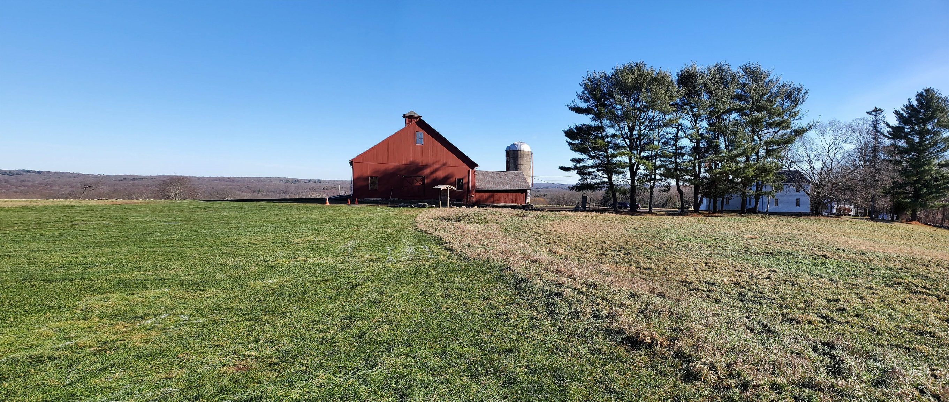
Bolton Heritage Farm – Master Planning for Site Development Presentation to Board of Selectmen June 7, 2022
Nelson Edwards Company Architects, LLC □ Elmore Design Collaborative LLC □ Public Archaeology Survey Team (PAST)

Slide 36
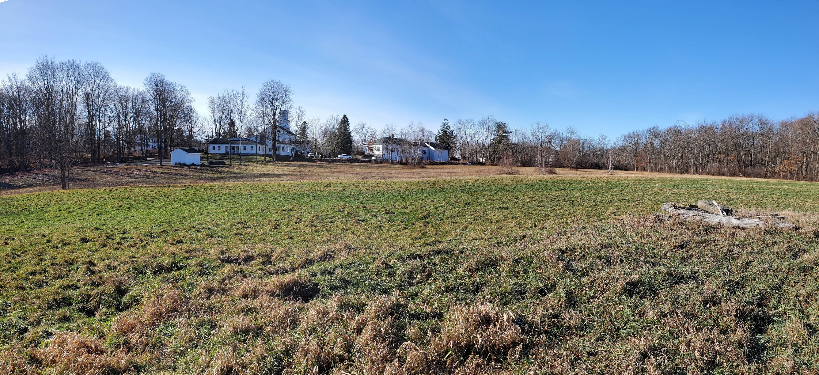
Bolton Heritage Farm – Master Planning for Site Development Presentation to Board of Selectmen June 7, 2022
Nelson Edwards Company Architects, LLC □ Elmore Design Collaborative LLC □ Public Archaeology Survey Team (PAST)

