Slide 1
Opioid Abatement Working Group
-
Community Advisory Board (DivCare)
July 29, 2026

Slide 2
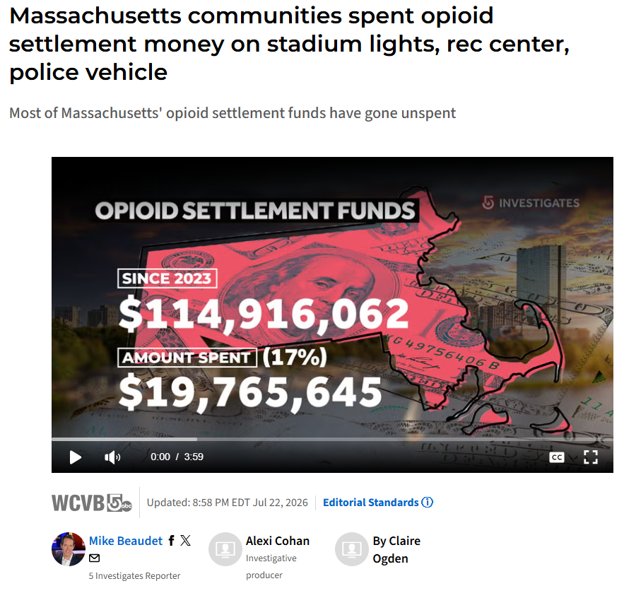
In The News…

Slide 3
Talking Points for the OAWG
We have received (to date): $826,938.23
By the end of this Fiscal Year, we will have spent: $ 582,840.31
That means we will have spent 70% of our funds by the end of this Fiscal Year (June 30, 2027)
Reminders on what we have spent our $$ on:
Narcan Boxes
SUDHI Staff Time
Street Medicine Doctor
Narcan Training in Businesses
Housing Case Manager for Opioid-Use Disorder Clients
Sober Home/Detox Bed Voucher Program
Assistance with Bereaved Families
Basic Needs for Outreach workers to utilize for clients
Prevention Work – R.A.W. program

Slide 4
DivCare Updates
Reminder: DivCare is a grant that Public Health has received from the state’s substance use division. We’ve gotten it for the last 3 years.
For FY27:
  Use it to help pay for SUDHI Office staff time
  Use it to help pay for our Outreach Worker team
  Use it to pay for a small portion of Revere Police Co-Response Clinician with North Suffolk Community Services
What is a Co-Response Clinician?
  Licensed Social Worker who rides with Revere Patrol Officers
  Why- attempt to head off non-criminal calls of service that have a Behavioral Health or Substance Use origin

Slide 5
Upcoming Events
Overdose Memorial Vigil – 8/31/26
3rd Annual Stigma Event – 9/12/26
PLEASE HELP US PROMOTE, PLEASE ATTEND!!!!

