Slide 1

Community Development Block Grant (CDBG)
Public Hearing
February 17, 2026

Slide 2
CDBG PY 2026
July 1, 2026 - June 30, 2027
Estimated HUD entitlement: $690,800.00
A statutory requirement of CDBG is that at least 70% of the impending grant benefits low and moderate income residents

Slide 3
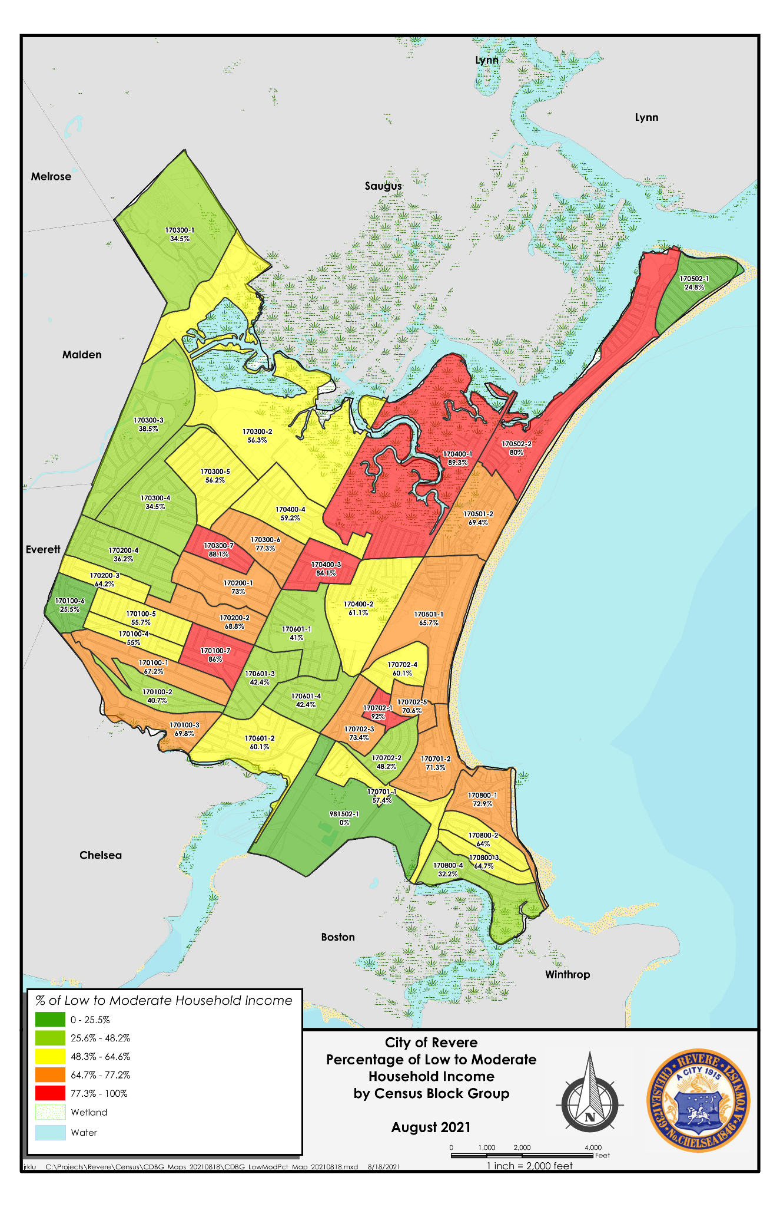
Percentage of Low to Moderate Income Households by Area

Slide 4
Areas of Focus
Increase economic development opportunities
Enhance public facilities, infrastructure, and parks
Expansion of affordable housing
Public services

Slide 5
Note on Public Services
Restricted to 15% of grant allocation
RFP released tomorrow, February 18th → proposals due by March 13th at 5:00 pm
Nonprofits requesting technical support can reach out to:
-Julie DeMauro jdemauro@revere.org
-Amelia Viscay aviscay@revere.org

Slide 6
North Suburban Consortium
Affordable housing development
Downpayment Assistance
Homeowner Rehab

Slide 7
Progress on 2025 CDBG Projects

Slide 8
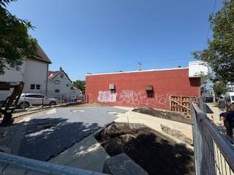
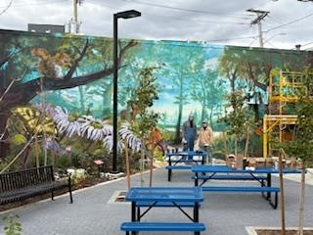
Shirley Avenue Forest Park
Recreational Green Space at 69 Shirley Avenue complete with native plantings, public art and seating area
BEFORE
AFTER

Slide 9
Small Business Loan Program
Provide six low to no interest loans to new local businesses located on the Broadway and Shirley Avenue Corridor. Loans amounts varied between $5,000.00 to $20,000.00.
Currently reviewing three applications for new businesses on Shirley Avenue

Slide 10



Public Services
30 residents have received wrap around services, including:
Housing and employement assistance
8 households have received emergency rental assistance payments
8 youth received after school care

Slide 11
Component | Deadline | Location
Public Hearing #1 | Wednesday, February 17, 2026 at 5:30PM | Revere City Hall 281 Broadway, Revere, MA 02151
Draft Annual Action Plan released *30-day citizen comment period begins 3.25.26 | Tuesday, March 24, 2026 | Department of Planning and Community Development 281 Broadway, Revere, MA www.revere.org/business-development/cdbg-program
Public Hearing #2 | Wednesday, April 1, 2026 at 5:30PM | Revere City Hall 281 Broadway Revere, MA 02151
30-Day Public Comment Period Ends | Wednesday, April 15, 2026 at 5:00PM | Department of Planning and Community Development 281 Broadway, Revere, MA
Funding Authorized by HUD | September-October 2026 | HUD

Slide 12
Questions or Comments?
Julie DeMauro
Community Development Program Manager jdemauro@revere.org

