Slide 1
Keeping the Books: Basic Recordkeeping and Accounting

Slide 2
Welcome and Chat Introductions
www.CWEonline.org | Eastern MA | Central MA | Rhode Island | New Hampshire | Vermont | VBOC New England

Slide 3
Welcome to CWE!
Women-founded, non-profit organization established in Boston in 1995
Mission: To empower women to become economically self-sufficient & prosperous through business and entrepreneurship.
Goal: To provide the education, technical assistance and access to capital that aspiring entrepreneurs need to start and run their own business...regardless of their economic status.

Slide 4
Session goals
Learn about bookkeeping and accounting approaches
Identify your current approach and what you aspire to
Learn how to develop a strategy for your company to move to your desired standard
Learn where to go for help

Slide 5
Why is bookkeeping important?
www.CWEonline.org | Eastern MA | Central MA | Rhode Island | New Hampshire | Vermont | VBOC New England

Slide 6
Provides data to file state and federal income taxes
Many small businesses overpay income taxes because they do not have records to support legitimate deductions
Many “small” items are often missed, increasing tax payments
Business travel—the mileage deduction adds up!
Office supplies—pens, paper, ink, folders
Home office expenses—percentage of overall expense plus depreciation
Meals and entertainment—every cup of coffee you buy a client or prospect is a deductible business expense
Enables year end tax planning and avoids surprises at tax time
www.CWEonline.org | Eastern MA | Central MA | Rhode Island | New Hampshire | Vermont | VBOC New England

Slide 7
Provides information needed to make good decisions
Does the business have enough cash to operate?
How much cash is needed each month?
How many units of product or hours of service must be sold each month?
When do I get to pay myself?
Is the business making enough profit?
Which products or services are most profitable?
Which customers consume too many resources for the money they pay?
www.CWEonline.org | Eastern MA | Central MA | Rhode Island | New Hampshire | Vermont | VBOC New England

Slide 8
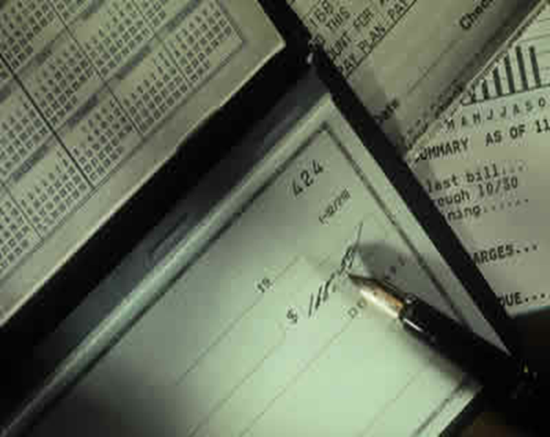
Provides data needed for financial transactions
Required for bank loans
Required by equity investors
Required to negotiate a merger with a partner or to form a joint venture
Required to establish a fair market value to sell a business
www.CWEonline.org | Eastern MA | Central MA | Rhode Island | New Hampshire | Vermont | VBOC New England

Slide 9
Components of a bookkeeping system
www.CWEonline.org | Eastern MA | Central MA | Rhode Island | New Hampshire | Vermont | VBOC New England

Slide 10
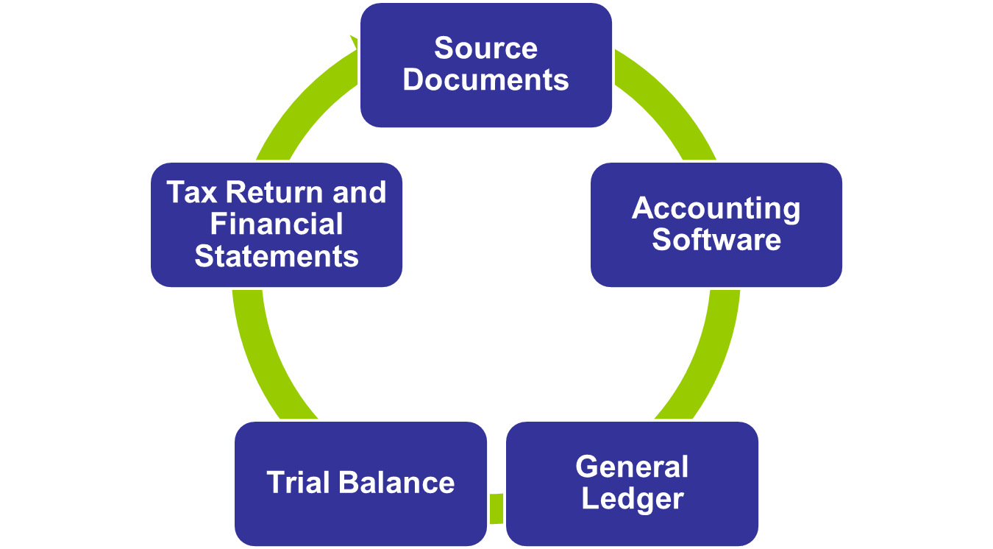

Slide 11
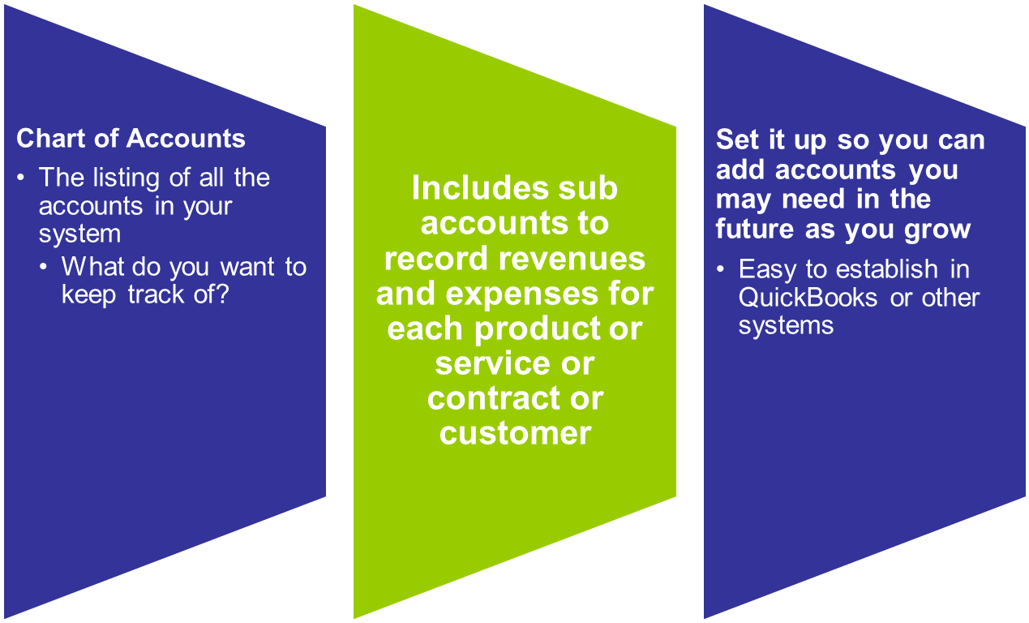

Slide 12
Class discussion
What items are important to track in your businesses?
Product examples
Cost of goods sold
Inventory
Service examples
Actual time spent on a project and dollars per hour earned
Marketing costs
Total cost of trade shows
Fees
Travel
Promotional items
Staff time

Slide 13
Components of a bookkeeping system (continued)

Slide 14
A bookkeeping “workflow” plan as part of your operations plan
Set deadlines
Create internal control process
Consequences of falling behind
Cash flow issues
Inaccurate tax returns and financial statements
Additional cost for amendments
Loss of trust with advisors
Overcomplicating recordkeeping
www.CWEonline.org | Eastern MA | Central MA | Rhode Island | New Hampshire | Vermont | VBOC New England

Slide 15
Accounting Methods
www.CWEonline.org | Eastern MA | Central MA | Rhode Island | New Hampshire | Vermont | VBOC New England

Slide 16
Cash basis
Recognizes revenues and expenses at the time physical cash is actually received or paid out
Like your personal checkbook
You record deposits when you make them
You record checks when you write them
Accrual basis
Records income when the revenue is earned but not received (AR)
Records expenses when liabilities are incurred but not paid for (AP)
Annual payments apportioned and reported monthly (Prepaid)
www.CWEonline.org | Eastern MA | Central MA | Rhode Island | New Hampshire | Vermont | VBOC New England

Slide 17
Cash Basis Accounting Examples
Revenue Example: Your painting business completes a job on April 15th, but you don’t collect payment until May 1st. The income is recorded in May since that’s when you receive the check.
Expense Example: You pay the annual rent of $12,000 in one lump sum in January. January will show rent expense of $12,000 and every other month will show zero

Slide 18
Accrual Basis Accounting Examples
Revenue Example: Your painting company completes the job on April 15th and you get paid on May 1st. The transaction is recorded as income on April 15th
Expense Example: You purchase paint brushes on account on April 1st and you pay the bill on May 1st. The transaction is recorded as an expense on April 1st because that’s when the activity occurred
Expense Example: You pay the annual rent of $12,000 in one lump sum in January. Every month will show a $1,000 rent expense

Slide 19
Which accounting method is best?
Cash basis is easier to manage and make entries—if you can balance your checkbook, you can manage this method
Accrual basis provides better understanding of expenses and profitability
Accrual basis accounting is typically required when providing financial statements to lenders or shareholders.
Accounting software can run reports on Cash or Accrual Basis
Tax preparer will determine method to use for tax filing

Slide 20
Typical steps of bookkeeping in early stage companies
Many businesses start with a cash basis, manual system
Common starting point for businesses that start as hobbies
Provides data for filing taxes
Cash or Accrual basis system using software such as QuickBooks
Companies (should) move to this system when growth starts
Provides data for filing taxes
Provides management control information
Positions company to move to more sophisticated statements
Use of CPA/EA services to compile, review, or audit books
One of these levels of CPA/EA service is generally triggered by financing requirements

Slide 21
Typical steps of bookkeeping for companies preparing for financing
Tax returns
CPA/EA Compiled financial statements
Typically OK for banks and other lending institutions
Lowest cost option
CPA/EA Reviewed financial statements
Typically OK for certain equity investors
Midrange cost option
CPA/EA Audited financial statements
The gold standard—satisfies all investor requirements
Highest cost option
Price dependent on factors such as complexity of company, years of data to analyze, and bookkeeping processes in use

Slide 22
Early Stage Companies – Getting Started
Address bookkeeping in business plan
Set up and use QuickBooks or other platforms
Include a tax professional on team of advisors
Invest personal time to learn about financial management and how QuickBooks works, even with hiring a bookkeeper/accountant
Assign bookkeeping function
Have a tax professional prepare or advise on tax planning and preparation

Slide 23
Individual Exercise
Assess your current bookkeeping system
Which steps from previous slide have you completed?
Is outside financing in the future?
Prepare action plan
In 3 months I will do…
In 6 months I will do…
Discussion

Slide 24
Some useful websites
www.sba.gov
www.irs.gov
http://www.dwmbeancounter.com/tutorial/Tutorial.html
http://bizfinance.about.com/od/bookkeepingessentials/a/Chart_of_Accounts.htm
www.cweonline.org

Slide 25
Questions?
To register for additional CWE programs, visit www.cweonline.org or contact us at info.easternma@cweonline.org

Slide 26
Thank you for attending Keeping the Books
CWE & Facilitator Contact

