Slide 1
Doreen Nicastro Nicastro Consultants Subscribe to my mailing list 22828 text ITPAYSTOBESOCIAL doreen@nicastroconsultants.com www.nicastroconsultants.com https://www.facebook.com/NicastroConsultants/ #ItPaystobeSocial
Social Media Made Simple

Slide 2
Agenda:
Common Pitfalls
What is Social Media Marketing
Understanding your Target Market
Review Navigating each Platform
Review Time Saving Tools
Review Types of Content to Post
www.CWEonline.org | Eastern MA | Central MA | Rhode Island | New Hampshire | Vermont

Slide 3
Common Pitfalls

Slide 4
Common Pitfalls
Trying to be on too many social media platforms
Not updating your social media on a regular basis
Inconsistencies – with language, with terminology, with brand messaging

Slide 5
Social Media Marketing

Slide 6
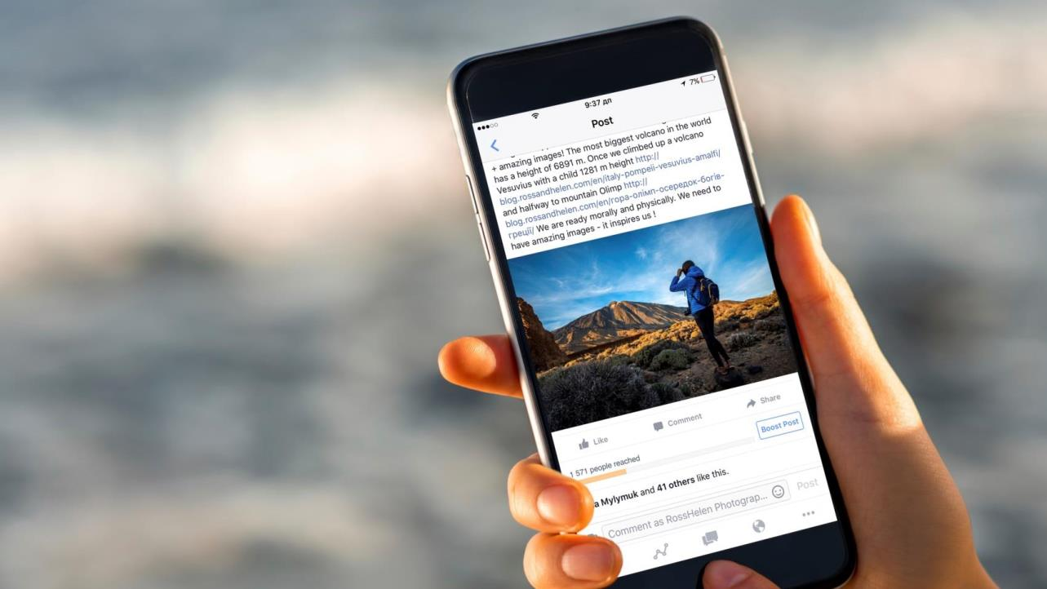
What is social media?

Slide 7
Social Media Marketing*
Social media marketing is the use of social media platforms to connect with your audience to build your brand, increase sales, and drive website traffic.
*metrics, baseline, growth

Slide 8
Social Media Marketing Goal
Build brand awareness
Boost sales, book events
Build community
Knowing your goal will inform your marketing
strategy, what content you produce and help attract your target audience

Slide 9
Using Your Target Market to Inform Your Social Media Channels

Slide 10
Your Advantage:
your authentic connection
with your audience

Slide 11
Use social media to:
Build and expand relationships
Increase brand awareness
Grow your email list
© 2017 Constant Contact, Inc

Slide 12
How do you measure value? Like? Follow? Client / email list?
Size of email list
X
Avg price of service / product =
value of list

Slide 13
Target Market
Target market is the end consumer to which the company wants to sell its end products too.
Demographic Traits:
Age
Location
Gender
Income level
Education level
Marital or family status
Occupation
Ethnic background
Psychographic Traits:
Personality
Attitudes
Values
Interests/hobbies
Lifestyles
Behavior

Slide 14
Target Market
If your target market is too broad you’re going to be wasting your time, money and effort
Not everyone has the same problem, and sometimes different individuals need different solutions

Slide 15
Market Research
Research has already been done – utilize it!
Databases available at your local Public Library (i.e. WPL – Jackie Dzugan – Business Librarian)
Your Industry Association
They conduct market research and distribute, whether it’s online, or via mailings

Slide 16
Market Research
Conduct your own market research
In-person conversations
Online surveys
Gather feedback from social media

Slide 17
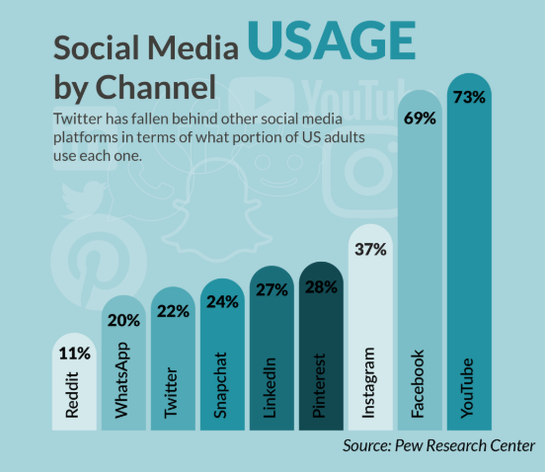

Slide 18
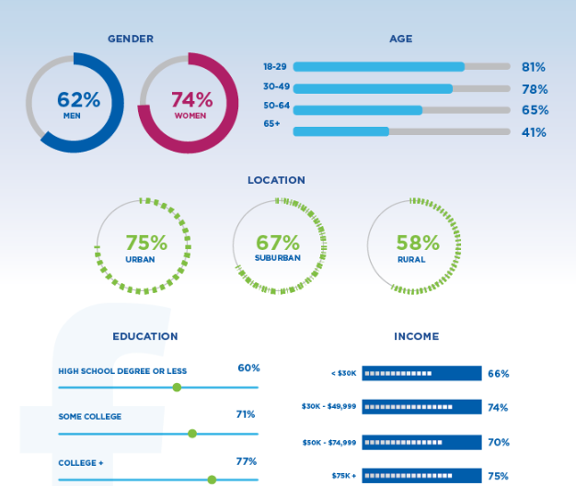

Slide 19
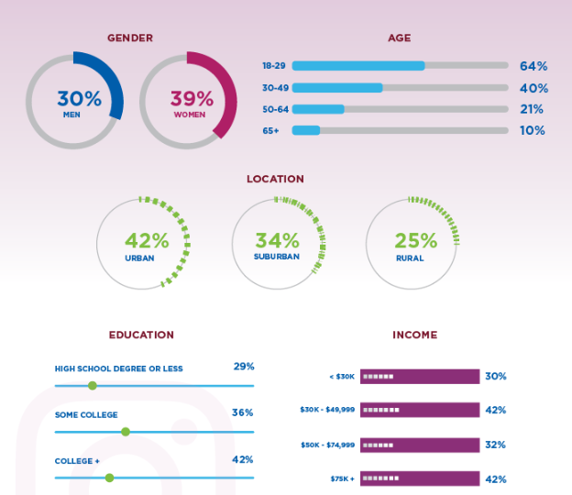

Slide 20
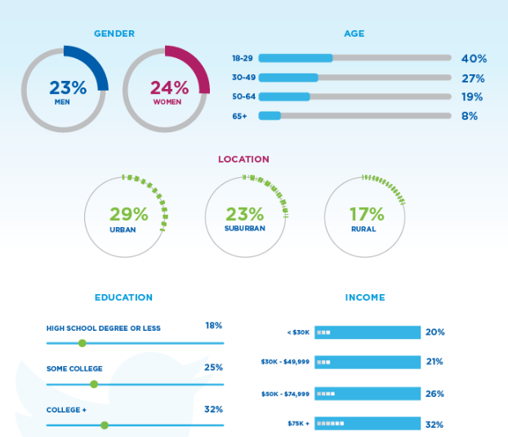

Slide 21
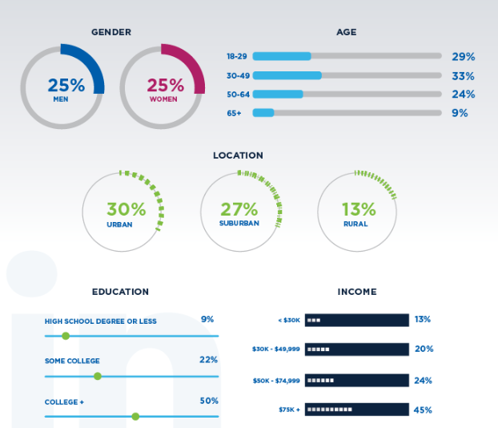

Slide 22
Overview of Social Media Platforms

Slide 23
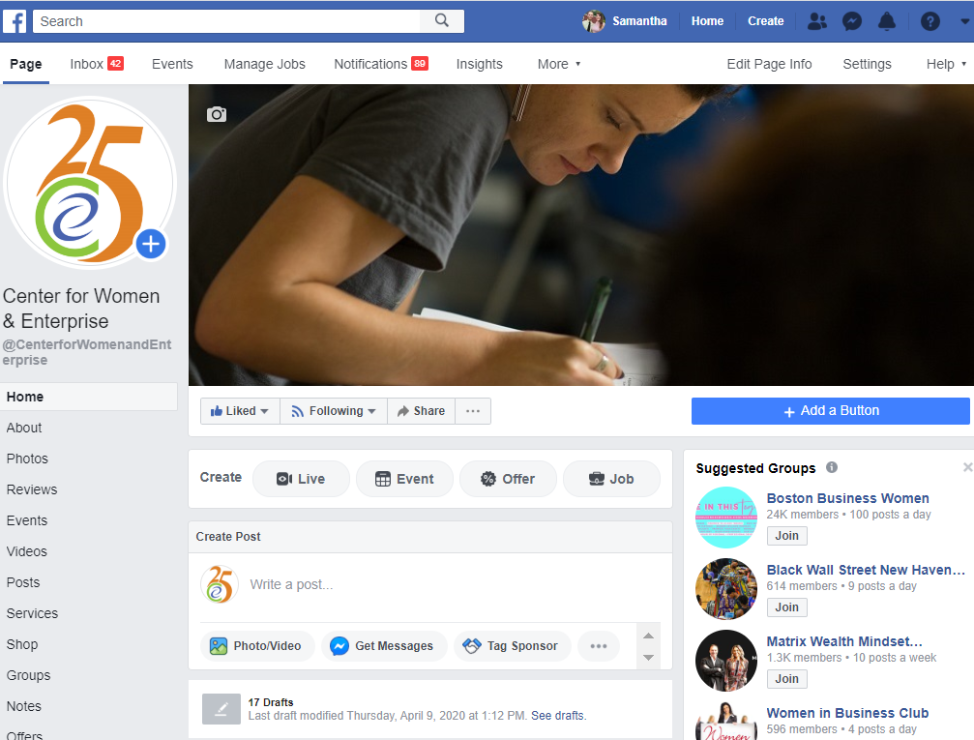

Slide 24
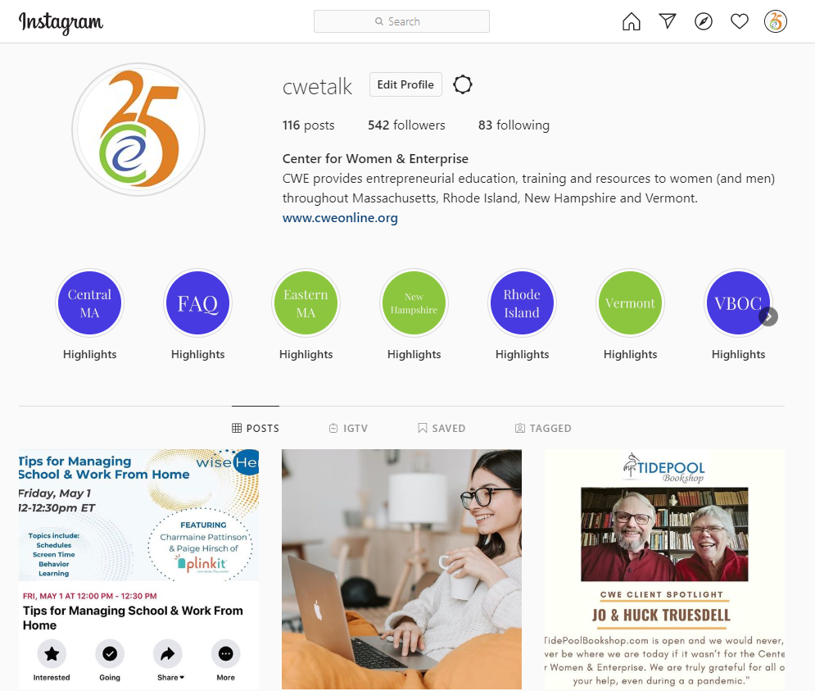

Slide 25
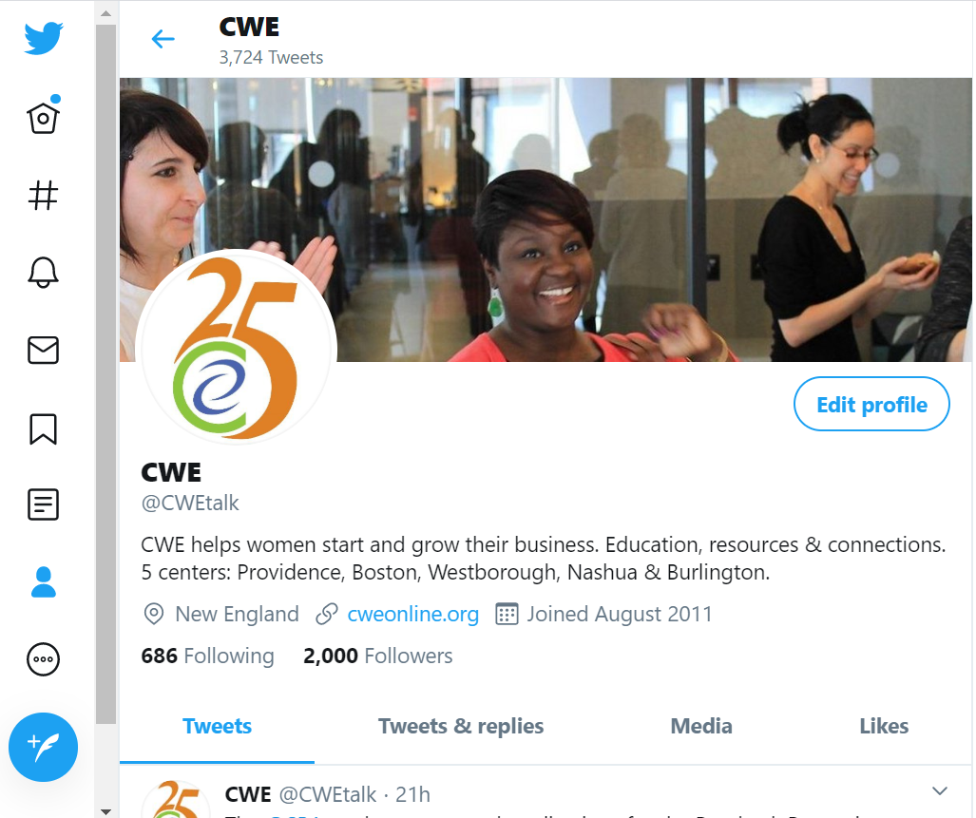

Slide 26
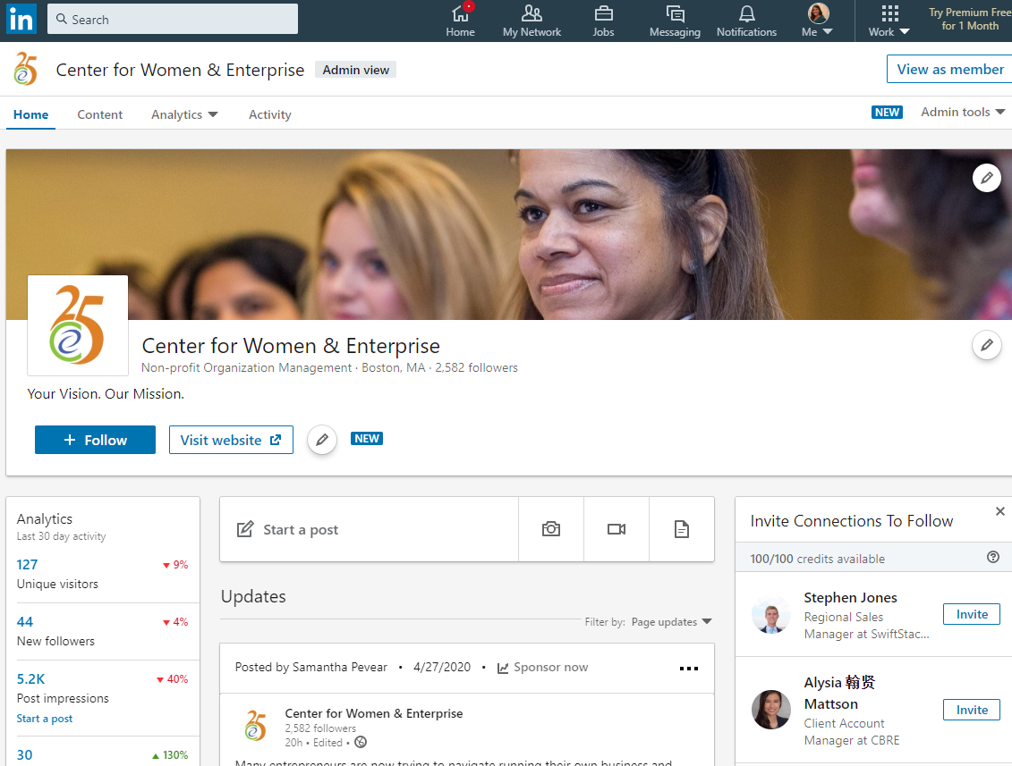

Slide 27
Time Saving Tools

Slide 28
Hootsuite (Manages Facebook, Twitter,
LinkedIn, Instagram, etc.)
Planoly (Instagram)
Constant Contact (Website builder, email social media manager and scheduler.)
Facebook has a built in scheduler

Slide 29
Other Helpful Tools

Slide 30
Canva – Pre-set templates for social
media posts
Pexels - Free, high quality stock photos

Slide 31
How Frequently / When to Post

Slide 32
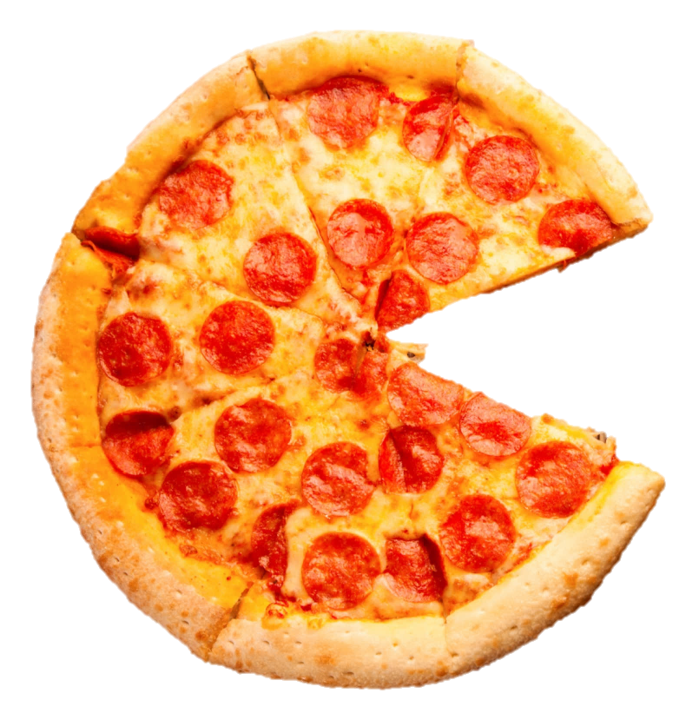
80%
valuable,
interesting
content
20%
Promotional Content

Slide 33
Facebook: At a minimum – 3 times/wk – best was 1/ day
Twitter: 3/day, 15/day, 30/day
Instagram: 1/day, suggested: 1-2
LinkedIn: 2/wk (minimum), ideal: 1/day

Slide 34
Types of Posts

Slide 35
Guidelines for Social Media
Use a variety of content (Original content, Shared content, images, videos, etc.)
Engage and educate your audience
No one wants to be sold to all of the time
Post, Measure, Adjust, Repeat

Slide 36
Original Content vs. Sharing Content
Original Content you create – promoting a new item, your space, about the owner, your story, etc. (Canva)
Sharing posts that are of interest to your clients – but tying it back to your business

Slide 38
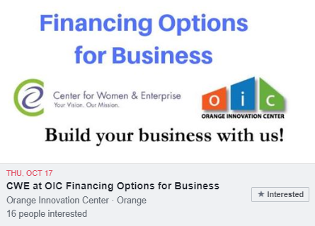
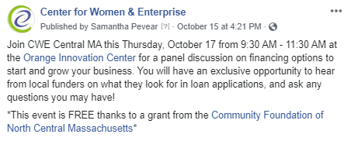

Slide 39
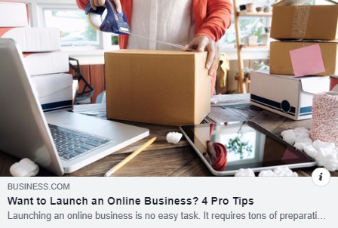
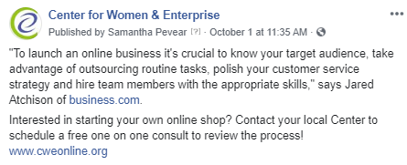

Slide 40
Posting During a Crisis

Slide 41
Items that are important to share via email
Inform your audience of pending changes
Highlight new hours
Inform new policy or procedures
Clarify if you have any service challenges
Provide company and employee COVID precautions
Ask to join mailing list for regular alerts
Give incentives to follow your social media profile
Showcase how you give back to your community
Notes:
Based on what we have talked about earlier, let’s break down that plan into a per email plan. Some of you may already be doing some of this, others may need to still take some of these actions.
Inform of changes in your day-to-day operations or modified hours
Highlight delivery, takeout options or non-touch interactions, if applicable
Clarify if you have any product/support availability challenges at this time
Tell customers how they can buy merchandise or gift cards from your company at this time

Slide 42
Social Media Best Practice
Share behind the scenes, how you have an impact, how you are helping
Remind social followers to sign up to email list for alerts on sales and special Use “pin to feed” for important info
Do not scheduled posts/tweets that may seem distasteful
Do not to bombard with too many posts
Notes:
<click>Try not to bombard your social followers with constant posts or updates. <click>Instead, use your social accounts to share promotions or donation requests, behind-the-scenes looks at how your business is adapting, and share local information to keep your community informed.
<click>Use your social accounts to remind people to sign up for your email list for the most up-to-date information about your business. Inversely, make sure that your social accounts are linked in your emails so your customers know how to get a hold of you in a pinch!
When it comes to what to write on social, keep your messages factual and to the point. Use the “pin to my feed” options on Facebook and Twitter so customers visiting your profile can quickly see your most important post.
Keep in mind that you should also be urging your customers to comply with social distancing and other CDC regulations.
Lastly, this is a good time to review any communications you may have already scheduled in order to determine their appropriateness and relevance based on the current state of affairs. Make sure to unschedule things that could come off as offensive or distasteful during this time.
If you use Constant Contact do know you do have access to a social management tool right in Constant Contact for no extra charge. I’ll show you how to use it in a moment.
So let’s now look at some real world social media examples

Slide 43
Be Conscious of the Current Climate
Right now may not be the best time to schedule your usual content
Talk about how your business is adapting in the current climate and/or how you are giving back

Slide 44
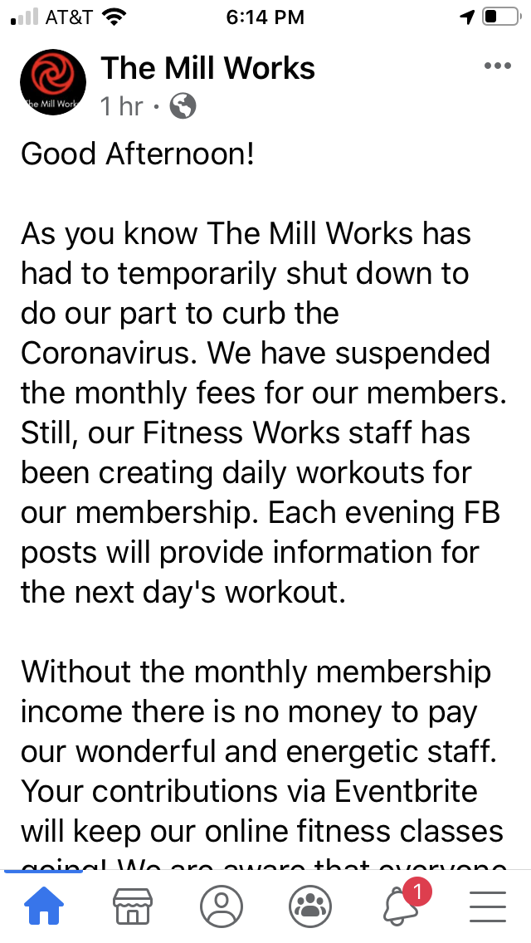
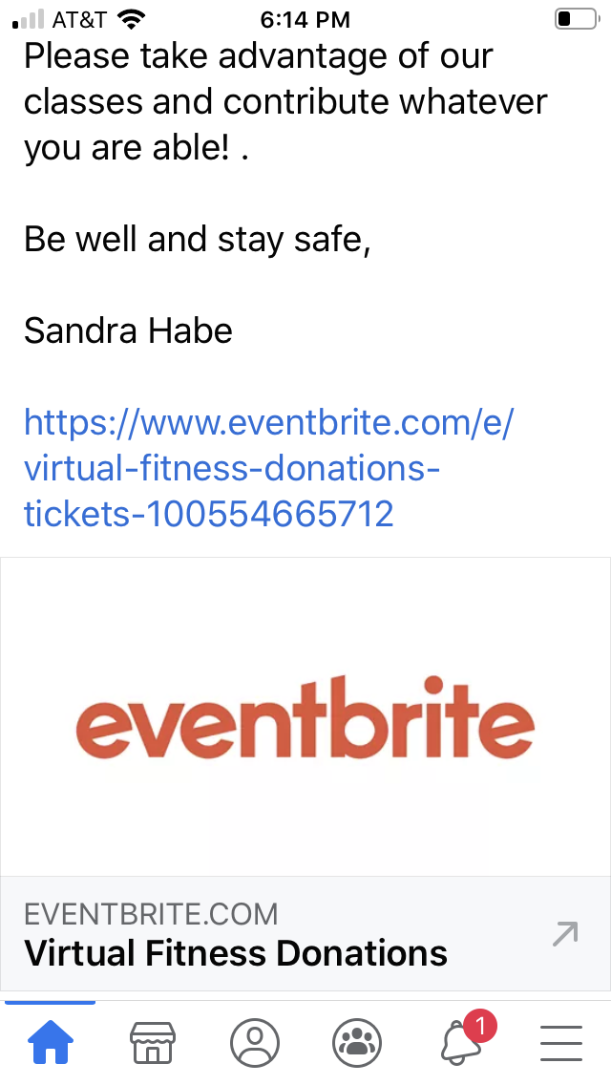
Social Post COVID example
Notes:
Here’s an example of a social post where the gym is doing several things. First The Mill Works, a gym, is updating followers on the change in availability, announcing they are offering online classes, as are many fitness organizations, but they are also soliciting donations to help pay the fitness experts that would otherwise lacking in in
<NOTE: Feel free to update or add examples you’ve worked on or have seen>

Slide 45
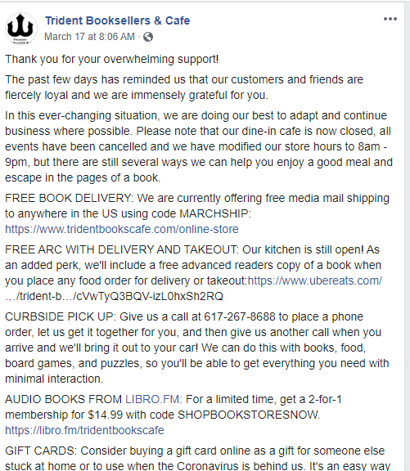
Social Post COVID example
Notes:
Trident Booksellers is doing a bit of all of it. It’s a bit much for a post, but I suspect they’ll carve out each of these initiatives into individual email and social posts. You can see that they are offering book delivery, book delivery with food delivery. Game and puzzle delivery (how much do we all need that in these days?)
They are also offering gift cards (thinking again about the future)

Slide 46
Example Posts
Queen Adeline Collections

Slide 47
Learn from Your Competition
What social medias are they utilizing?
What promotions have they done that have performed well?
Implementing any new/innovative social media strategies (i.e. going “Live on FB or Instagram, adding stories, etc.)

Slide 48
Questions & Answers
This Photo by Unknown Author is licensed under CC BY-SA

