Slide 1
Steps to Grow Your Business
David Michelson

Slide 2
Agenda
How to use our time together
Ways to think about growing your business
What really matters
Your action plan
Certifications
Q&A

Slide 3
How to use our time together
There’s no lack of material related to growing your business
Understand and practice the basics
Think about your business, customers, and your goals; listen for ideas that resonate with you
Consider conducting experiments versus making choices
Your journey is unique – your starting point, your goals, and your path to get there

Slide 4
Agenda
How to use our time together
Ways to think about growing your business
What really matters
Your action plan
Certifications
Q&A

Slide 5
Three ideas for you to consider
SWOT Analysis
Strategic planning
Business planning
Growth Planning

Slide 6
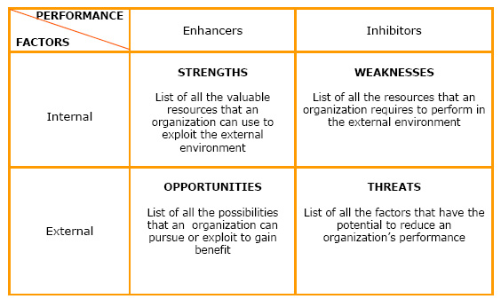
S W O T

Slide 7
BUSINESS PLAN: WHO? WHAT?
STRATEGIC PLAN: HOW? WHEN?
For new business looking to obtain funding /direct ops
Provides structure and ideas to define the business
Critical for funding
Tactical in nature
Outlook: typically up to 1 year
For existing organization serious about growth
Provides focus, direction, action
Critical to prioritizing resources to grow revenue and ROI
Strategic in nature
Outlook: typically 3-5 years

Slide 8
Strategic Planning Process

Slide 9
Strategic Plan
Create a 3-5 year detailed, concrete strategic plan
Begin with the end in mind – set clear ST and LT visions
Analyze current state - business structure, legal obligations, internal operations
Set explicit milestone goals with action items - be optimistic, but realistic
Compare results with goals, plans, budgets
Include risk mitigation strategies: disaster preparedness

Slide 10
Implementing a Strategic Plan
Vision, Mission, Values
Strategy
Culture
Structure
Execution
Metrics
People

Slide 11
Business Plan Process
Overview
Business Plan
(1 Year)
What do we need to believe to be true
Executive Summary
Company Description
Products & Services
Market Analysis
Competitor Analysis
Goals & Objectives
Financial Plan
Cash Flow requirements
Areas of Investment
Risk analysis
Assumptions
Risks
Organization & People
Culture

Slide 12
Business Plan
One year detailed plan of how you want the business to perform
It should support your strategic plan
Be sure to update the overview – things can change quickly
Set explicit milestone goals with action items - be optimistic, but realistic
Compare results with goals, plans, budgets
Include risk mitigation strategies: disaster preparedness

Slide 13
Growth Planning – The Ansoff Model
Market Development
Increase sales of existing products in new markets
Diversification
Develop and launch new products in unexplored markets
New
Markets
Market Penetration
Increase sales of existing products in current markets
Product Development
Launch new products in existing markets
Existing
Existing
New
Products

Slide 14
Tactical Growth Planning
Market Development
Research markets
Identify competitors
How to support
Conduct a series of tests
Diversification
High Risk
Adjacent products (i.e. paper & pencils)
Acquisition
New
Markets
Market Penetration
Introductory pricing
Loyalty programs
Referral bonus
Increase promotions
Social programs
Product Development
Add features & benefits
Investment in R&D
Joint Development
Utilize channel for other products
Existing
Existing
New
Products

Slide 15
Agenda
How to use our time together
Ways to think about growing your business
What really matters
Your action plan
Certifications
Q&A

Slide 16
What really matters . . .
Doing the basics
Embracing your brand
Being a thought leader
Building your network
Proof points & evidence
Living your metrics
“Plans are of little importance, but planning is essential.”
― Winston Churchill

Slide 17
What really, really matters . . .
Problem Solving
Empathy
Story telling
Creativity
Dependability
Willingness to learn
Avoiding imposter syndrome
“Luck Is What Happens When Preparation Meets Opportunity."
― Seneca, Roman philosopher

Slide 18
Agenda
How to use our time together
Ways to think about growing your business
What really matters
Your action plan
Certifications
Q&A

Slide 19
Action Plan
Develop your strategic plan
Create your business plan
Identify where you want to invest your time and resources
Develop experiments to test your ideas with customers
Analyze your results and experience
Expand positive outcomes, eliminate experiments with poor results (or adapt)

Slide 20
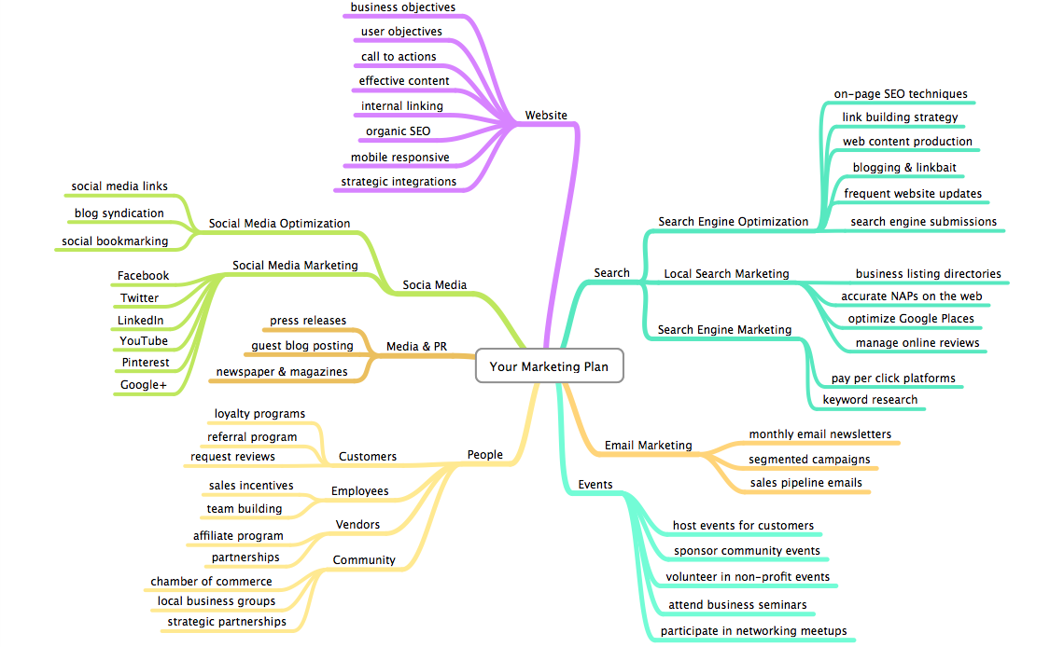

Slide 21
Focus on Existing Customers
Know who they are, keep them happy
What’s the customer experience like?
What is the customer journey?
Stay connected with them – increase frequency of communication/transaction
Up-sell and cross-sell (subtlety) -- get them to spend more
Engage them:
Feedback – ID new opportunities, issues (“Voice of Customer”)
Referrals
Testimonials

Slide 22
Ramp Up Marketing & Sales
Use VOC market research to refresh your marketing message
Generate awareness and demand
Personalize content
Don’t forget events and trade shows
Improve sales techniques
Create a Marketing Plan

Slide 23
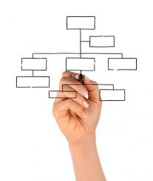
Develop Good Internal Systems
Build and sustain a company culture in line with vision
Build an organizational structure that makes sense
Assign the right people to the right jobs – match skills
Bring in new people; train existing staff; reassign/remove staff, if needed
Build “emotional capital” – keep yourself and employees motivated/ happy; maintain passion, enthusiasm
Track performance
“What you measure is what you get”
Closely monitor cash flow and control costs
Make everyone accountable

Slide 24
Leverage Technology
Automate wherever possible
Sales funnel, CRM
Accounting
Streamline and improve systems
Increase efficiency
Lower costs

Slide 25
Innovate/Enhance Products & Services
Enhance existing products & services
Add value to existing products & services
Reassess pricing
License products
Diversify: strategically develop new products & services

Slide 26
Identify New Sales Channels
More locations
Franchises
Internet Sales
New markets/customers (ex: government contracts)
Global expansion; export

Slide 27
Develop Partnerships & Alliances
Strategically leverage/expand existing relationships
Form alliances
Merge or acquire
Deepen vendor relations
Deepen relations with financial sources

Slide 28
Seek Professional Assistance
Know when to ask for help
Create an advisory board
Find a mentor

Slide 29
Agenda
How to use our time together
Ways to think about growing your business
What really matters
Your action plan
Certifications
Q&A

Slide 30
Is Certification Something to Consider?

Slide 31
What is a small business certification?
Official designation
Used primarily for contracting (e.g. getting a contract to clean facilities at a ballpark)
Enhances opportunities for diverse suppliers
Notes:
A “diverse supplier” is a small business that is at least 51% owned, operated and controlled by an individual or group that is part of a traditionally underrepresented or underserved group. Common examples are women-owned businesses, LGBT-owned businesses, minority-owned businesses, and businesses owned by people with disabilities.

Slide 32
VENDORS/SUPPLIERS
Non-diverse
Suppliers
DIVERSE SUPPLIERS
WOMEN
WBE
Corporations
DISABILITY
VETS
MINORITY
MBE
LGBTQ
CITY
/ LOCAL
SLBE
MWBE
VOSBE
STATE
FEDERAL
WBE (women)
MBE (ethnic minority)
DBE (disadvantaged)
WOSB (women/small)
VOSB (veteran)
DSDP (disabled)
LGBTBE (LGBT)
SLBE (small/local)
CERTIFICATION = ASSURANCE OF DIVERSE STATUS
WBE
MBE
DBE
CERTIFICATION
MAIN BENEFIT --> CONTRACTS
WOSB
Notes:
Let’s start off with an example of certifications as they are used in the area of contracting, which is the primary benefit of getting certified. Say you own a cleaning company. You may want to work with a large office building to be the one in charge of cleaning the offices every night. Whoever owns that building, may put out what is called a “Request for Proposals” or RFP. That means, they’re inviting cleaning companies to submit offers – what their price would be, what their level of service is, how many years they have been cleaning commercial spaces, etc. You’d submit your proposal, and the reviewer would compare it to others. One of the factors they consider, is whether you are certified as a diverse vendor, which can give you an advantage in the eyes of the reviewer.
This chart shows the “world of supplier diversity.” Basically, it’s comprised of vendors or suppliers, and purchasers. Small businesses are the vendors who sell stuff; purchasers are the entities which buy stuff.
The grey circle is all the vendors/suppliers in the U.S.
Some vendors are considered “diverse vendors”, which are businesses that are owned by people with disabilities, women, people of color, members of the LGBTQ community, veterans, and others not listed here.
Then there are public agencies and private companies that want to do business with diverse vendors (purchasers)
The KEY is that as a diverse vendor, although it may be very obvious to YOU, you cannot just walk up to one of these organizations or companies and say “you should do business with me, I’m diverse!” Because…how do they know that?
That’s where certification comes in. You get certified so that you can say, “you know I’m diverse because I’m certified.” It’s a ticket into the arena.
The advantage for you is that this arena is much smaller and so you are competing against fewer suppliers. Sometimes there are even set-asides, or projects, specifically for diverse vendors.
HERE’S WHERE IT GETS COMPLICATED. The world of certification is VERY CONFUSING because everyone is recognizing different certifications. For example, if your business is certified as woman-owned with WBENC, you are referred to as a WBE. If you are certified as woman-owned through the Commonwealth of Massachusetts, you are also referred to as a WBE, but the certifications are not the same.
So, you want to be sure, and we want you to be sure that you are applying for the certification /s that are most right for you. You can apply for several.

Slide 33
Supplier Diversity – Public v. Private Sector
Public Sector - federally mandated quotas/set-asides.
VS.
Private Sector - working with diverse vendors is optional.
Notes:
When you’re thinking about certification, you can think about it as falling into one of two major buckets – public, and private. Private sector is corporations. Public certification has three primary levels – federal, state and municipal (city/town) – each level recognizes different certifications.
There is a BIG DIFFERENCE between PUBLIC SECTOR certification and PRIVATE SECTOR certification.
In the public sector, there are federally & state mandates that require a certain amount of purchasing to be done with diverse vendors. In the private sector, THIS IS ENTIRELY OPTIONAL. They CHOOSE to do business with diverse vendors for a variety of reasons.
Once a private sector company chooses to do business with diverse vendors, generally what they do is set up a supplier diversity program, and then put a representative in charge of that program.
At the beginning of the year, they look at all that they have to spend for the entire company, and then they set goals, either by $ dollar, or more typically by % percent of total spend.
Then it becomes that representatives JOB to meet those goals.
So, they are self-imposed quotas, but they are motivated to do business with you.

Slide 34
Why get certified?
Potential advantage on contracting opportunities
Regional & national networking events – connect with purchasing entities that are looking for diverse suppliers (government/PTAC and corporate/WBENC)
Also connect with other women-owned businesses and other diverse suppliers
Brand recognition associated with certifications
Invitations to best practices webinars, workshops and conferences

Slide 35
Is it right for me?
Maybe!
To take full advantage of a certification, you need:
A business that is fully formed and operational (registered & making sales)
Proven ability to complete large/commercial jobs or deliver on large orders
Time to network, identify and bid on contracts

Slide 36
But, keep in mind:
Certification is NOT a guarantee that you will win a contract
Certification is NOT required in order to bid on contracts
Getting certified and leveraging that certification take significant time and resources, and it is not right for everyone
It can be an option to incorporate your woman-owned status into your marketing materials rather than getting a certification (just don’t use the official certification logos!)

Slide 37
Notes:
This is a chart of certifications.
Across the top we have WHO DO YOU WANT TO DO BUSINESS WITH: private sector companies? State? Federal gov’t?
And down the left side we have WHAT TYPE(S) OF DIVERSITY DOES YOUR OWNERSHIP REPRESENT?
It could be the case that many certifications are options for you and the important thing to remember is that none of these interfere with each other. We have many companies that have multiple certifications.
WHY? It could be advantageous to have multiple certifications as you may count doubly towards buyers’ goals if you are. So, it gives you a competitive advantage even in this smaller arena.

Slide 38
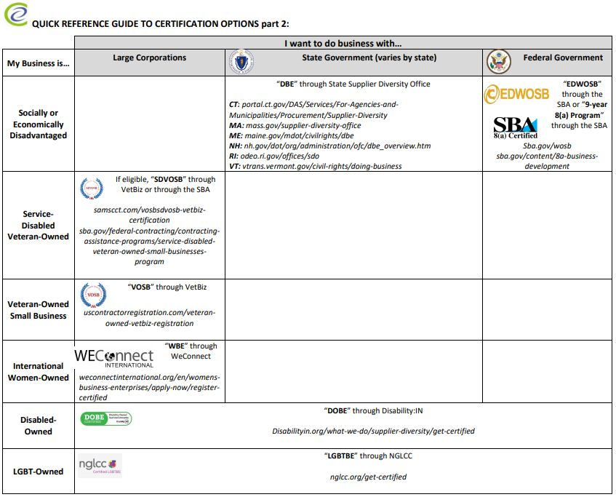

Slide 39
Questions?
For more information or to register for our other programs, please contact:
CWE Staff & Presenter Contact

