Slide 1
Opioid Abatement Working Group/ DivCare Community Advisory Board
January 28, 2026

Slide 2
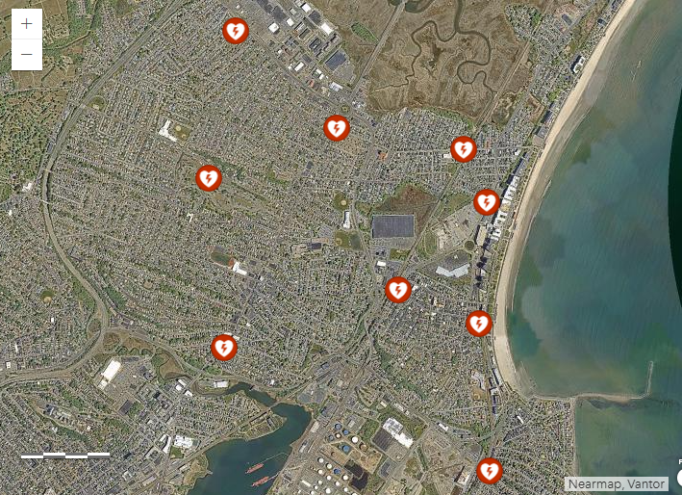
Review of the NaloxBox locations

Slide 3
Review of NaloxBoxes – Narcan Doses Taken

Slide 4
Month by Month Narcan Doses

Slide 5
Review of Opioid Contract – Fiscal Year 26 (1/2 way through)
Category of Expenditure | Amount of Expenditure | Specific Programs | Status
Housing | $48,500 | Sober Home/Detox Voucher Program | Atlantic Hill received contract. Status: Initial meetings, no vouchers awarded yet (1/2 was distributed, ½ in 3 months)
Housing | $48,500 | High-Intensity Case Manager | Atlantic Hill awarded contract. Status: Case Manager has started meeting with our team for referrals (Reimbursable by month)
Community Engagement/Prevention | $50,000 | R.A.W. (in conjunction with RIZE Grant) | Expended. (In conjunction with $50,000 matching grant we gave $46,500 to Revere Boxing, Revere PALS, $4,400 to a LICSW, and the rest on food & T-shirts)
Community Engagement/Prevention | $10,000 | Grief Support for Families affected by OUD | Expended – Just a Little Help received all the funding.
Community Engagement/Prevention | $13,000 | Continued Business –Narcan Outreach | Atlantic Hill received contract. Atlantic Hill is continuing to do outreach weekly and training monthly. (Reimbursed by month)
Harm Reduction | $8,000 | Basic Needs | Expended. JALH holds the funding.
Harm Reduction | $65,000 $33,143 | Street Medicine Contract | Contract awarded to Dr. Bunker- through MGH. ½ a year only, so contract was for $32,500. Started in January, in Revere once a week.

Slide 6
These are the outcomes we want to measure:
Program | Outcomes we want to measure | Agree or Disagree/ Other suggestions
Sober Home/Detox Bed Voucher Program ($48,500) | # of people placed using a voucher # of month’s that we’ve paid for Success stories
High-Intensity Case Manager ($48,500) | # of hours of case mgmt. # of individuals assisted Success stories
R.A.W ($50,000) | # of participating kids Scores on their Surveys (positive change?)
Grief Support ($10,000) | # of families assisted and amount spent on each
Continued Business Narcan Outreach ($13,000) | # of Narcan trainings completed # of individual staff trained # of Narcan given out
Basic Needs ($8,000) | Types of basic needs and total amount spent
Street Medicine ($65,000) | # of individuals served Types of care provided Success stories

Slide 7
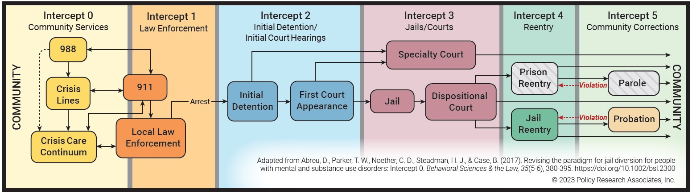
Sequential Intercept Mapping Review
What is Sequential Intercept Mapping?
SUDHI Office held a SIMS Conference on 1/14
Who was there??
What came out of the SIMS Conference?

Slide 8
Other Items
OAWG/DivCare Community Advisory Board – stipends
Not Eligible for stipends: City Employees, Contracted City Employees, anyone contracted with the City for Opioid Funding
Eligible for stipends: Those attending the OAWG/DivCare CAB meetings with lived experience or those in the workforce
What is the stipend: It will always be a $50 gift card to Market Basket.
After this meeting we will have them available at the date of the meeting.
437 Revere Street Update
Showers- any ideas??
Warming Center and PIT Count

