Slide 1
Cancer Screening
A Review of Guidelines for Primary Care
Armand Auger, MD
Maine Dartmouth Family Medicine Residency
Maine Academy of Family Physicians
April 4, 2024

Slide 2
Objectives
1. Review the characteristics of a good screening test
2. Review the current guidelines for the most common types of cancer
3. Summarize the most recent updates for cancer screening and helpful resources

Slide 3
Conflict of Interest Statement
I have no financial or commercial support for this presentation. I have no actual or possible conflicts of interest that would affect the quality or content of this or any other presentation.
The intent of this presentation is solely and entirely educational. Most of the content is evidence based. Where it is not, that will clearly be stipulated.
I may occasionally refer to specific resources, products or tests by their trade name or general name and this reference does not constitute an endorsement of any specific product or test.

Slide 4
Cancer Screening - Content
Qualities of a good screening test
Common epidemiology principles
Grade of recommendation
Most common types of cancer and cancer death
Specific cancer screening guidelines
  Breast cancer
  Cervical cancer
  Colorectal cancer
  Lung cancer
  Prostate cancer
Summary of most recent cancer screening updates and helpful resources

Slide 5
Cancer Screening – Screening Tests
Qualities of a good screening test:
A. Disease related
  The condition should be an important health problem
  There should be sufficient prevalence of morbidity and mortality to make screening of value
  There should be a recognizable latent stage and early symptomatic stage
  The natural history of the condition should be adequately understood
  There should be recognized treatment for patients with the disease
  Facilities for diagnosis and treatment of the disease should be available
(1)

Slide 6
Cancer Screening – Screening Tests
Qualities of a good screening test
B. Test related
  Suitable test or examination with a high degree of accuracy (specificity/sensitivity)
  The test should be acceptable to the population (and clinicians)
  The cost of the test and diagnostics and treatment should be acceptable
  There should be an agreed upon policy for whom to screen and treat
  Screening should be a continuing process
  Data should be systematically evaluated on an ongoing basis to determine the efficacy, timing, and patient population that should be screened
(1)

Slide 7
Cancer Screening – Common Epidemiologic Terms
Sensitivity – the ability of a test to correctly identify a person with the disease (positive in disease).
Specificity – the ability of a test to correctly identify a person without disease (negative when disease free).
A seNsitive test has few false Negatives. SNOUT-sensitivity rules out
A sPecific test has few false Positives. SPIN – specificity rules in

Slide 8
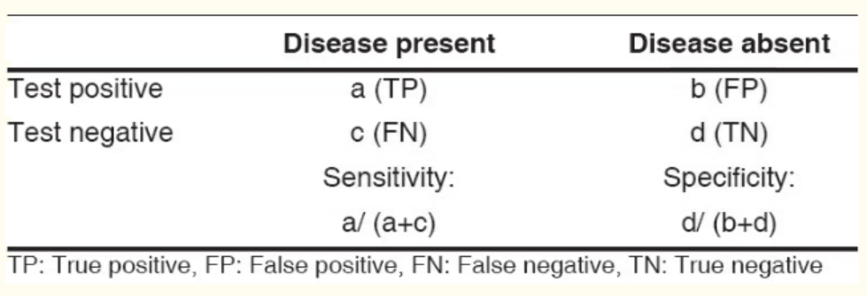
Cancer Screening – Common Epidemiologic Terms
(2)

Slide 9
Cancer Screening – Common Epidemiologic terms
Positive predictive value (PPV) – the percentage of patients with a positive test who have the disease
Negative predictive value (NPV) – the percentage of patients with a negative test who do not have the disease (healthy)

Slide 10
Cancer Screening – Common Epidemiologic terms
PPV = a/a + b
NPV = d/c + d (2)

Slide 11
Number Needed to Treat/Harm
Number needed to treat (NNT): The number of patients who would have to receive the treatment in order to benefit 1 patient. Calculated as 1/ARR (absolute risk reduction). (i.e. finding early lung cancer by low dose chest CT screening)
  This number is generally higher in cancer screening compared with drug treatment due to the longitudinal nature of screening and is related to the prevalence of the disease in a given population.
Number needed to harm (NNH): The number of patients who would have to receive a treatment in order for 1 of them to receive an adverse effect. Calculated as 1/ARI (absolute risk increase)
  The number of patients who have a colonoscopy for 1 to experience a complication. The number is usually very high.
(3)

Slide 12
Cancer Screening – Grade of Recommendation
United States Preventive Services Task Force (USPSTF) – most common source of practice based screening guidelines
Other sources: American Cancer Society, AAFP, ACOG, ACS
Grade of Recommendation: A, B, C, D, I
Level of Certainty: High, Moderate, Low
(4)

Slide 13
Cancer Screening – Grade of Recommendation - USPSTF
A – USPSTF recommends, high degree of certainty, substantial net benefit
B – USPSTF recommends, high degree of certainty that the net benefit is moderate or moderate certainty that the benefit is moderate to substantial
C- USPSTF recommends selectively offering the screening/service based on professional judgment and patient preference. Moderate certainty
D – USPSTF recommends against, moderate to high certainty that the screening service provides no net benefit or that harm outweighs benefit
I – USPSTF concludes that there is insufficient evidence to balance the harm vs. benefit
(4)

Slide 14
Cancer Screening - Most Common Types of Cancer and Cancer Death in the US
1.9 million people diagnosed with cancer in the US (2021 estimates)
608,570 deaths from cancer estimated in 2021
Male > female
Maine is above the US average for cancer incidence and cancer death, especially due to lung cancer
Black/African American patients have the highest cancer death rate of all races

Slide 15
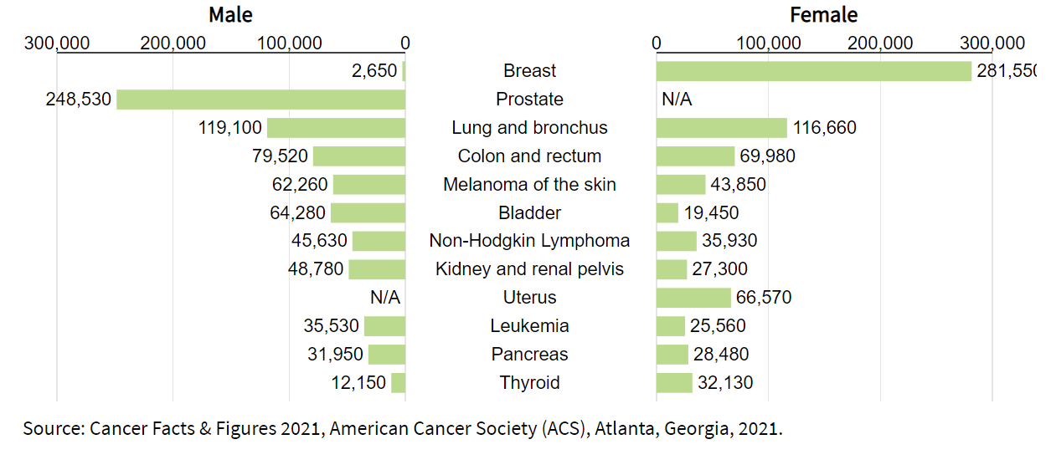
Cancer Screening - Most Common Types of Cancer in the US
(5)

Slide 16
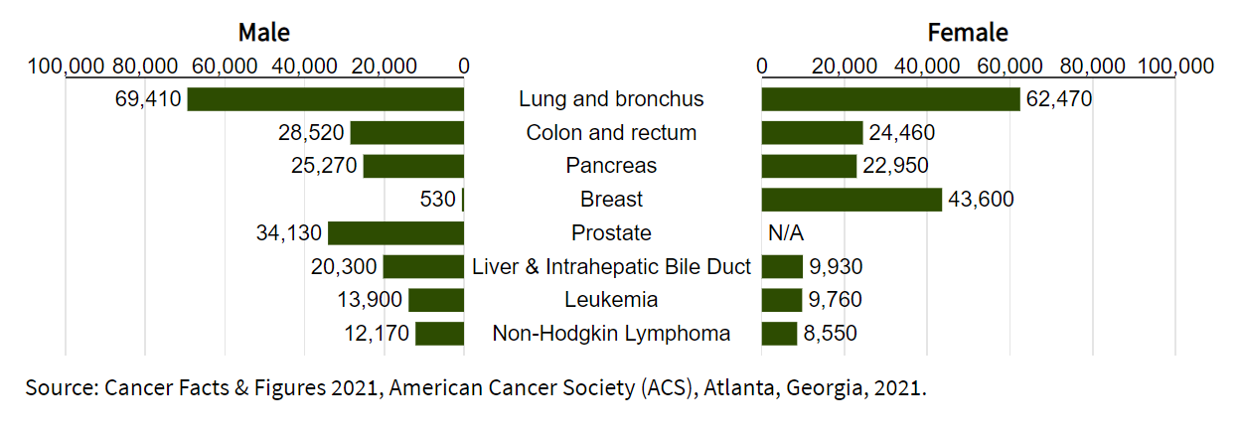
Cancer Screening - Most Common Types of Cancer Death in the US
(5)

Slide 17
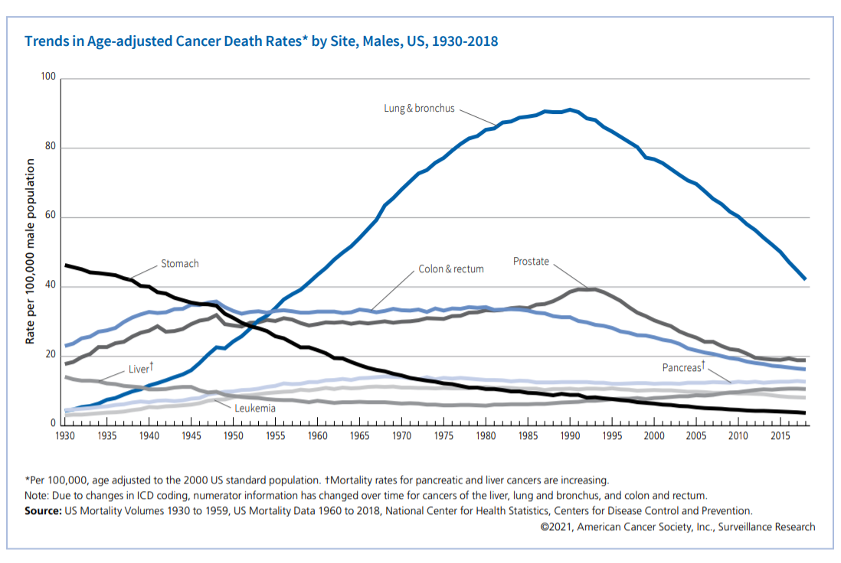
Cancer Death Rate –Historical Trends- Male
(5)

Slide 18
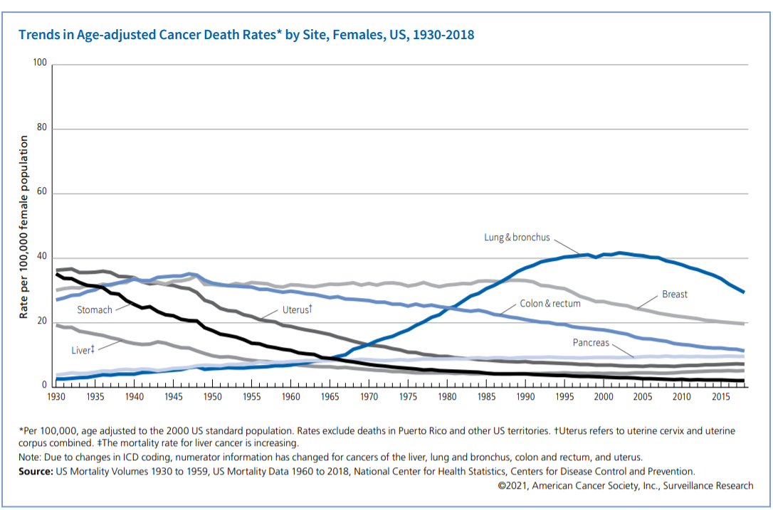
Cancer Death Rate –Historical Trends- Female
(5)

Slide 19
Breast Cancer
Estimated new breast cancer (female) cases 2021: 281,550
Estimated new breast cancer (female) deaths 2021: 43,600
Breast cancer incidence is essentially unchanged at 130.0/100,000 in 1992 compared with 128.8/100,000 in 2018
Breast cancer deaths have improved from 31.6/100,000 in 1992 compared with 19.8 in 2018
Improved treatment, regular screening and early detection are the most significant factors for improved mortality
(6)

Slide 20
Breast Cancer Survival
(6)

Slide 21
Cancer Screening Guidelines –
Breast Cancer-USPSTF
The USPSTF recommends biennial screening for women age 50-74 at average risk for breast cancer
Grade B
The decision to start screening mammography before age 50 should be an individual one, women who place a greater benefit of screening over risks if screening may choose to begin screening at age 40-49
Grade C
(7)

Slide 22
Cancer Screening Guidelines –
Breast Cancer-USPSTF
For women of average risk for breast cancer, most of the benefit of screening occurs between age 50 and 74
Of this group those who are age 60-69 years are the most likely to avoid breast cancer death through breast cancer screening
While screening between age 40-49 may avert some breast cancer death, the number is smaller compared with older women
In addition to false positive results and unnecessary biopsy, all women are at risk for diagnosis and treatment of non-invasive (and even invasive) breast cancer that would not have become a threat to their health or even apparent in their lifetime.
Women with a parent, sibling or child with breast cancer may benefit more than average risk women from beginning screening in their 40s.
(7)

Slide 23
Cancer Screening Guidelines –
Breast Cancer-USPSTF
Pending Final Review/Update
USPSTF will likely move the biennial screening age down to age 40 (Evidence level B) –from age 50
Other information:
No change in screening modality for patients with dense breasts (Category c or d) but may be an independent risk factor in early studies – may potentially affect screening interval. This does not contradict specific follow up recommendations for an individual patient (especially high risk) with a specific abnormality, where advanced studies may be appropriate.
Mortality for breast cancer is higher in black patients

Slide 24
Cancer Screening Guidelines
Breast Cancer-USPSTF
All women: The USPSTF concludes that evidence is insufficient to assess benefits and harm of digital breast tomosynthesis (DBT) as a primary screening method for breast cancer screening.
Grade I
Women with dense breasts: The USPSTF concludes that there is insufficient evidence to evaluate the benefits vs. harm of using breast ultrasonography, MRI, DBT or other methods for women identified as having dense breasts on an otherwise negative screening mammogram
Grade I
The USPSTF concludes that evidence is insufficient to assess the benefit vs. harm for routine screening mammography in women age 75 and older
Grade I
(7)

Slide 25
Cancer Screening Guidelines
Breast Cancer
USPSTF:
Age 40-49 Grade C: Individualized decision, may begin early if the woman places greater value in potential benefit over potential harm, or if higher risk for developing breast cancer (i.e. family history of a first degree relative)
Age 50-74 Grade B: recommended every 2 years
Age > 75 Grade I: insufficient evidence
DBT: Grade I insufficient evidence for digital breast tomosynthesis
Dense breasts Grade I: Insufficient evidence for MRI or DBT
Clinical breast exam: Insufficient evidence
*Recent abnormal mammogram will influence the frequency of screening
*Revised guidelines in progress to review impact of frequency, screening modality and when to initiate screening and its impact on morbidity, mortality (breast cancer and all cause), diagnosis of advanced breast cancer and impact on harms of screening)
(7)

Slide 26
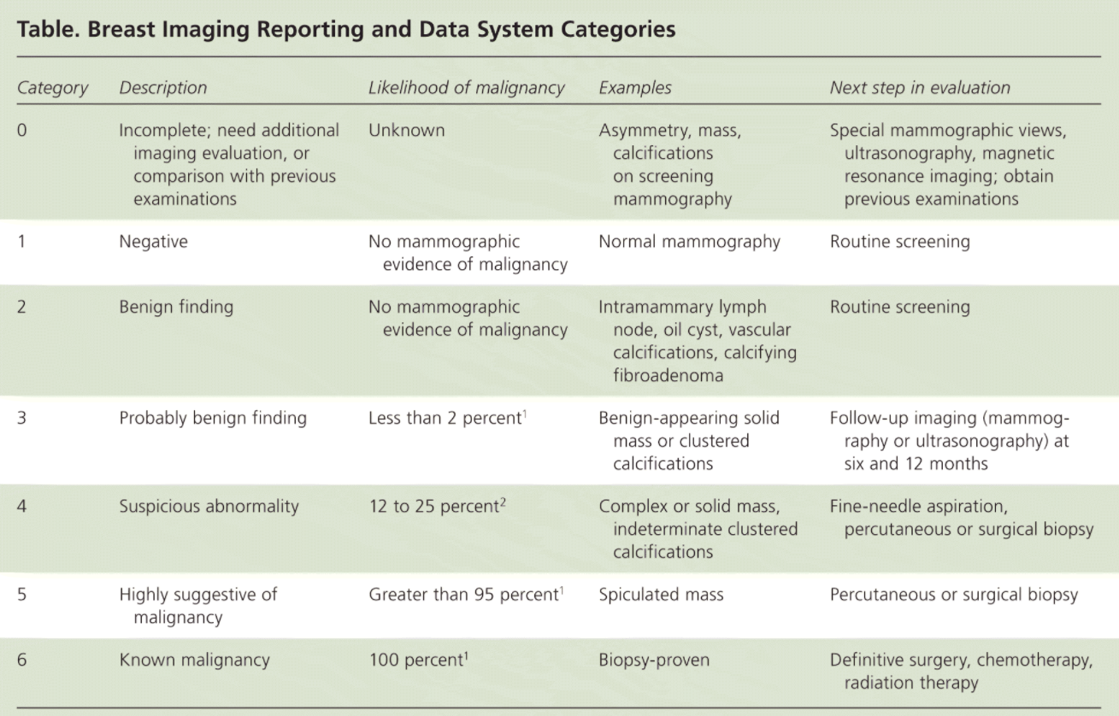
Cancer Screening Guidelines –
Breast Cancer-BI-RADS interpretation
(8)

Slide 27
Cancer Screening Guidelines
Breast Cancer
American Cancer Society:
Age 40- 44: Women should have the choice for early screening, consider benefits vs. risks
Age 45-54: annual mammography recommended
Age 55- 75: every 2 years mammography if low/standard risk, but may continue annual screening if chooses or high risk
Age > 75: may continue screening as long as they are in good health and have an expected 10 year life expectancy
Clinical breast exam – not recommended for low risk women
(9)

Slide 28
Cancer Screening Guidelines
Breast Cancer and Genetic Screening-USPSTF
Women with a personal or family history of breast, ovarian, tubal or peritoneal cancer or whose ancestry is associated with BRCA1 or 2:
The USPSTF recommends assessment of women with the above risks be screened with a brief risk assessment tool and if a positive result a referral for genetic counseling should be made. If indicated after the genetic assessment, genetic testing should be offered.
Grade B
For women whose personal or family history is not associated with the BRCA 1 or 2 gene mutation:
The USPSTF recommends against routine risk assessment, genetic counseling or genetic testing for BRCA 1 or 2
Grade D
(10)

Slide 29
Breast Cancer and Medication Use for Risk Reduction-USPSTF
Women at increased risk for breast cancer age 35 years and older: The USPSTF recommends that clinicians offer to prescribe risk-reducing medications (tamoxifen, raloxifene or aromatase inhibitor) to women at increased risk for breast cancer and lower risk for side effects.
Grade B
Women not at increased risk for breast cancer age 35 years or older: The USPSTF recommends against routine use of risk reducing medications (tamoxifen, raloxifene and aromatase inhibitors) for women not at increased risk for breast cancer.
Grade D
(11)

Slide 30
Cancer Screening Guidelines
Breast Cancer
AAFP: similar to USPTF
Age 40-49: Individual decision to start screening, the woman places higher value of potential benefits over potential risks
Age 50- 74: mammography screening every 2 years
Age >75: Insufficient evidence to balance benefits vs. harms
Clinical breast exam: insufficient evidence to recommend for or against annual screening
(7)

Slide 31
Cancer Screening Guidelines
Breast Cancer
Risk factors for breast cancer:
Age > 50
BRCA1 and BRCA 2 mutation
Reproductive history: menarche before age 12, menopause after age 55
Personal history of breast cancer
History of non-cancerous abnormalities (Atypical hyperplasia, lobular carcinoma is situ - LCIS)
Family history of breast or ovarian cancer (1st degree relative)
Previous treatment with radiation therapy before age 30
DES exposure or prolonged HRT
Dense breasts lowering diagnostic yield of mammography

Slide 32
Breast Cancer Screening – WISDOM study
WISDOM: Women Informed to Screen Depending On Measures of risk
Funding National Cancer Institute, several other quality assurance and private health foundations
100,000 patients- multicenter trial to assess breast cancer screening recommendations, over at least 5 years (possibly 10 years)
Control group: Annual mammography
Experimental group: Personalized screening approach based on risk factors and personal/family health history
(21)

Slide 33
Cervical cancer
Estimated new cervical cases 2021: 14,480
Estimated new cervical cancer deaths 2021: 4,290
Cervical cancer incidence has decreased from 11/100,000 in 1992 to 7/100,000 in 2018
Cervical cancer death has decreased from 3.5/100,000 in 1992 to 2.2/100,000 in 2018
HPV vaccine and regular Pap smears are essential at reducing mortality as 5 year survival form advanced cervical cancer remains low
(13)

Slide 34
Cervical Cancer Survival
(13)

Slide 35
Cancer Screening Guidelines
Cervical Cancer
ACS/ASCCP:
  Cervical Cancer screening should begin at age 25
  Those age 25-65 should have a primary HPV test every 5 years or a Pap with HPV every 5 years or a Pap alone every 3 years if HPV testing is not available
  May discontinue screening at age 65 if there has been adequate screening in the past 10 years (3 negative tests every 5 years) and/or no h/o CIN 2 or greater in the past 25 years
  For patients with a hysterectomy, cervical cancer screening may stop unless the reason for the hysterectomy was cervical cancer or advanced pre-cancer (CIN 2 or 3).
  Supra-cervical hysterectomy- screen as above normally
(14)

Slide 36
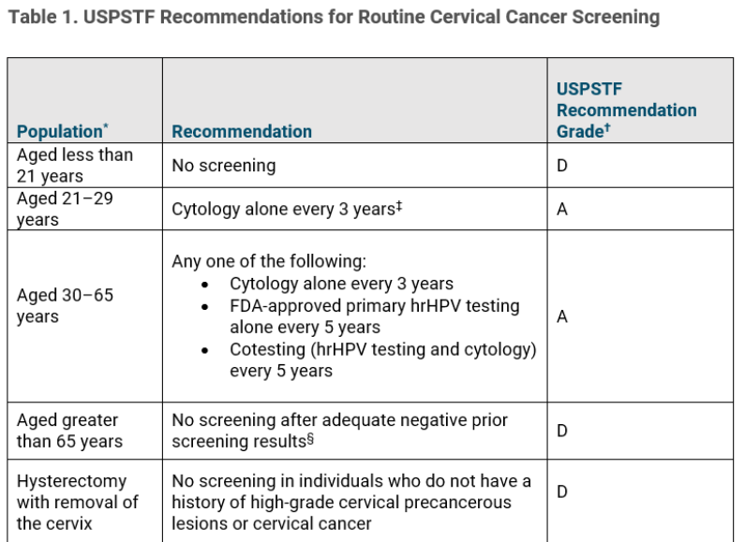
Cancer Screening Guidelines
Cervical Cancer –USPSTF and ACOG
(15)
*USPSTF is currently updating guidelines likely to follow ACS/ASCCP recommendations

Slide 37
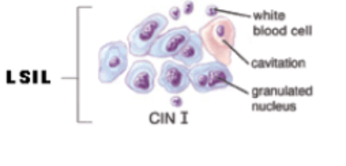
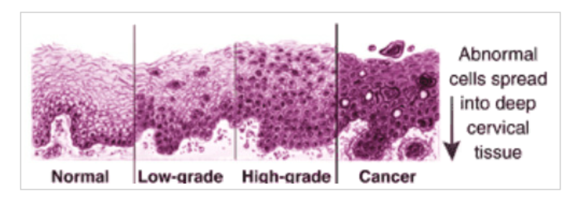
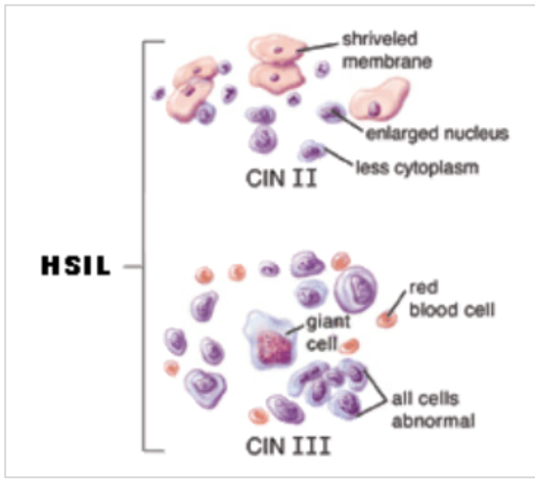
Cancer Screening Guidelines
Cervical Cancer
Progression from normal to cancer
Cytopathology
(16)

Slide 38
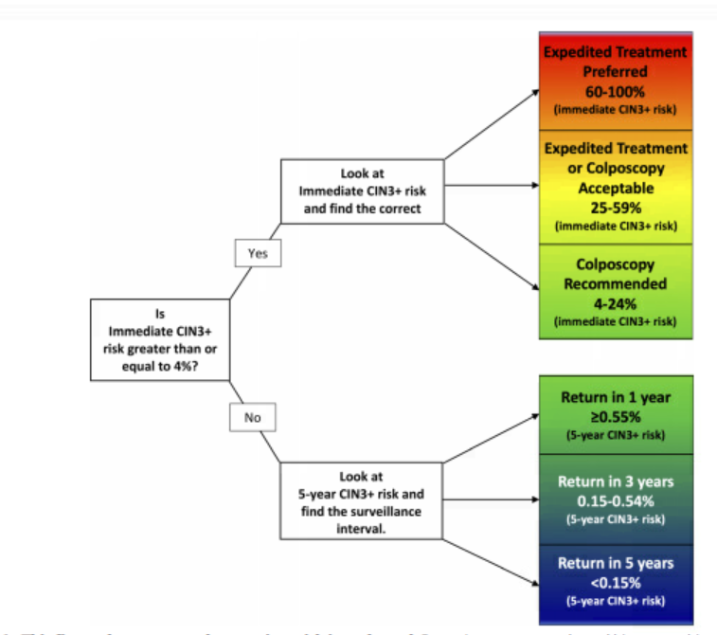
Cancer Screening Guidelines
Cervical Cancer – Risk based follow up
(17)

Slide 39
Cancer Screening Guidelines
Cervical Cancer
Summary:
  Follow up of abnormal Pap/HPV based on risk for CIN 3
  ASCCP guidelines and especially the ASCCP App. are the best reference to determine patient specific screening/management approach
  Generally, HPV status and CIN 3 risk influence necessity for colposcopy and/or frequency of follow up Pap/HPV
  This is evolving, USPSTF, AAFP and ACOG likely to follow the ACS/ASCCP revised guidelines
  For patients making the transition to screening from age 21 to 25, follow up any abnormal result as you normally would

Slide 40
Cancer Screening Guidelines
Cervical Cancer Prevention
HPV vaccination is highly effective
Potential for saving thousands of lives for cervical, anogenital and head and neck cancer
Current CDC guidelines:
Start at age 11-12: (allowed at age 9)
If before age 15: 2 doses at time 0 and 6-12 months
If > age 15- 26: 3 doses at time 0, 1-2 months and 6-12 months
Ages 26-45: May offer to patients, especially if risk factors for HPV

Slide 41
Colon Cancer
Estimated new colon cancer cases 2021: 149,500
Estimated new colon cancer deaths 2021: 52,980
Colon cancer incidence decreased from 56.7/100,000 in 1992 compared with 34.8/100,000
Colon cancer deaths have improved from 23.6/100,000 in 1992 compared with 13.1 in 2018
(18)

Slide 42
Colon Cancer Survival
(18)

Slide 43
Cancer Screening Guidelines
Colon Cancer
Adults aged 50-75: The USPSTF recommends colorectal cancer screening for all adults aged 50-75.
Grade: A
Adults aged 45-49: The USPSTF recommends colorectal cancer screening for all adults aged 45-49.
Grade: B
Adults aged 76-85: The USPSTF recommends clinicians selectively offer colorectal cancer screening in adults aged 76-85. The net benefit is small and clinicians should consider the patient’s health, screening history and preferences.
Grade C
*Age is now 45 for beginning colorectal cancer screening, this is NEW!
(19)

Slide 44
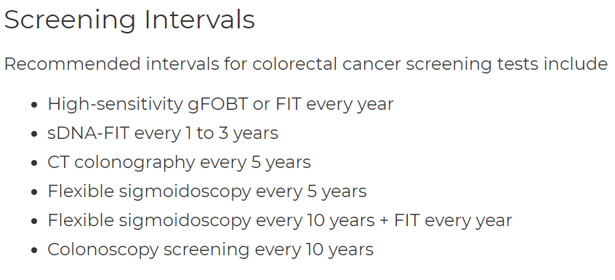
Cancer Screening Guidelines
Colon Cancer-Screening Method-Standard Risk
(19)

Slide 45
Cancer Screening Guidelines
Colon Cancer
ACS recommends beginning colon cancer screening at age 45
AAFP endorses USPSTF guidelines
USPSTF determines magnitude of benefit from screening:
  Age 50-75 substantial benefit
  Age 45-50 moderate benefit
  Age 75-85 small benefit

Slide 46
Cancer Screening Guidelines
Colon Cancer-Low/Standard Risk Patients
Non-invasive screening:
High sensitivity Guaiac Fecal Occult Blood Test (hs-FOBT) based on a chemical reaction, dietary restrictions required not as sensitive or specific
FIT – fecal immunochemical test – detection of occult blood by an immunochemical reaction
MT-sDNA or sDNA-FIT – Multi-targeted stool DNA or stool DNA-FIT test looking for genetic sections of cancer cells or adenomatous polyp cells found in stool. (20)
Fecal DNA testing was 92% sensitive and 87% specific, FIT testing was 74% sensitive and 95% specific (21,22)

Slide 47
Cancer Screening Guidelines
Colon Cancer – High Risk Patients
Increase frequency of screening based on personal risk for colon cancer:
  Screening MUST be by colonoscopy.
  FIT or sDNA-FIT, flexible sigmoidoscopy NOT adequate
  Personal history of colon CA – usually at year 1 then every 3-5 years depending on findings
  Family history of colon CA (begin age 40 or 10 years before the diagnosed family member, whichever is first)
  Personal history of adenomatous polyps (every 3-5 years depending on findings: type, size and number of polyps found)
  Personal history of inflammatory bowel disease (i.e. Crohn’s disease, ulcerative colitis), usually much more frequent screening, especially if established disease, usually every 1-2 years
  Any familial polyposis, genetic syndrome (i.e. Lynch syndrome) every 1 year colonoscopy

Slide 48
Cancer Screening Guidelines
Colon Cancer - Prevention
Colon Cancer Prevention
  Dietary (higher fiber diet, less animal fats)
  Smoking cessation
  Limit alcohol
  Possibly exercise and low dose ASA in appropriate patients

Slide 49
Cancer Screening Guidelines
Colon Cancer - Prevention
Adults aged 50-59 with a 10% or greater 10 year risk of CVD: The USPSTF recommends initiating low dose aspirin for prevention of cardiovascular disease (CVD) and colorectal cancer (CRC) who have a 10% or greater 10 year risk of CVD, have a 10 year life expectancy and do not have an increased risk of bleeding. *needs to be taken for 10 years for benefit
Grade: B
Adults aged 60-69 with a 10% or greater 10 year risk of CVD: The decision to initiate low dose aspirin for prevention of cardiovascular disease (CVD) and colorectal cancer (CRC) who have a 10% or greater 10 year risk of CVD should be individualized. Patients who have a 10 year life expectancy, do not have an increased risk of bleeding and are willing to take this for the full 10 years may have a potential benefit. Patients should place a higher value on the potential prevention benefits over the potential harm.
Grade C
(23)

Slide 50
Cancer Screening Guidelines
Colon Cancer - Prevention
Adults younger than 50 years: The current evidence is insufficient to assess the balance of benefits and harms of initiating aspirin use for the primary prevention of CVD and CRC for adults younger than 50 years.
Grade: I
Grade: I
Adults aged 70 years or older: The current evidence is insufficient to assess the balance of benefits and harms or initiating aspirin use for primary prevention of CVD and CRC for adults aged 70 years or older.
(23)

Slide 51
Lung Cancer
Estimated new lung cancer cases 2021: 235,760
Estimated new lung cancer deaths 2021: 131,880
Lung cancer incidence decreased from 67.0/100,000 in 1992 compared with 43.2/100,000
Lung cancer deaths have improved from 58.9/100,000 in 1992 compared with 34.8 in 2018
*Smoking cessation/rates, early detection and improved treatment are the most significant factors for the reduction of lung cancer rates and death.
(24)

Slide 52
Lung Cancer Survival
(24)

Slide 53
Cancer Screening Guidelines
Lung Cancer
Adults aged 50 to 80 years who have smoked 20 pack years and currently smoke or have quit within the past 15 years: The USPSTF recommends annual screening with low dose computer tomography (LDCT) for adults aged 50 to 80 who have a 20 pack year smoking history or have quit within the last 15 years. Screening should be discontinued once a person has not smoked for 15 years or develops a health problem that substantially limits life expectancy or ability or willingness to undergo curative lung surgery.
Grade: B
*This is new! The age range has been expanded to age 50-80 and the smoking history threshold has been lowered to 20 pack years.
(25)

Slide 54
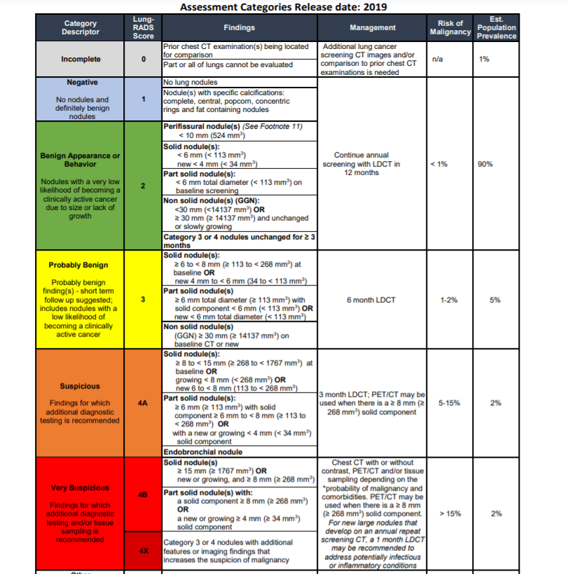
Cancer Screening Guidelines –
Lung Cancer-Lung RADS interpretation
(26)

Slide 55
Cancer Screening Guidelines
Lung Cancer
Lung Cancer screening: additional information
Offer screening to patients age 50 – 80 with a greater than 20 pack year smoking history
Continue annual screening until age 80 or until the patient has quit smoking for >15 yrs.
Follow up annually, meticulous follow up of abnormalities more frequently needed.
Informed/shared decision making for benefits, risks, harms and need for follow up
Ideally the patient should be a candidate for definitive treatment (i.e. Surgery- stage 1 or early stage 2 disease) but the role of immunotherapy and advances in radiation therapy may still offer benefit to those who are at advanced age and not optimal surgical candidates
Always offer tobacco cessation counseling and treatment
Lung cancer screening and tobacco cessation offers very significant potential for reduction in morbidity and mortality as lung cancer is the #1 cause of cancer death in the US for males and females, especially in Maine!

Slide 56
Cancer Screening Guidelines
Lung Cancer - Prevention
Non-pregnant adults: The USPSTF recommends clinicians ask all adults about tobacco use, advise them to stop using tobacco, and provide behavioral interventions and FDA approved pharmacotherapy for cessation to non-pregnant adults who use tobacco.
Grade A
Pregnant adults: The USPSTF recommends clinicians ask all adults about tobacco use, advise them to stop using tobacco and provide behavioral interventions for cessation to pregnant persons who use tobacco.
Grade A
(27)

Slide 57
Cancer Screening Guidelines
Lung Cancer - Prevention
The USPSTF concludes that the current evidence is insufficient to assess the balance of benefits and harms of pharmacotherapy interventions for tobacco cessation in pregnant persons.
Grade I
The USPSTF concludes that the current evidence is insufficient to assess the benefits and harms of electronic cigarettes (e-cigarettes) for tobacco cessation in adults including pregnant persons. The USPSTF recommends that clinicians direct patients who use tobacco to other tobacco cessation interventions with proven effectiveness and established safety.
Grade I
(27)

Slide 58
Prostate Cancer
Estimated new prostate cancer cases 2021: 248,530
Estimated new prostate cancer deaths 2021: 34,130
Prostate cancer incidence decreased from 234.3/100,000 in 1992 compared with 106.8/100,000
Prostate cancer deaths have improved from 39.2/100,000 in 1992 compared with 18.9 in 2018
*The improved mortality occurred likely as a result of diagnosis at an earlier stage and improved screening. Less PSA testing did not generally result in increased mortality.
(28)

Slide 59
Prostate Cancer Survival
(28)

Slide 60
Prostate Cancer Screening Guidelines
Men age 55-69 years: The decision to undergo periodic prostate specific antigen (PSA) screening should be an individual one. There is a small potential benefit of reducing the chance of death from prostate cancer in some men. However many men will experience potential harms including false positive results, additional testing, prostate biopsy and over-diagnosis and treatment with complications.
Grade C
Men aged 70 years and older: The USPSTF recommends against screening for prostate cancer in men 70 years and older.
Grade D
(29)

Slide 61
Cancer Screening Guidelines
Prostate Cancer Screening
Practical considerations:
  Age 55-69 years old have a small mortality benefit but increased harm from diagnostic tests and treatment (urinary incontinence, erectile dysfunction, unnecessary biopsy)
  Always review risks vs. benefits, evidence is very limited
  Clinical considerations: new or worsening urinary symptoms, abnormal prostate exam if a DRE is done, family history of prostate cancer dx < age 60 or family history of someone who died from prostate CA, unexplained bone pain or high calcium/alk. phos. (not really screening here), higher mortality for black/African American patients –uncertain if inherent risk in addition to health care disparity

Slide 62
Prostate Cancer Screening
Survival is very good for localized and regional prostate cancer
Determination of potential for aggressive disease is complex (stage at diagnosis, Gleason Grade, PSA value).
Gleason Grade (score) is between 2-10. A biopsy is assigned a score from 1-5 depending on the grade of the tumor, 1 the least aggressive, 5 the most aggressive. The score is derived from the 2 biopsies with the most involved cancer (Gleason score of 7 = 3+4). Gleason score 6= favorable, 7= mostly favorable, 8-10= potentially aggressive/life threatening. Most prostate cancer is at least Grade 6.
The PSA value alone is not an adequate predictor of prostate cancer vs. BPH and aggressive vs. indolent prostate CA.
As always, evaluation of a urologic complaint and/or screening of high risk patients may offer some value.
(30)

Slide 63
Cancer Screening Guidelines –
Screening Not recommended
Pancreatic Cancer
Ovarian Cancer
Thyroid Cancer
Testicular Cancer
All are USPSTF Grade D – recommended against, moderate to substantial evidence that there is no benefit or harm may outweigh benefit
This applies to general screening
This does not include follow up/surveillance of a specific abnormality

Slide 64
COVID Impact on Cancer Screening and Treatment
The full impact of COVID on cancer screening and diagnosis is not yet known. A theoretical concern is the diagnosis of certain cancers at later stages due to delay of routine screening and necessary tests
The effect of COVID for patients with cancer can be serious, many are immunocompromised and susceptible to more serious illness even if vaccinated
An active COVID illness can delay or interrupt cancer treatment
COVID vaccinations are always advisable. An “extra dose” is advised for patients with an active hematologic malignancy, previous bone marrow/stem cell transplant –especially within 2 years, and anyone treated with immunosuppressive medications (most chemotherapy and many types of immunotherapy).

Slide 65
Cancer Screening Guidelines –
Conclusion/ Take Home Points
Recent updates to the USPSTF Guidelines for colon cancer and lung cancer both expanded the eligibility and/or reduced the age for which screening is started
For colon cancer screening: begin screening average risk patients at age 45 (decreased from age 50)
For lung cancer screening: begin screening at age 50 (decreased from age 55) through age 80 (increased from age 77) for a patient who has a history of smoking 20 pack years (decreased from 30 pack years) for current smokers or patients who have quit within 15 years (unchanged)
Next expected revisions are for breast cancer screening and cervical cancer screening (both in progress)

Slide 66
Cancer Screening Guidelines –
Conclusion/ Take Home Points
USPSTF is the general resource most should follow as a foundation for preventive health care as primary care providers. Learn the common guidelines well.
Frequently cited by the ABFM for certification/re-certification exam
Consider screening intervals to be the floor and not the ceiling, most listed are for average/standard risk patients. Talking with your patients and shared decision making is very important
Finally, patients at high risk for a specific malignancy either by genetic mutation, strong family history or specific risk factors may require more frequent screening (i.e. mammography, colonoscopy screening intervals)

Slide 67
Cancer Screening Guidelines –
Resources
National Cancer Institute: National Institute of Health https://www.cancer.gov/
CDC Cancer for Health Care Providers: https://www.cdc.gov/cancer/health-care-providers/resources.htm
American Cancer Society : Helpful resource for patient education. https://www.cancer.org/
US Preventive Service Task Force: https://www.uspreventiveservicestaskforce.org/uspstf/topic_search_results?topic_status=P&searchterm
App: ASCCP – Cervical Cancer Screening and Follow up Guide ($)
App: Prevention Task Force (USPSTF)

Slide 68
References
1. Wilson JMG, Jungner G. Principles and practices of screening for disease. Geneva, Switzerland: World Health Organization; 1968. Report No.: Public Health Papers No. 34. Available from: http://whqlibdoc.who.int/php/WHO_PHP_34.pdf.
2. Indian J Ophthalmol. 2008 Jan-Feb; 56(1): 45–50
3. Barratt A, Wyer P, et al. The Evidence-Based Medicine Teaching Tips Working Group. Tips for learners of evidence-based medicine: 1. Relative risk reduction, absolute risk reduction and number needed to treat. CMAJ August 17, 2004 171 (4) 353-358; DOI: https://doi.org/10.1503/cmaj.1021197
4. Grade Definitions. U.S. Preventive Services Task Force. October 2018.
5. Cancer Facts & Figures 2021, American Cancer Society (ACS), Atlanta, Georgia, 2021. In National Cancer Institute, 2021
6. Cancer Stat Facts: Female Breast Cancer. Surveillance, Epidemiology, and End Result Program, National Cancer Institute, National Institute of Health, 2022. https://seer.cancer.gov/statfacts/html/breast.html
7. Breast Cancer Screening Guidelines, USPSTF, 2018.
8. Guide to Mammography Reports: BI-RADS Terminology, Am Fam Physician. 2010 Jul 15;82(21):114-115.

Slide 69
References
9. Breast Cancer Screening Guidelines in American Cancer Society, 2020.
10. Breast Cancer Screening and Genetic Testing, USPTF, 2019.
11. Breast Cancer Medication use and Risk Reduction, 2019.
12. The WISDOM Study in https://www.thewisdomstudy.org/
13. Cancer Stat Facts: Cervical Cancer. Surveillance, Epidemiology, and End Result Program, National Cancer Institute, National Institute of Health, 2022. https://seer.cancer.gov/statfacts/html/cervix.html
14. Elizabeth T. H. Fontham MPH, DrPH, et al. Cervical cancer screening for individuals at average risk: 2020 guideline update from the American Cancer Society. CA. 2020; 70(5):321-346. In the ASCCP Guidelines for Cervical Cancer Screening, 2020.
15. USPSTF Cervical cancer screening Guidelines, 2018 in Updated Cervical Cancer Screening Guidelines, ACOG Clinical Guidelines, 2021.
16. Cervical dysplasia, in Johns Hopkins Medicine, 2021.

Slide 70
References
17. 2019 ASCCP Risk-Based Management Consensus Guidelines for Abnormal Cervical Cancer ScreeningTests and Cancer Precursors, Journal of Lower Genital Tract Disease • Volume 24, Number 2, April 2020.
18. Cancer Stat Facts: Colorectal Cancer. Surveillance, Epidemiology, and End Result Program, National Cancer Institute, National Institute of Health, 2022. https://seer.cancer.gov/statfacts/html/colorect.html
19. Colorectal Cancer: Screening, USPSTF, 2021.
20. Imperiale TF, Ransohoff DF, Itzkowitz SH, et al. Multitarget stool DNA testing for colorectal-cancer screening. N Engl J Med.. 2014; 370( 14): 1287– 1297.
21. Colorectal Cancer Screening Tests. https://www.cancer.org/cancer/colon-rectal-cancer/detection-diagnosis-staging/screening-tests-used.html. 2022.
22. Ebell M. Accuracy of Fecal DNA and Fecal Immunochemical Test for Colorectal Cancer Detection. Am Fam Physician. 2014 Sep 1;90(5):326a-331.
23. Aspirin Use to Prevent Cardiovascular Disease and Colorectal Cancer: Preventive Medication, USPSTF, 2016.
24. Cancer Stat Facts: Lung and Bronchus Cancer. Surveillance, Epidemiology, and End Result Program, National Cancer Institute, National Institute of Health, 2022. https://seer.cancer.gov/statfacts/html/lungb.html

Slide 71
References
25. Lung Cancer: Screening, USPSTF, 2021.
26. Lung RADS Classification System, 1.1, 2019, American College of Radiology.
27. Tobacco Smoking Cessation in Adults, Including Pregnant Persons: Interventions, USPTF, 2021.
28. Cancer Stat Facts: Prostate Cancer. Surveillance, Epidemiology, and End Result Program, National Cancer Institute, National Institute of Health, 2022. https://seer.cancer.gov/statfacts/html/prost.html
29. Prostate Cancer: Screening, USPSTF, 2018.
30. Prostate Cancer: Tests to Diagnose and Stage Prostate Cancer, in American Cancer Society, 2022. https://www.cancer.org/cancer/prostate-cancer/detection-diagnosis-staging/how-diagnosed.html

Slide 72
Thank you!

