Slide 1
Opioid Overdose Rescue (Part 1)
9:30am-12pm
Friday, January 24, 2025

Slide 2
WELCOME & INTRODUCTIONS

Slide 3
Go-Around Introductions!
Tell us...
Your name & pronouns
Your role or what brings you here
Last TV show you loved or hated

Slide 4
Group Agreements
Be prepared to be called on and share
Take space, make space
Four virtual walls
Be mindful of lived/living experience
Be
open-minded
Anything else?

Slide 5
AGENDA & OBJECTIVES
Part 1: Overdose Rescue

Slide 6
Part 1: Agenda for Opioid Overdose Rescue
Welcome & Introductions
What are opioids?
How to Assess for an Opioid Overdose
Overdose Response & Naloxone Administration Scenarios
Part 1 Closing & Break
What is Naloxone & How does it Work?

Slide 7
Part 1: Learning Objectives
Name 5 risk factors for opioid overdoses
Distinguish between someone who is “really high” versus overdosing
Describe how to assess for opioid overdose
Practice overdose response and how to administer Naloxone
Explain how Naloxone works to reverse opioid overdoses

Slide 8
Language Matters
SAY THIS:
NOT THIS:
Language is powerful —especially when talking about addictions. Stigmatizing language perpetuates negative perceptions.
"Person first" language focuses on the person, not the disorder.
Person who uses drugs/with a substance use disorder
Person living in recovery
Person living with an addiction
Person arrested for drug violation
Chooses not to at this point
Medication is a treatment tool
Had a setback, resumed use
Maintained recovery
Positive drug screen
Addict, junkie, druggie, abuser
Ex-addict or reformed addict
Battling/suffering from an addiction
Drug offender
Non-compliant/bombed out
MAT is replacement addiction
Relapsed
Stayed clean
Dirty/failed drug screen

Slide 9
WHAT ARE OPIOIDS?

Slide 10
What are Opioids?
Natural Opioids
Chemical compounds that are extracted or refined from natural plant matter such as the opium poppy.
Examples:
Opium
Morphine
Codeine
Semi-synthetic Opioids
Synthesized from natural opioids.
Examples:
Heroin
Hydrocodone
Hydromorphone
Oxycodone
Oxymorphone
Buprenorphine
Synthetic Opioids
Synthesized to have opiate-like effects. Not naturally occurring.
Examples:
Fentanyl
Methadone
Tramadol

Slide 11
Fentanyl: Know the Facts
It's potent and fast-acting.
Fentanyl is 50x stronger than heroin and 100x more powerful than morphine.
It has a stronger affinity and binds faster to the body's opioid receptors than other opioids,
It's omnipresent.
Fentanyl is administered in medical settings, but today it often shows up as an illicitly manufactured street drug, cheaper to produce than other drugs like heroin.
In MA, many street drugs, including non-opioids like cocaine, have been found contaminated with fentanyl. However, there is no evidence to support this risk for cannabis use.
It's safe to respond to a fentanyl overdose.
You cannot overdose from touching fentanyl.
Being in a room where powder fentanyl is present poses little to no risk of exposure via air.
Notes:
1) Lowman & LeFauve, 2003, 2) (Griffith, Ober Allen, & Gunter, 2011; Shavers, Klein, & Fagain, 2012) 3) Ali, McWhirter, & Chronister, 2005; Diemer & Blustein, 2007). (Jacobson, Robinson, Bluthenthal, 2007; Saloner & Cook, 2013).

Slide 12
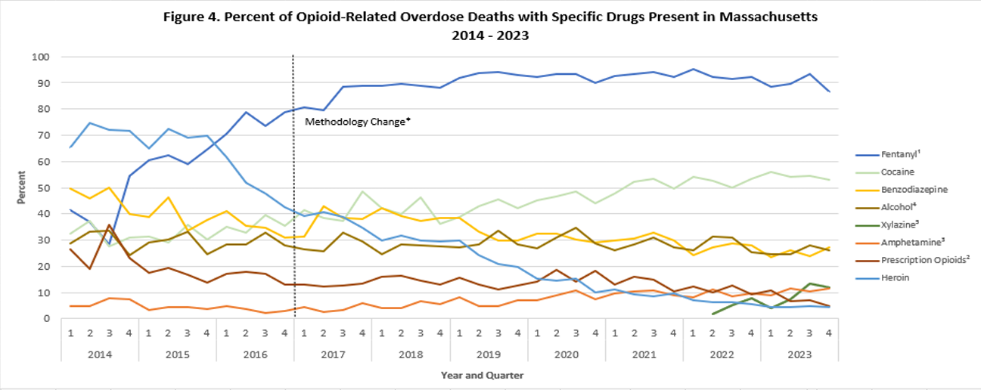
Data Brief
Percent of Opioid-Related Overdose Deaths with Specific Drugs Present
Massachusetts Residents: 2014-2023
-MA Department of Public Health, June 2024

Slide 13
What is Xylazine (ZIE-LUH-ZEEN)?
Xylazine is marketed as a veterinary tranquilizer that produces sedative-like effects. It is becoming more frequently found in the drug supply. It is NOT an opioid.
Although naloxone can treat an opioid overdose, it does not affect xylazine. Always administer naloxone during suspected overdose events and call 911.
With large doses, xylazine depresses breathing, slows heart rate, and induces low blood pressure. There is an increased risk for overdose and death when xylazine is found in combination with other sedating drugs like opioids.
~1/3 of drug samples contained Xylazine
DPH advises people who use drugs to not use alone. Taking turns when using can prevent simultaneous overdose. Ensuring adequate wound care is also important as Xylazine can cause serious skin ulcers, wounds, and skin infections.
Since November 2021, about 1/3 of drug samples that have been tested in the Boston area have contained Xylazine. Nearly all cases where Xylazine was detected, fentanyl was present as well (MA Drug Supply Data Stream (MADDS).
Xylazine appears as a BROWN or WHITE powder and cannot be detected by routine toxicology tests.

Slide 14
RISK FACTORS FOR OVERDOSE

Slide 15
Small Group Brainstorm
For someone who is using opioids, what are some specific risk factors for overdose?
E.g. Not knowing the source of the drugs they're using
*Please designate one person to take notes and share back with the large group*

Slide 16
Risk Factors for an Overdose
of Medicine
Risk Factors for Substance Use

Slide 17
Risk Factors for an Overdose
In the first 2 weeks post-release, a person’s risk for death by drug overdose is 129 times the risk for the general population.
-New England Journal of Medicine
A period of abstinence including a period of sobriety, treatment stay, hospitalization, or incarceration
Moving to or getting drugs in a new city or neighborhood
New dealer or source
Mixing opioids with other depressants like alcohol or Benzodiazepines
New route of administration
Poor physical health
Previous overdose
Using by yourself increases risk of fatal overdose

Slide 18
HOW TO RECOGNIZE AN OVERDOSE

Slide 19
Video: Signs of an Overdose
Notes:
https://www.youtube.com/watch?v=__AJv68xtxU

Slide 20
Recognizing an Overdose
Really High
Muscles become relaxed
Speech is slow and slurred
Sleepy looking
Nodding
Will respond to stimulation like yelling, sternal rub, pinching, etc.
Overdose
1. Non-responsive to sounds and/or touch:
Loud sounds (e.g. calling the person’s name) or appropriate physical stimulation (e.g. sternal rub) is ineffective in rousing the individual.
2. Very infrequent or no breathing:
Death rattle (shallow snoring, gurgling) or labored breathing and slow heartbeat/pulse.
3. Skin color:
White or fair skin: individuals’ skin, eyelids, nail beds and lips turn blue. Black or brown skin: individuals’ skin turns grey, their lips turn grey or purple and the nail beds turn a vivid white color.
Other potential symptoms: Wooden Chest Syndrome
IF REALLY HIGH: Stimulate and observe
IF OVERDOSING: Give Naloxone and perform rescue breathing

Slide 21
BREAK

Slide 22
WHAT IS NALOXONE?

Slide 23
How does Naloxone work in the body?
Notes:
https://www.youtube.com/watch?v=RcAaZQQqd50

Slide 24
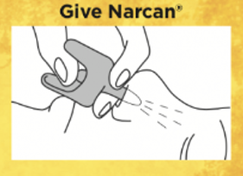
What is Naloxone?
Reverses overdose in ~3-5 minutes
Lasts ~30-90 minutes
No side effects
No potential for misuse or addiction
Store at room temperature (68°F to 77°F)
Check the expiration date regularly
Expired naloxone is effective
Single-step nasal spray Naloxone

Slide 25
Naloxone Distribution Sites & Opioid Resources in MA
BOSTON Boston Public Health Commission, AHOPE 774 Albany Street 617-534-3976 Mobile Outreach 617-592-7828
BROCKTON Brockton Area Multi-Services, Inc. The COPE Center 81 Pleasant Street 508-583-3405
CAMBRIDGE Fenway Health AIDS Action Committee Access: Drug User Health Program at Green Street 359 Green Street 617-599-0246
FALL RIVER Seven Hills Behavioral Health 310 South Main Street 508-235-1012
Stanley Street Treatment and Resources
386 Stanley Street
508-324-3561
GREENFIELD Tapestry Health 277 Main Street #404a 413-773-5403 |Syringe Access Program – Greenfield 8 Church Street 413-475-3377
HOLYOKE Tapestry Health 15A Main Street 413-315-3732 Holyoke Health Center 230 Maple Street, lower level 413-420-2200
HYANNIS AIDS Support Group of Cape Cod 428 South Street 508-778-1954
HULL Manet Community Health Center 180 George Washington Blvd. 857-939-4108
LAWRENCE Greater Lawrence Family Health Center, Prevention & Education Dept. 100 Water Street 978-685-7663
LOWELL Lowell Community Health Center 161 Jackson Street 978-937-9700 Lowell House 101 Jackson Street 4th Floor 978-459-8656
LYNN Health Innovations, Inc Healthy Street Outreach Program 100 Willow Street, 2nd floor 339-440-5633
NEW BEDFORD Seven Hills Behavioral Health 1173 Acushnet Avenue 508-996-0546
NORTH ADAMS Tapestry Health MCLA Wellness Center 289 Church Street 413-443-2844 or 413-662-5258
NORTHAMPTON Tapestry Health 16 Center Street, Suite 423 413-586-0310
ORANGE Center for Human Development 131 West Main Street 978-544-2148, option 4
PITTSFIELD Tapestry Health 100 Wendell Avenue Suite 1 413-443-2844
PROVINCETOWN AIDS Support Group of Cape Cod 336 Commercial Street, Unit 10 508-487-8311
QUINCY Manet Community Health Center 110 West Squantum Street 617-376-3000
REVERE North Suffolk Mental Health Association 265 Beach Street 617-912-7700
SPRINGFIELD Tapestry Health 1985 Main Street 413-363-9472
WORCESTER AIDS Project Worcester 85 Green Street (Entrance in rear, off Plymouth St.) 508-755-3773 x 27
PHARMACY ACCESS You can get naloxone from a pharmacy without a prescription, under a standing order. Please call or visit a local pharmacy for more information.
LEARN TO COPE 508-738-5148 Naloxone is available at support groups for family members dealing with a loved one suffering from addiction. Please go to www.learn2cope.org for meeting locations and times
MA HEALTH PROMOTION CLEARINGHOUSE Free education materials https://massclearinghouse.ehs.state.ma.us/
MA SUBSTANCE USE HELPLINE https://helplinema.org 800-327-5050
Locations may change. Be sure to check here or www.mass.gov/narcan for the most up-to-date information.

Slide 26
Community Naloxone Purchasing Program (CNPP)
Learn more and apply: https://www.mass.gov/service-details/community-naloxone-purchasing-program-cnpp
The Massachusetts Department of Public Health recently expanded the types of agencies eligible to purchase naloxone through the State Office of Pharmacy Services (SOPS).
To purchase naloxone through SOPS, an agency must apply to become an “affiliate program” of CNPP.
Those eligible to apply include BSAS-licensed or funded treatment programs, criminal justice personnel, and more. You can find a full list of those eligible here: https://www.mass.gov/news/order-of-the-commissioner-of-public-health-allowing-statewide-standing-order-for-community-dispensing-of-naloxone

Slide 27
RESPONDING TO AN OVERDOSE

Slide 28
[ONLINE] Group Activity – Order the Steps
Directions: How would you handle this? With your group, review the scenario and steps in the chat box, and discuss what order you think these steps should be in. Be prepared to share with the rest of the group.

Slide 29
[ONLINE] Overdose Rescue Scenario
Put the following steps in order:
Grab naloxone from the kit under the sink and administer it to Jason
Assess Jason for symptoms of overdose
Place Jason in the rescue position (rolled over on his side) while you meet first responders at the door
Call 911 and give a detailed account of the situation, including your specific location
Begin rescue breathing with the CPR face shield you have in your pocket
Jason has an appointment with you for 9am this morning to talk about possible work opportunities. He arrives an hour late for the appointment and doesn’t seem himself. You ask if he’s okay and he says he’s fine, that he just really needs to use the bathroom. You walk him to the restroom and per your bathroom policy, you start the timer for 5 minutes. The timer goes off and Jason is still inside. You knock loudly and call out his name, but there’s no response. After another loud knock and calling his name, you announce that you’re coming inside. You push open the door to find Jason unconscious on the floor and his lips and fingertips have started turning blue.
How would you respond?

Slide 30
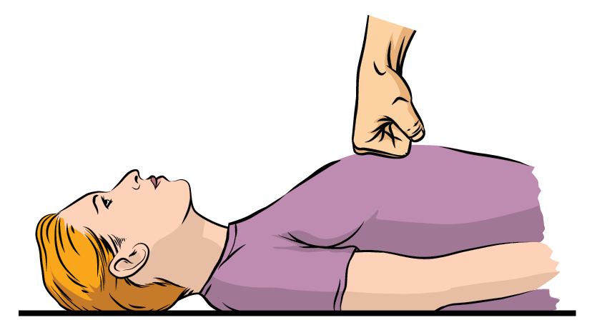
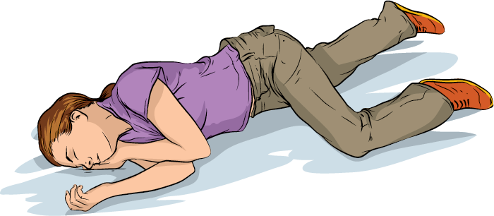
Responding to an Overdose
Sternal Rub
1
Recognize overdose
2
Call 911
3
Administer naloxone as soon as available
4
Rescue Breathing
Begin rescue breathing or CPR compressions
Recovery Position
5
Stay with the person until help arrives (place in recovery position if they start breathing)

Slide 31
Rescue Breathing
1
Open the airway
2
Pinch the nostrils
Cover their mouth with yours and form a seal
3
4
1 breath every 5 seconds; watch for chest to rise and fall
5
Continue giving rescue breaths until first responders arrive
Notes:
https://www.youtube.com/watch?v=CHWQJfRz-jE

Slide 32
[IN-PERSON] Group Activity – Role Play Scenario
Directions: How would you handle this? With your group, review the scenario and steps to responding to an overdose. Then, perform a role play simulating how you would respond to the given scenario as demonstrated by the facilitators.

Slide 33
Overdose Rescue Scenario
Jason has an appointment with you for 9am this morning to talk about possible work opportunities. He arrives an hour late for the appointment and doesn’t seem himself. You ask if he’s okay and he says he’s fine, that he just really needs to use the bathroom. You walk him to the restroom and per your bathroom policy, you start the timer for 5 minutes. The timer goes off and Jason is still inside. You knock loudly and call out his name, but there’s no response. After another loud knock and calling his name, you announce that you’re coming inside. You push open the door to find Jason unconscious on the floor and his lips and fingertips have started turning blue.
How would you respond?

Slide 34
Good Samaritan Law
Protection
These laws generally protect people when calling 911 or intervening during a medical emergency. Specifically, they typically grant immunity from arrest, charge, or prosecution for controlled substance possession and paraphernalia offenses, when a person overdoses or a person attempts to rescue another person overdosing by seeking help. Limitations
The Good Samaritan Law does have limitations. You can be arrested for possessing the following, also known as the “3 Ws”:
Weapons
Warrants (out for someone’s arrest)
Weights (large quantities of drugs)

Slide 35
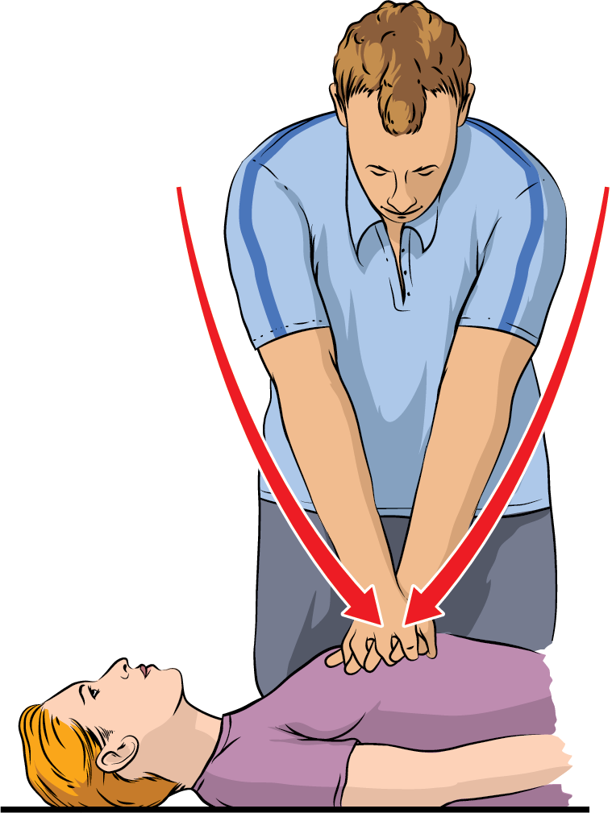
Overdose Rescue & COVID-19
RESPONSE OPTIONS (DEPEND ON TRAINING & AVAILABILITY)
Minimum
Call 911
Administer naloxone
Best Practice
Call 911
Administer naloxone
Wear PPE
Use Bag-Valve Mask to
perform rescue breathing
Receive proper training, and practice to maintain skills
Perform chest compressions
Maintain CPR certification
Performing mouth-to-mouth rescue breathing on an individual to whom you have not been exposed increases risk of COVID-19 transmission.
Chest Compression

Slide 36
During and After an Overdose...
Call 911. Let EMT's know where you are.
Clear the space and alert site directors/building security of the emergency.
Keep track of time between naloxone doses. Give a does every 3-5 minutes, with rescue breathing in between (one big breath every 5 seconds).
Have one person wait outside for emergency responders – give them a detailed account of what has happened when they arrive.
Debrief with staff. A traumatic incident just happened and allowing a space to process and debrief is vital!
What else feels important during and after an overdose?

Slide 37
CLOSING

Slide 38
Training & Technical Assistance Offerings
See all offerings at: behereinitiative.org/resources
13 Training Offerings (all 3 hours or under)
3 Technical Assistance Workshops
SCHEDULING OPTIONS
To learn more or schedule a training for your staff, contact: Michael Leonard (mleonard@hria.org) or call 443.610.2616
For a full schedule of free and open trainings, please visit:
behereinitiative.org/trainings

Slide 39
Additional Resources
Massachusetts Health Promotion Clearinghouse
The only statewide, public resource for finding substance use treatment and recovery services. All services are free and confidential:
HelplineMA.org
800.327.5050
Free health promotion materials for Massachusetts residents and health and social services providers: Mass.gov/MAclearinghouse

Slide 40
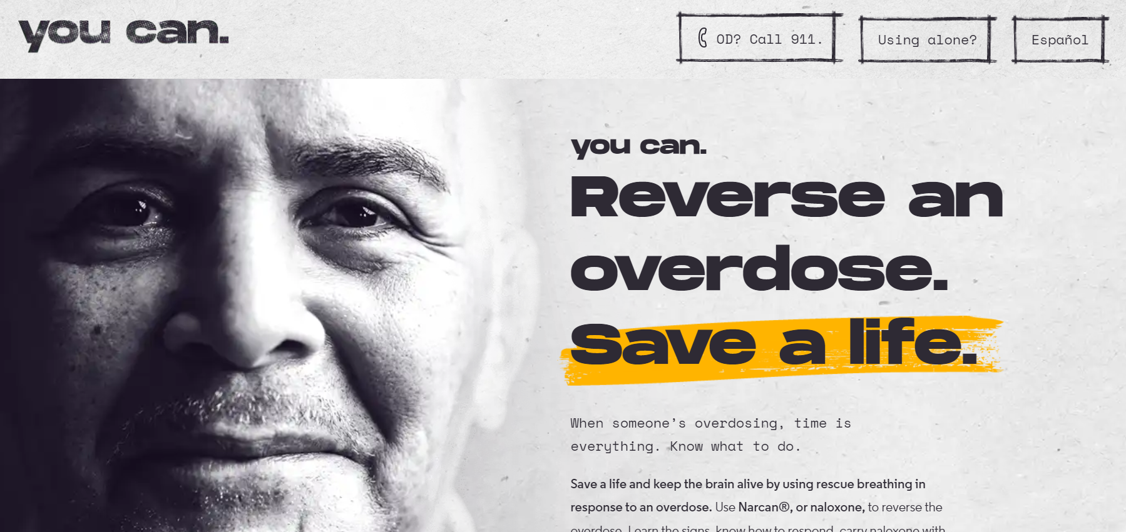
Additional Resources
Visit youcan.info to learn more.

Slide 41
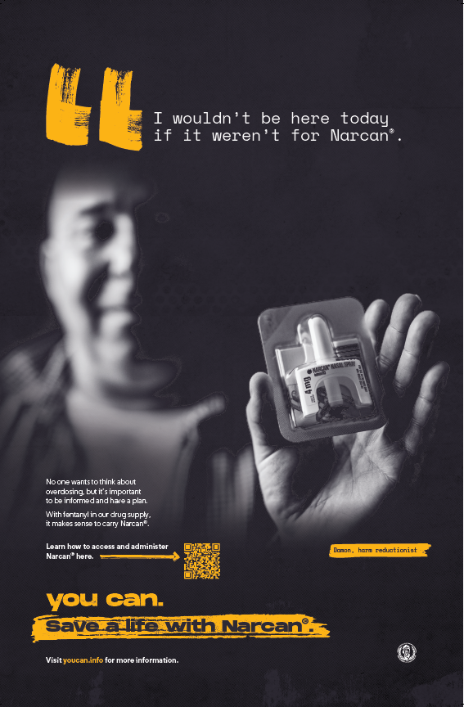
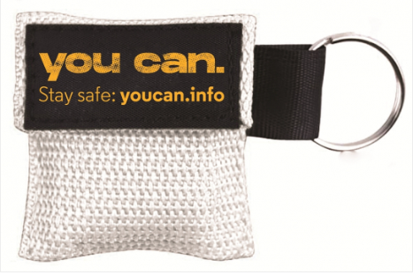
Clearinghouse Materials
Postcard
Posters
Rescue breathing masks
Wallet Cards
Fentanyl test strips
Stop an OD
Notes:
Brought together 2 different contracts-Narcan, FTS, masks, materials, etc.

Slide 42
Additional Resources
safe-spot.me
800.972.0590
Virtual spotting / overdose detection service for people who use drugs.
*Formerly known as the Massachusetts Overdose Prevention Helpline

Slide 43
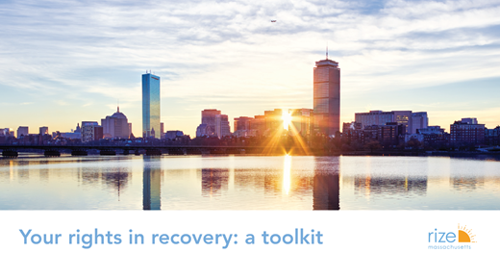
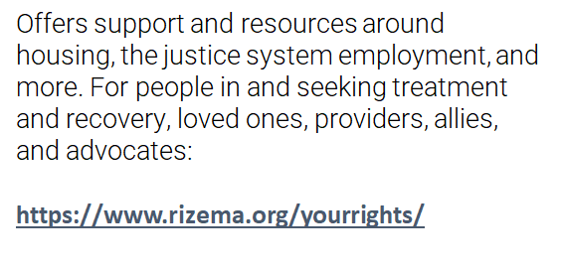
Additional Resources
Massachusetts Health Promotion Clearinghouse
Community Naloxone Purchasing Program
https://www.mass.gov/service-details/community-naloxone-purchasing-program-cnpp

Slide 44
THANK YOU!
Please fill out our BRIEF survey to help improve this training!
Be on the lookout for a follow-up email from us!

