Slide 1
McKinney Vento 101 Homeless Education For School Staff School Year 2020 - 2021

Slide 2
This is a quick guide to explore the basics of the McKinney-Vento Homeless Assistance Act
This will take 15-30 minutes to review
If you have any suggestions or questions on these materials, please reach out to your district’s McKinney-Vento Liaison
This Photo by Unknown Author is licensed under CC BY-SA

Slide 3
Learning Objectives
Identify children who meet the definition of “homeless” according to the McKinney-Vento Homeless Assistance Act
Understand the educational rights of students experiencing homelessness, including protections for unaccompanied homeless youth
Help ensure that students experiencing homelessness have access to the services they need to succeed in school
This Photo by Unknown Author is licensed under CC BY-SA

Slide 4
Video: Homeless Students in Their Own Words (2 minutes)

Slide 5
Overview
Homeless children and youth face many educational barriers due to the disruption and trauma of not having a fixed, regular, and adequate place to live. Most face educational disruption due to changing schools as they move from one temporary location to another. Homeless children and youth also have higher incidences of illness, depression, and exposure to violence than their stably housed peers.

Slide 6
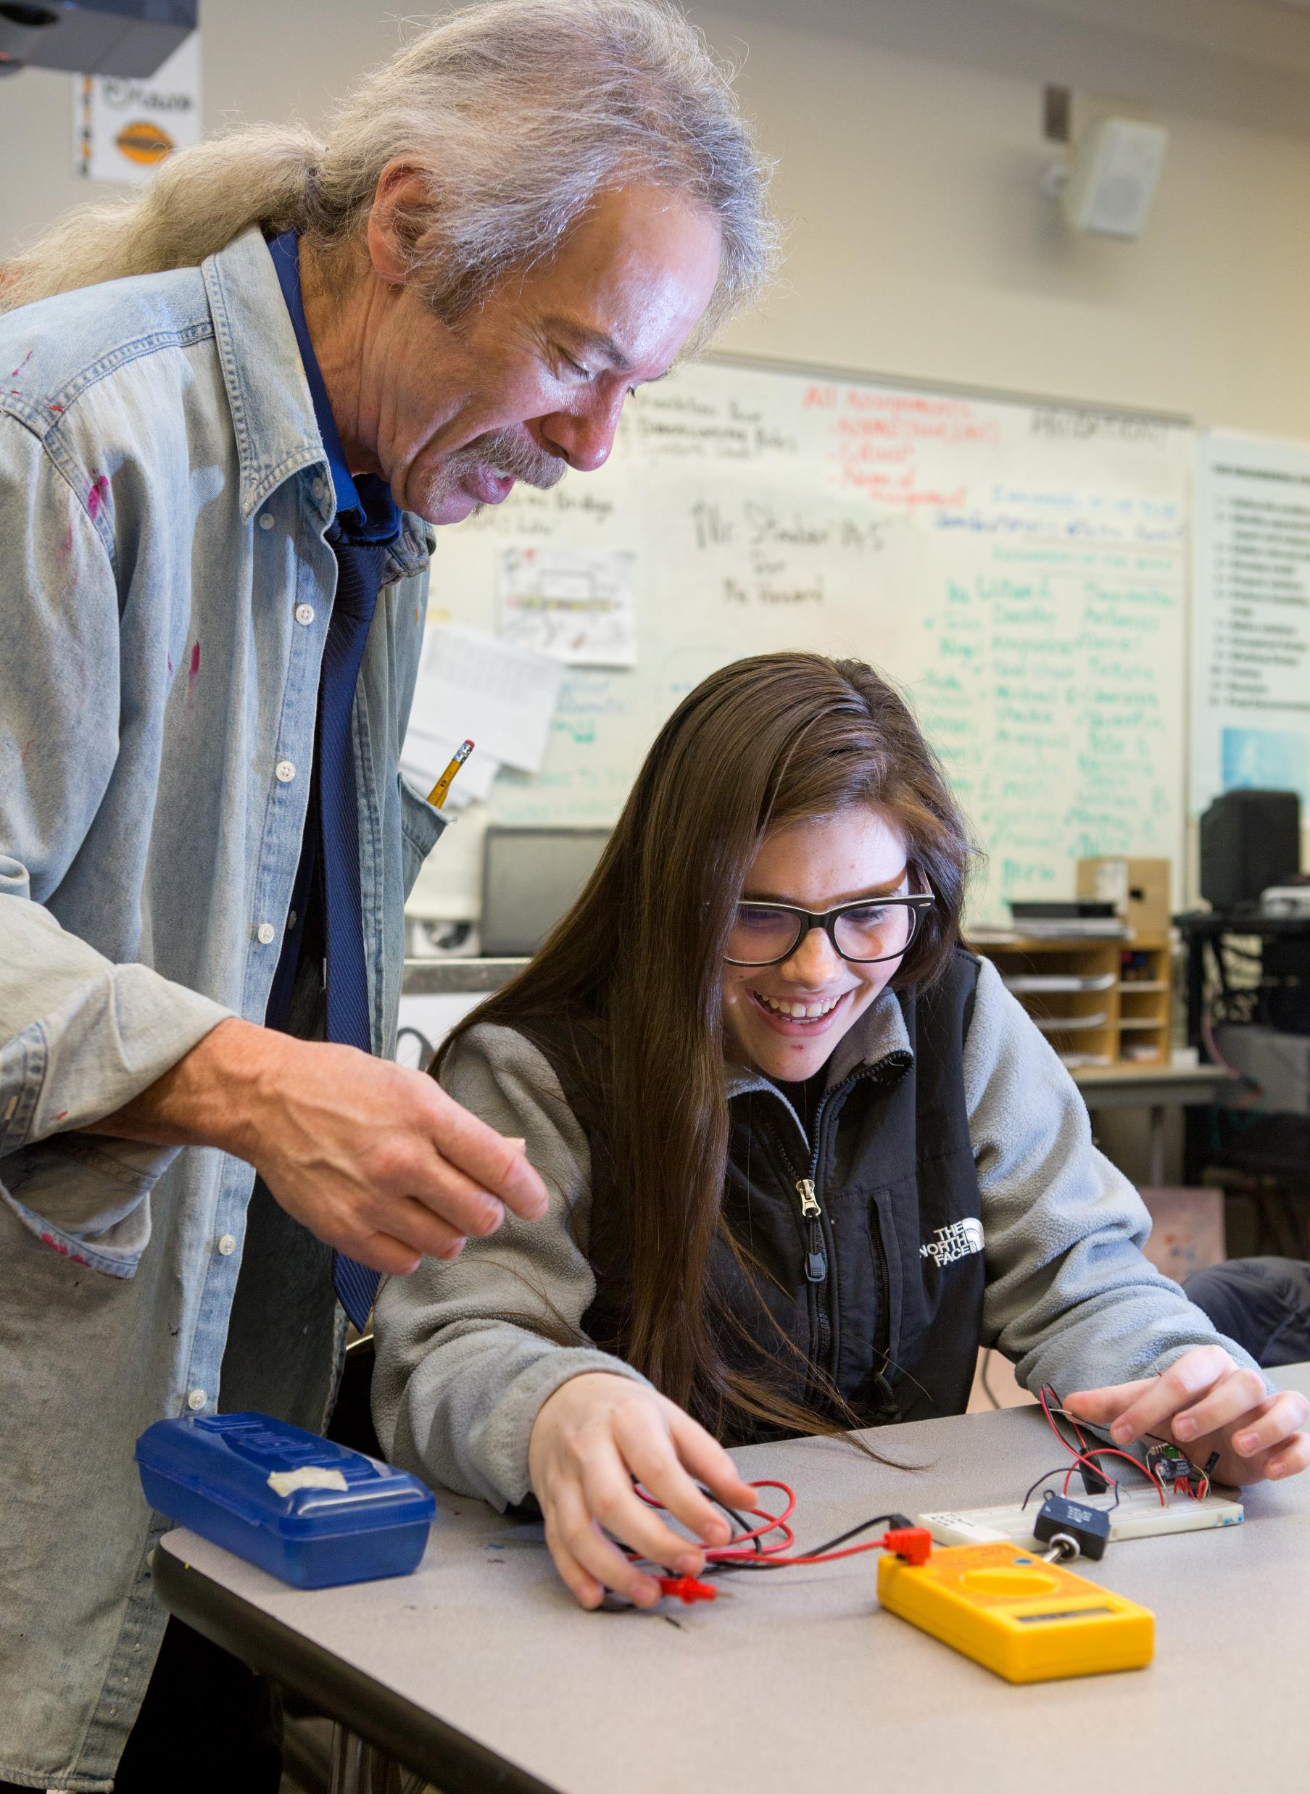
Many homeless youth are also unaccompanied, meaning they are not in the physical custody of a parent or guardian. Being both homeless and unaccompanied leaves youth fending for themselves in a world where they may be vulnerable to a myriad of potential dangers.
For all these reasons, school can often be the one place of stability, safety, and support in the tumultuous lives of these students.

Slide 7
Student Homelessness in Maine
In Maine, homeless students range between .46 % – 1.36% of student population
National averages assume homeless students make up at least 3% of entire student population
Doubled Up is the most common category in Maine and nationally – students who are living with another family due to loss of housing

Slide 8
Video: Supporting Homeless Students (5 mins)

Slide 9
Definition
Homelessness is defined as lacking a fixed, regular, and adequate nighttime residence. Situations specifically described in the McKinney-Vento Act include
sharing housing due to loss of housing, economic hardship, or a similar reason,
living in hotels, motels, trailer parks, or camping grounds due to lack of adequate housing,
living in emergency or transitional housing,
or children abandoned at hospitals.
It also includes a primary nighttime residence that is not designed for or ordinarily used as a sleeping accommodation for humans, living in cars, parks, public spaces, abandoned buildings, substandard housing, bus or train stations, and migratory children living in one of the circumstances described previously.

Slide 10
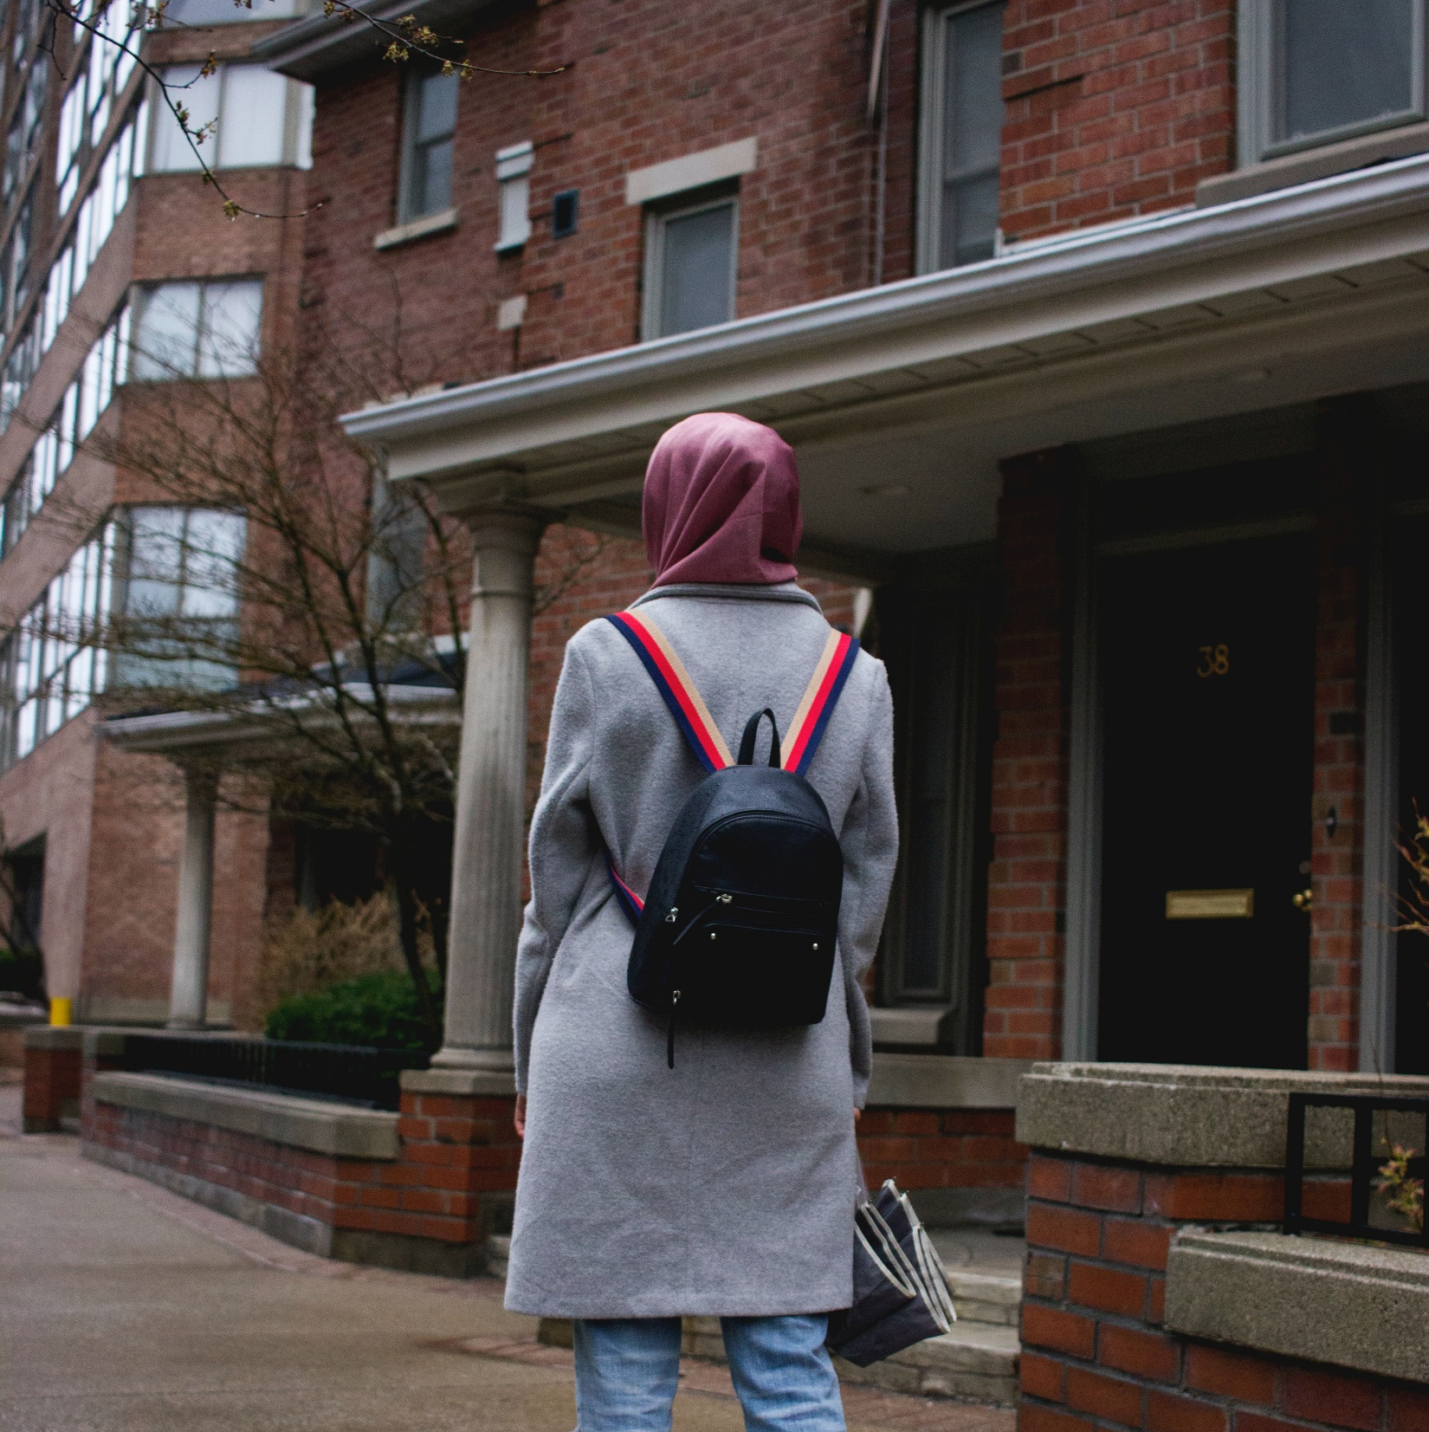
Definitions
If a housing situation does not clearly fall under one of the categories provided in the definition of homelessness provided in the law, you should ask yourself if the student can go to the same place every night to sleep in a safe and sufficient space. If the answer is no, the student likely meets the criteria of lacking a fixed, regular, and adequate nighttime residence and should be considered homeless.
If you believe you know a student who may qualify, connect with your district McKinney-Vento Liaison to determine next steps.

Slide 11
First Step: Look Closer
Potential signs of homelessness might include:
Hearing children or parents talking about having to leave where they are staying, or staying with other people
Being in public places during the school day
Poor hygiene
Unmet medical/dental needs (not having Personal Protective Equipment (PPE))
Wearing the same clothes repeatedly
Fatigue
Social and behavioral challenges may include extreme shyness, withdrawal, or aggression; clinginess; difficulty with peer and/or adult relationships; poor attention span; and anxiety late in the school day
Lack of participation in field trips and/or afterschool activities, lack of basic school supplies, inability to complete special projects
Enrollment at multiple schools, lack of records, gaps in learning, poor/inconsistent attendance
If you are an educator, see these signs of potential homelessness during virtual learning
If you notice any of these signs, check in with your district liaison

Slide 12
Step Two: Learn More
If you suspect a child, youth, or family may be experiencing homelessness, make a plan with your liaison. Determine whether you or them will learn more by talking with the family with sensitivity.
Remember that parents and youth are often afraid to share their situation and uncomfortable asking for help. Trauma-informed tips from the Office of Head Start for talking to parents experiencing homelessness include:
Be attentive to the stigma of homelessness and avoid using the word “homeless” - try “displaced” or “in transition” instead
Talk with the family privately
Be conversational so that families do not feel interrogated
Request permission to ask questions
Share your commitment to problem-solving and sharing resources with the family
Avoid unnecessary questions that may cause embarrassment
Explain the reasons for your questions
Show respect by conveying that you see the parents as the experts on their family
Apply active listening skills that demonstrate compassion and respect

Slide 13
Step Three: Act
Help families and youth experiencing homelessness connect to resources at school and exercise their right to an education. Public schools are required to identify, enroll, and serve homeless children and youth. Specific rights include:
Staying in the same school even if they move, and receiving transportation to that school, as long as it is in the student’s best interest;
Enrolling in school immediately without the documents schools usually require;
Receiving free school meals;
Getting help with school supplies and other needs;
Connecting young children with early childhood services.
To help parents and youth exercise their rights, connect parents or youth to their local homeless education liaison, a position required by federal law that is responsible for identifying children and youth experiencing homelessness and connecting them with relevant local resources.

Slide 14
Video: Eligibility for McKinney-Vento (3 mins)

Slide 15
“If runaway youth would just follow their parents’ rules, they could live at home; why should we encourage their bad behavior?”
Most runaway youth, especially those who stay away from home a significant length of time, have fled abusive homes for their own survival. Studies of unaccompanied youth have found that 20 to 50 percent were sexually abused in their homes, while 40 to 60 percent were physically abused. Severe dysfunction in the home is also common. Thirty percent of callers to the National Runaway Switchboard identified negative family dynamics as the leading reason for leaving home.
For example, over two-thirds of unaccompanied youth surveyed in a recent study reported that at least one parent abused drugs or alcohol
Many young people are not welcome in their parents’ or guardians’ homes due to their sexual orientation or identity, pregnancy, or other types of family conflict.
20 to 40% of homeless youth identify as gay, lesbian, bisexual, questioning and/or transgender

Slide 16
continued
10% of currently homeless female teenagers are pregnant
More than half of youth living on the streets became homeless for the first time because they were asked to leave home by a parent or caregiver. Youth often leave home to remove themselves from an immediately painful situation, but without plans for what to do next.
In a recent survey of unaccompanied homeless youth in California, over half felt that being homeless was as safe as or safer than being at home. More than 60% of homeless youth report being raped, beaten, robbed or otherwise assaulted while living on the streets, and homelessness is the largest risk factor for commercial sexual exploitation and sex trafficking of minors.

Slide 17
Select the resource based on your role for more information
Registrars
Counselors
Teachers
Superintendents and school board
Principals
Food Service
Bus Drivers

Slide 18
Thank you!
Please connect with your district McKinney-Vento Liaison to let them know you have completed this training.

